Slide 1

Congenital Heart Disease and Transplant

Slide 2
Outline
Conditions
  Single Ventricle
    Bands, Norwood, Glenn, Fontan
  High risk vs standard risk
ECMO
Nutrition Interventions
  Medications and Nutritional Implications
Transplant Nutrition

Slide 3
Single Ventricle
Typically 3-4 procedures total
Bands
  May or may not be needed
  Typically completed within the first few days of life.
  Act as a bandaid to allow patient to grow prior to next surgery
Norwood
  Typically done within first 2 weeks of life
  A ‘new’ aorta is created and connected to the right ventricle along with placing a tube from the aorta or right ventricle to pulmonary arteries allowing the right ventricle to pump blood to the lungs and rest of the body.
  Nutrition Needs:
    Most often with increased nutrition needs and fortified formula/HM. May not meet full weight gain goals but optimize wt gain as much as possible.

Slide 4
Single Ventricle
Glenn
  Typically done around 4-6 months of age
  Creates a direct connection between pulmonary artery and superior vena cava returning oxygen poor blood from the upper body to the heart
  Reduces work of the right ventricle by allowing blood returning from the body to flow directly to the lungs
  Nutrition Needs:
    Most often, decreased back to baseline nutrition needs. Start unfortified formula and monitor weight trends
Fontan
  Final procedure completed around 18 months to 3 years of age.
  Pulmonary artery is connected to the inferior vena cava returning oxygen poor blood from lower part of the body to the heart. Oxygen rich and poor blood no longer mix in the heart.
  Nutrition needs:
    Most often, same nutrition as they required prior to surgery. Will need fat-controlled diet – typically limit to 25 grams/day. If on EN support, will need low fat formula (Vivonex Pediatric is most common at Children’s WI).

Slide 5
Feeding Pathways: Pre-OP
High Risk Pathway (ductal-dependent systemic blood flow)
  TPN/SMOF required
  Allowed 10 min PO with unfortified feeds if meeting parameters for practice only
  Max fluids of 120 ml/kg
  Do not NG feed
Standard Risk Pathway (ductal-dependent pulmonary blood flow)
  PO ad lib
  May require NG feeds, but delay initiation if working up on PO (similar to a baby in the newborn nursery)
    Goal of 120-150 ml/kg or per discussion with medical team
  If not tolerating NG, may require TPN/SMOF
Both Pathways
SLP eval by DOL 2 to assess suck, voice and cry along with parent counseling on feeding expectations and cue based feeding plan development.

Slide 6
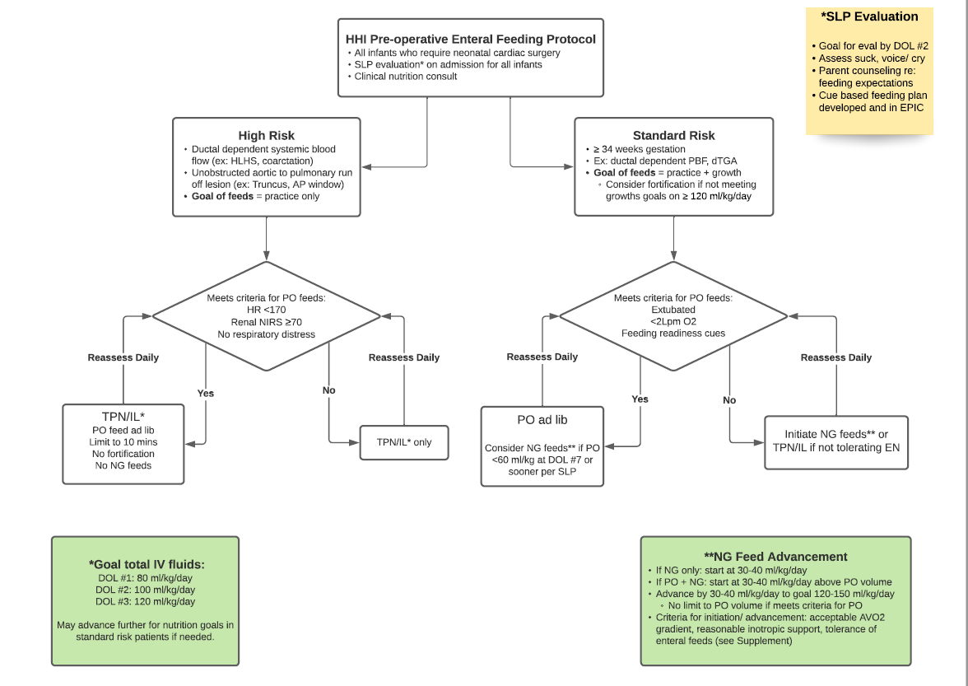
Feeding Pathways: Pre-OP
Pathway can be found on Connect under HHI department

Slide 7
Feeding Pathways: Post-OP
High Risk Pathway
  If unable to PO, consider NG within 48 hours
    Usually can start 20 ml/kg/day
    If meeting criteria, can advance by 20 ml/kg/day to goal 120-130 ml/kg
  If cannot advance safely, start TPN/SMOF
Standard Risk Pathway
  If unable to take PO, or meet needs with PO alone, start NG feeds at 30-40 ml/kg (or 30-40 ml/kg above what they are taking PO).
    Can advance by 30-40 ml/kg/day BID, so will reach full feeds within 1-2 days.
Both Pathways
Begin with bolus feeds. If not tolerating advancements with bolus feeds, and it is not related to perfusion, there are criteria for transitioning to continuous feeds.

Slide 8
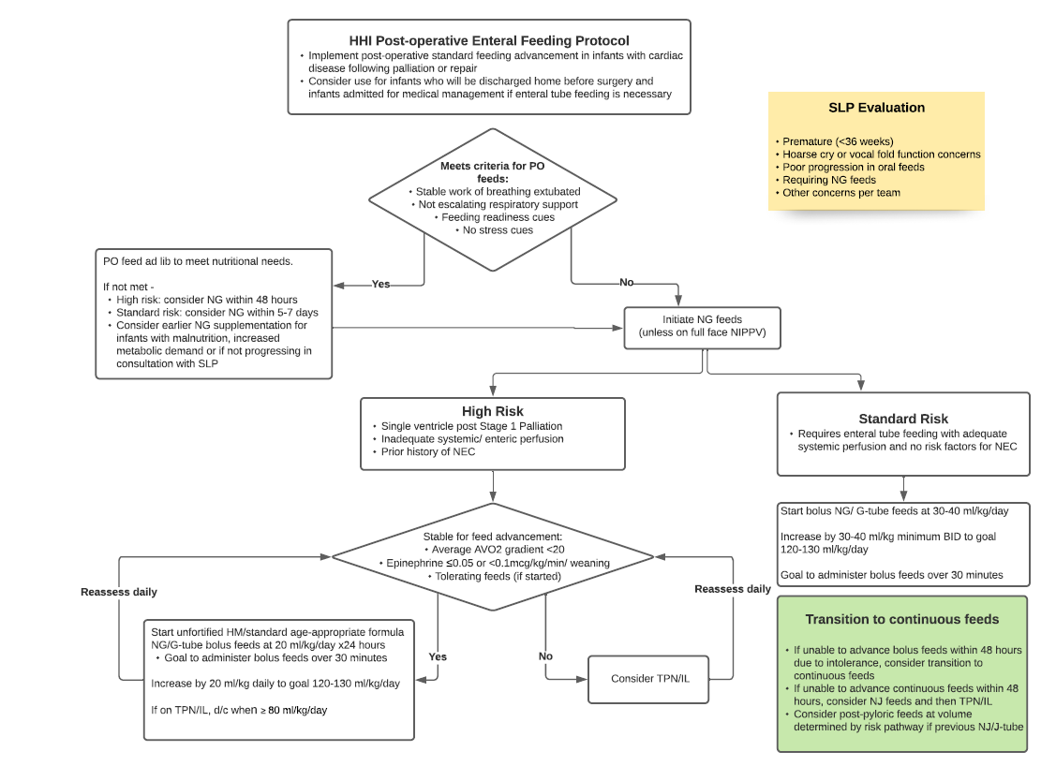
Feeding Pathways: Post-OP
Pathway can be found on Connect under HHI department

Slide 9
Follow Up
Single Ventricle
  Considered ‘interstage’ when patient is between Norwood and Glenn procedures.
  During this time, high risk of overall decline. Followed q 1-2 weeks in interstage clinic on Tuesday afternoons with MD, NP, RD
All other conditions
  May be followed in cardiology clinic Monday-Friday
Gtube Patients
  May be followed by cardiology RD or GI. Discuss with the cardiologist and put who will follow in Home Nutrition

Slide 10
ECMO

Slide 11
ECMO
Extracorporeal membrane oxygenation
  Similar to a heart-lung bypass machine that is used in open heart surgery
  It pumps and oxygenates a patient's blood outside the body, allowing the heart and lungs to rest.
  VV (venovenous) versus VA (venoarterial) ECMO
    VV ECMO supports the lungs only. VA ECMO supports both lungs and heart. This matters when discussing feeds. You can safely feed on both methods, but VV ECMO is likely to start sooner and advance to goal feeds as there is not usually concern for perfusion. Patients on VA ECMO can also be enterally fed, but will need to be adequately perfused and usually remains trophic; TPN/SMOF providing the majority of nutrition.
Nutrition
  Increase protein to 2-3x the RDA
  Calorie needs may be less to avoid overfeeding
Notes:
Refer to the CHD SOP

Slide 12
Nutrition Interventions

Slide 13
Calorie Needs
Newborns/Infants:
  REE x 1.6-1.8 (90-100 kcals/kg) for PN
  REE x 1.8-2 for EN (100-110 kcals/kg)
Toddlers/Children:
  REE x 1.4-1.6 for those on PN
  REE x 1.6-1.8 for those on EN
The above calculations are just starting points, usually for new patients without previous feeding regimens.
  If growth remains unsatisfactory, increase may be required to achieve age appropriate growth (can be as much as REE x 2-2.5).
  On the other side, patients may require less to avoid overfeeding (trach, long-term intubation, etc).
  If a patient already has a feeding regimen, start with that and adjust as needed based on growth and medical status (s/p surgery, newly intubated, etc).
Account for medical status and level of instability

Slide 14
Calorie Needs for Palliation vs Repair
Palliative surgery: surgery performed to relieve symptoms, not cure.
  If presenting post palliation, needs may still be high
    Examples: after PA bands or Norwood; residual cardiac lesion s/p surgery
If presenting post repair, may not need fortified feeds going forward as heart should be functioning well and comparable to other children the same age.
  Example: AV Canal, VSD
  Initiate unfortified feeds and monitor weight trends to assess need for fortification. Needs might be higher short-term for healing

Slide 15
Protein Needs
RDA x 1-2
If on ECMO, may require increased amount of protein up to 2-3x RDA
Factor in other underlying medical conditions:
  PLE: will require high protein due to losses from malabsorption
  Renal failure: protein needs adjusted based on dialysis

Slide 16
Fluid Management
Patients with congenital heart defects have a tenuous fluid balance, many times requiring diuretics
Total fluid intake to be determined by the medical team
  Typically no more than 140 ml/kg unless needed per team based on medical status
  Determine the amount of fluid available to be used for nutrition support based on total fluid requirement as determined by team.
Pediatrics
  When calculating feeds, 1 ml is considered 1 ml
  For example, 240 ml of Pediasure gives 240 ml fluid

Slide 17
Post Fontan Nutrition Intervention
Fat controlled diet for 4 weeks
  Provide the Fat Controlled Diet teaching sheet
  Write the total number of fat grams allowed at the top of the teaching sheet
    Limit to 25 grams/day.
When in the hospital, may use Ensure Clear (fat free) to supplement if poor PO.
If enteral feeds are indicated, use Vivonex Pediatric
Family may follow up in cardiology clinic to monitor weight trends or help with food choices

Slide 18
Post Surgery Complications - PLE
Protein losing enteropathy
  Loss of serum proteins in the digestive tract due to abnormalities in lymphatic flow.
  Symptoms include low levels of albumin, electrolytes, coagulants and T-Cells, diarrhea and edema.
  Most common to see in patients with heart failure (often with a failing Fontan) and Heart Transplant
Diet:
  High protein and low fat diet due to malabsorption
  May warrant adjusting fats to provide more MCT vs LCT but is case specific
Notes:
https://www.chop.edu/conditions-diseases/protein-losing-enteropathy-ple#:~:text=Protein%2Dlosing%20enteropathy%20refers%20to,vital%20nutrients%20to%20the%20body.

Slide 19
Post Surgery Complications – Chylous Effusions
Definition:
  Accumulation of chyle in the pleural space due to disruption or obstruction of the thoracic duct
Chest tube output will increase or change to a milky color. Fluid is typically tested for triglycerides to officially diagnose chylous output.
  Requires high MCT/low LCT formula x 2 weeks
    For infants, can use Skimmed HM fortified with Enfaport, if the infant is getting Mom’s milk. If the infant is getting formula, change to Enfaport. Can use Portagen/Pregestimil as an alternative, if absolutely needed).
      Note that Enfaport contains intact cow’s milk protein.
    Vivonex Pediatric is used for children >1 years old
  If output re-accumulates or is very high, may require NPO period and need for TPN
  If patient develops chylous s/p Glenn, then fat controlled diet is completed for 4 weeks.

Slide 20
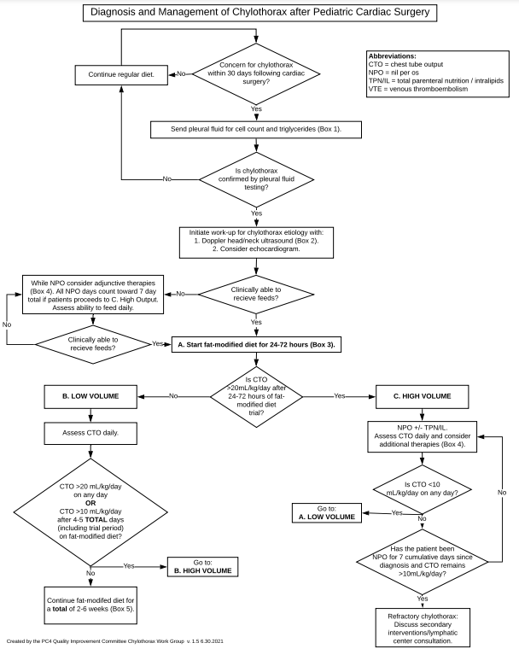
Chylous Effusion Protocol
Pathway can be found on Connect under HHI department

Slide 21
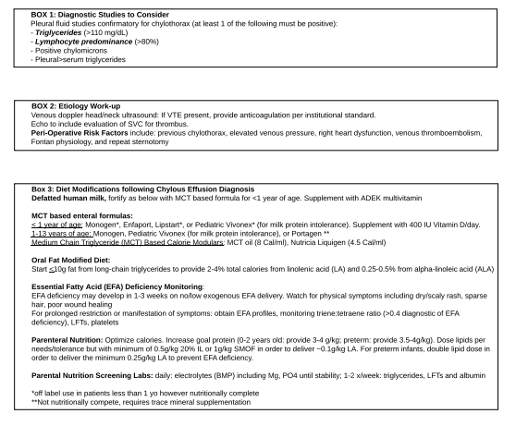
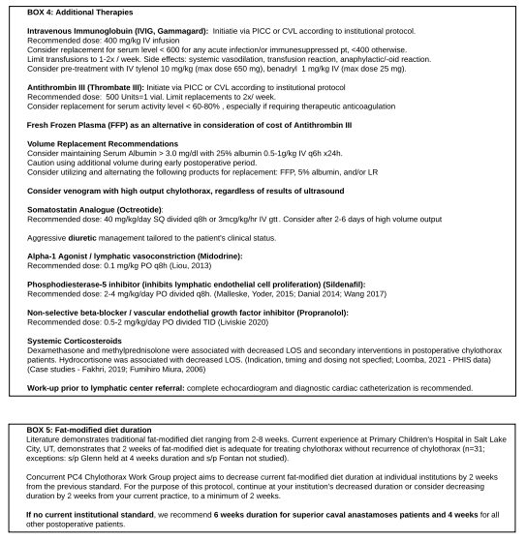
Chylous Effusion Protocol

Slide 22
Monitoring for Enteral Feeding Ability
Renal NIRS
  Renal near-infrared spectroscopy (NIRS) is used to evaluate regional oximetry in a non-invasive continuous real-time fashion, and reflects tissue perfusion.
  In an average healthy person, normal NIRS of 75 or better
In addition to NIRS, saturations are continuously monitored
  Normal sats are >/=95
AVO2 gradient
  Difference in oxygen in arterial blood vs venous blood and how much oxygen is being pulled out.
  Team must calculate: difference between sats and NIRS

Slide 23
Monitoring for Enteral Feeding Ability
When AVO2 gradient is >20, the body is using more oxygen with increased metabolic demand.
  Increased risk of NEC so need to feed cautiously and continue to monitor trends
  Patients with single ventricle physiology often have a higher gradient at baseline, so trends with feeding are important
Cardiology accepts lower sats at baseline, therefore already at an increased risk of poor perfusion and must always be careful when feeding

Slide 24
Impact of Na on Growth
Sodium
  Stimulates cell proliferation and protein synthesis.
  Deprivation inhibits growth
Na repletion can restore growth but does not induce catch up growth. Important to monitor Na levels closely, especially if on diuretics and supplement as needed.
Some patients may experience feeding intolerance with low Na due to nausea.

Slide 25
TPN – fluid management
Total fluid goal given from medical team (ex: 120 ml/kg).
Include all continuous drips
  Found under Active Order and then continuous medications.
  May be more accurate to view rates on the pumps at bedside as orders may not be up to date (especially when there are a lot of drips)
  Lipids and feeds are usually included in total fluids

Slide 26
TPN- Macronutrients
In infants, generally a goal –
  GIR 10-12 mg/kg/min
    Can consider checking continuous drips in D5% to account towards GIR if very large volumes, but this is not common.
    Prefer to give recommendations using GIR (or total grams of dextrose needed) versus giving a %dextrose goal. Volumes of TPN are always changing so the %dextrose may not be accurate and could cause over- or under-feeding and blood glucose abnormalities if it’s not properly adjusted.
  AA 3 g/kg
All infants in the CICU will receive SMOF lipids with a goal of 3 g/kg
  Watch for propofol and adjust SMOF as indicated
Adjust goals as indicated based on weight trends

Slide 27
TPN – Electrolytes
Always look at what your IV fluids are providing in comparison to your labs. Adjust as indicated based on lab results
Sodium
  Adjust Na as fluid changes to maintain same concentration per liter
  Ex: 5.2 kg, 300 ml TPN and Na 4.4 mEq/kg
    4.4 mEq/kg x 5.2 kg = 23 mEq/300 ml TPN = 76 mEq/L
    TPN increased to 450 ml – need to adjust Na to maintain same concentration
      76 mEq/L x 0.45 liters = 34.2 mEq/5.2 kg = 6.5 mEq/kg
Potassium
  Dosed per kg. Do not adjust with fluid shifts based per liter unless K is reaching 100 mEq/L

Slide 28
TPN – Electrolytes
Calcium
  Calculate 24 mEq/L to determine if this is an appropriate place to start.
2:1 calcium/phos ratio
  Adjust as indicated based on labs
  If Ca labs continue to trend high, yet TPN amounts are low (<0.5/kg), there is concern that Ca is leaching from bones and dropping it further will not help.
All other lytes are standard
  Use TPN guideline as a resource
    Found under pharmacy page on Connect
Acid/Base Balance
  Add acetate as needed based on CO2 and base deficit

Slide 29
Pertinent Medications and Nutrition Implications
Diuretics
  Implications: decreased Na, K. May require supplementation.
Prostins (PGE)
  Vasodilator
  Dilates pulmonary vascular bed to improve pulmonary blood flow by reducing pulmonary vascular resistance
  Due to increased risk of NEC and poor perfusion, only able to PO feed with TPN to meet nutrition needs
Steroids
  Can lead to elevated blood sugars. Adjust GIR in TPN accordingly.
  Weight trends may be elevated due to increased water and/or increased appetite.
Inotropes
  Epinephrine, norepinephrine, milrinone
  Increased inotropes, particularly epi and norepi, may mean less blood flow to the gut with inability to feed enterally until blood flow improves. Patients on milrinone can more easily be fed. Milrinone won’t usually be weaned until patient is on near-full feeds to avoid confusion if the patient starts showing intolerance – if patient is tolerating feeds when milrinone is weaned, and then they start having emesis, may be a sign that milrinone is needed for perfusion. Patients in heart failure may be on this long-term.

Slide 30
Medications
Propofol
  A sedation medication that is formulated in a lipid emulsion.
  1.1 cal/ml
  Lipids are stopped to account for fat in propofol. Need to monitor longer term use of propofol and need for some supplemental lipids to meet fat goals.
Tacrolimus
  Immunosuppressive medication used to prevent organ rejection after transplant
  Can lead to increased potassium levels.
Coumadin/Warfarin
  Blood thinner
  Will require education on consistent Vitamin K intake as this will counteract the effects of the warfarin.
Herbs/Supplements
  Many are contraindicated with medications provided and should be reviewed with the pharmacist and RD prior to starting.
  RD should always ask family about supplements, especially when starting new medications.

Slide 31
Transplant Nutrition

Slide 32
Ventricular Assist Device (VAD)
A device that helps pump blood from the lower chambers of your heart (ventricles) to the rest of your body.
If placed in the left ventricle of your heart, it is known as LVAD
Placed in heart failure and/or prior to heart transplant.
Heart function may improve to where VAD can be removed
There are better outcomes when going from VAD to transplant vs ECMO to transplant
Nutrition:
  Continue to optimize nutrition status in preparation for heart transplant. When patient is on VAD support, it is an ideal time for nutrition rehab.

Slide 33
Total Artificial Heart (TAH)
A pump that is placed in the chest to replace damaged heart ventricles and valves.
Nutrition:
  Continue to optimize nutrition status in preparation for heart transplant.
  Improved transplant success when receiving in a nourished vs malnourished state

Slide 34
Pre-Transplant
Pre-transplant evaluations to be completed by W3 or outpatient cardiology RD’s.
Focus on nutrition rehab and promoting adequate growth. For those that present adequately nourished at pre-transplant eval, goal is to maintain that status throughout waiting period.
  Studies have shown better outcomes with patients that do not have malnutrition prior to surgery/transplant
May require a combination of PO, EN, TPN
Review food safety
During evaluation, give brief overview of what diet in the future will look like

Slide 35
Post-Transplant
Post-transplant evaluation due within 72 hours after anastomosis
May remain NPO s/p transplant for a few days due to fluid shifts and while obtaining medical stability.
Nutrition support will be determined based on nutrition status at time of transplant. This includes their method of receiving nutrition (PO versus EN at home) and whether or not malnutrition was present (acute versus chronic).
  If nutrition support is needed, and EN is not possible, then TPN to be started. Goals similar to other post-op patients.
  If able to safely feed the gut, initiate EN as medically able. These patients will also follow feeding pathways, as able.
May require speech evaluation when appropriate based on age and feeding skills prior to transplant
Notes:
Timing of transplant notes is determined by CMS (Centers for Medicare & Medicaid Services)

Slide 36
Discharge Education
Transplant discharge note to be completed within 48 hours of discharge
Education includes food safety teaching sheet
  Stress importance of hand hygiene, washing all surfaces while cooking, thoroughly washing all fruits and vegetables.
  Keeping hot foods hot and cold foods cold
    Cooking meats to appropriate temperatures
    Avoid unpasteurized milk, cheese and juices
  Do not consume expired foods
  Avoid raw meat (can have sushi if it’s cooked)
No grapefruit or pomegranate as these are contraindicated with transplant medications.
Heart Healthy Diet

