Slide 1

Self-Study Module:
Diabetes
Notes:
Today, we are going to discuss Type 1 diabetes in the pediatric population

Slide 2
Objectives
Understand diagnosis and guidelines of treatment for Type 1 Diabetes
Learn what the role of nutrition is in the management of diabetes
Recognize the medical interventions and use of technology in the management of diabetes
Notes:
Our objectives are to:
First understand what the diagnosis of Type 1 diabetes is and how to treat it. We will discuss the criteria for the diagnosis of Type 1 Diabetes, along with the guidelines for treating T1DM.
You will learn and understand the role of nutrition in the management of T1DM.
Finally you will be able to understand and know the medical interventions for treating T1DM in addition to looking at the current technology that is available and improving the lives of our patients.

Slide 3
Type 1 Diabetes: diagnosis
    Type 1 diabetes is a chronic, autoimmune condition that makes the body unable to produce insulin, the hormone that regulates blood sugar. Without insulin, the body cannot use sugar in the bloodstream as energy.
Diabetes may be diagnosed based on:
  Fasting plasma glucose value
  2-hour glucose value during a 75-gram oral glucose tolerance test
  A1C criteria (diabetes is diagnosed when the A1c > 6.5%)

Slide 4
Type 1 Diabetes: how it happens
Someone with the genetic predisposition for type 1 diabetes encounters an environmental trigger
The immune system destroys insulin-producing beta cells of the pancreas
When enough of the beta cells are destroyed, blood glucose becomes elevated and symptoms of diabetes occur
The body is unable to replace the destroyed beta cells, so people with Type 1 diabetes need insulin.
Notes:
The next two slides explain how Type 1 diabetes develops.

Slide 5
Type 1 Diabetes: how it happens
It can take months or years to develop diabetes
What creates the genetic predisposition is partially known; what leads to the environmental trigger is unknown
The risk of diabetes in someone with a sibling or parent with type 1 diabetes is about 5% (1 in 20)
American Diabetes Association

Slide 6
Type 1 Diabetes: symptoms at diagnosis
Excessive thirst
Frequent urination
Unexplained weight loss
Exhaustion
In Diabetic ketoacidosis (DKA):
  Fruity-smelling breath
  Nausea
  Abdominal pain
  Confusion
  Drowsiness
  Rapid, shallow breathing (Kussmual respiration)
Notes:
Many patients are in Diabetic-Ketoacidosis, also known as DKA, when they are first diagnosed, but not all patients experience this. This serious condition is caused by very high blood sugars and includes symptoms of fruity-smelling breath, nausea, abdominal pain, confusion, drowsiness, and rapid shallow breathing in addition to excessive thirst, frequent urination, weight loss and fatigue.

Slide 7
Type 1 Diabetes: labs
Antibody Testing
  diagnosis is confirmed with positive GAD antibodies
  Zinc Transporter 8 Antibody test helps assess risk of type 1 diabetes used alone or in combination with GAD tests
Hemoglobin A1c
  Measures the average blood sugar levels over 3 months, recorded as a percentage
  Gold standard for prevention of complications related to diabetes and evaluates overall management
Thyroid
  Thyroid problems can be autoimmune and occurs in 20% of people with Type 1 Diabetes
Celiac
  Autoimmune disease that occurs 5-7% in people with Type 1 diabetes.
Notes:
Antibody testing for Type 1 diabetes includes the GAD antibodies. GAD stands for Glutamic Acid Decarboxylase antibodies, which are a group of diabetes-associated antibodies that instruct the immune system to destroy the insulin-producing pancreatic cells. When insulin production stops, diabetes develops. When GAD antibodies are positive, Type 1 diabetes is confirmed. Zinc Transporter 8 Antibody test helps assess risk of type 1 diabetes used alone or in combination with GAD tests.
Hemoglobin A1c is lab test that measures the average blood sugar levels over the last 3 months. It is the gold standard for prevention of complications related to diabetes and evaluates overall management. The HbA1c is measured at each follow-up appointment by finger poke and is recorded as a percentage. Goals for kids younger than 18 years old is 7.5%, while the goal for patients 18 and older is less than 7%.
Less stringent A1c goals (such as <7.5%) may be appropriate for patients who cannot articulate symptoms of hypoglycemia, have hypoglycemia unawareness, lack access to advanced insulin delivery technology, and/or continuous glucose monitoring, cannot check blood glucose regularly, or have non-glycemic factors that increase A1c. Even less stringent A1c goals (such as <8%) may be appropriate for patients with a history of severe hypoglycemia, limited life expectancy, or where the harms of treatment are greater than the benefits.
Providers may reasonably suggest more stringent A1C goals (such as <6.5%) for selected individual patients if they can be achieved without significant hypoglycemia, negative impacts on well-being, or undue burden of care, or in those who have non-glycemic factors that decrease A1C. Lower targets may also be appropriate during the honeymoon phase.
Thyroid problems can be autoimmune and occurs in 20% of people with Type 1 Diabetes. Thyroid antibodies test for an antibody attacking the thyroid and are tested at diagnosis of diabetes or within the first year. When a person loses thyroid function it is called ”hypothyroidism” and is more common in girls.
Celiac Disease is an autoimmune disease that occurs in 5-7% of people with Type 1 diabetes. Celiac is when a person is unable to have gluten in their food and the most common symptoms include stomach aches, constipation and/or diarrhea.

Slide 8
Type 1 Diabetes: labs (continued)
Lipid panel
  Includes cholesterol, LDL, HDL, and triglycerides
Urine Microalbumin
  Microalbumin is a protein that can “spill out of” the kidneys. This is an early screening test for early changes in kidneys. These changes have been found to predict later kidney failure if not treated.
Liver Tests
  If a patient is taking pills such as Metformin/Glucophage for type 2 diabetes, the liver and kidney function tests may be done every 6-12 months.
Notes:
People with diabetes are at higher risk for heart problems as they age. Early identification of those at risk is key to beneficial treatment. A cholesterol test is typically done at diagnosis of diabetes or within the first year. A full lipid requires 12 hours of fasting prior to the lab draw.
A urine microalbumin test is done typically after having diabetes for 5 years and are over 12 years of age. Microalbumin is a protein that can “spill out of” the kidneys. This is an early screening test for early changes in kidneys. These changes have been found to predict later kidney failure if not treated.
If a patient is taking pills such as Metformin for type 2 diabetes, the liver and kidney function tests may be done every 6-12 months.

Slide 9
Type 1 Diabetes: treatment
Balance of preventing acute, life-threatening hypoglycemia or long-term damage caused by hyperglycemia
  Target blood sugar ranges typically between 70-150 mg/dL
Blood sugar levels must be monitored either with finger pricks or a continuous glucose monitor.
Insulin doses must be carefully calculated based upon blood sugar, carbohydrate intake, and other factors like physical activity, stress, and illness
Notes:
Treatment of Type 1 Diabetes is a balance of preventing acute, life-threatening hypoglycemia or long-term damage caused by hyperglycemia. Target blood sugar ranges typically are between 70-150 mg/dL, some may be 70-130 mg/dL or 70-180 mg/dL.
Blood sugar levels must be monitored either with finger pricks or a continuous glucose monitor.
Insulin doses must be carefully calculated based upon blood sugar, carbohydrate intake, and other factors like physical activity, stress, and illness.

Slide 10
Honeymoon phase
Period of time soon after diagnosis when the body continues to make some insulin and less insulin may be required by injection
Usually triggered by starting to give insulin injections
It’s typically 3 months to 2 years
Blood sugars will be lower/possibly more consistent
Doses may need to be adjusted frequently
Breakfast and bedtime numbers should be over 100
Goal is to not have more than 2-3 lows per week
15 gram or less snacks may not require insulin
Notes:
Blood sugars may start to trend lower once patients start on insulin. This is the period of time soon after diagnosis when the body continues to make some insulin and less insulin may be required by injection. The honeymoon phase is not well understood how long it will last, but it is often 3 months to 2 years. During this time, blood sugars will be lower and possibly more consistent. Doses may need to be adjusted frequently to ensure blood sugars do not get too low too often. The goal is to have no more than 2-3 lows (blood sugar lower than 70) per week. During honeymoon, snacks of 15 grams or less carb may not require insulin.

Slide 11
What determines blood sugar levels?
Factors that raise blood sugar:
Not enough insulin
Other medications
Physical activity with high intensity
Excitement
Stress/Illness
Factors that lower blood sugar:
Too much insulin
Other medications
Physical activity
Stress

Slide 12
Acute complications: Hypoglycemia
Blood sugar below 70mg/dL is considered low
Many causes including illness, missing a meal, errors in carb counting or insulin dosing, other diabetes medications, exercise, stress, hormonal changes, honeymoon, drinking alcohol and more.
Signs and symptoms:
  Shaking
  Sweating
  Dizziness
  Hunger
  Confusion
  Tiredness
  Headache
  Pale
  Goofy or moody

Slide 13
Hypoglycemia treatment
“15/15 rule”
  Check blood sugar; if <70 then consume 15 grams fast acting carbohydrate
    Glucose tablets or gel
    4oz (1/2 cup) juice
    Candy like Skittles or Smartees (no chocolate, PB, or caramel)
  Wait 15 minutes and check blood sugar to make sure it is in range. If it’s not in safe range, repeat until it is.
  Consider a complex carb + protein snack after treating (if not eating a meal within an hour)
Severe Hypoglycemia
  Person with diabetes cannot eat or drink, possibly pass out or have a seizure
  Treat with Glucagon (or Baqsimi nasal glucagon spray)
Notes:
A severe low is not based on a blood sugar number, as it can vary for each individual, and it is rather how you act and how you feel. They may be “out of it”, cannot talk or cannot follow directions. A severe low is when a person with diabetes cannot eat or drink, they may possibly pass-out or have a seizure. When this occurs, someone must treat them with Glucagon which is either an injection or Baqsimi, a nasal glucagon spray, to raise blood sugars.

Slide 14
Acute complications: Hyperglycemia
Blood sugar higher than target range
Many causes including illness, stress, adrenaline, eating more carbs than dosed, not giving enough insulin and more
Signs and symptoms:
  Frequent thirst
  Frequent urination
  Tiredness
  Blurry vision
When blood sugar is >250 mg/dL for more than 3x in a row, urine ketones should be checked. If ketones present, follow sick day plan (push fluids, frequent BG checks, ketone checks, dose insulin every 2 hours, treat symptoms)
Notes:
When blood sugars are higher than target range, some acute signs and symptoms include frequent thirst and urination, tiredness or fatigue and/or blurry vision.
When blood sugar is >250 mg/dL for more than 3 blood sugar checks in a row, urine ketones should be checked. If ketones present, follow sick day plan which includes pushing fluids, frequent BG checks, ketone checks, dose insulin every 2 hours, and treat any symptoms.

Slide 15
Acute complications: DKA
Diabetic Keto-Acidosis (DKA):
  When the body is not receiving enough insulin to get glucose from the blood into the body’s cells, it forces the body to start breaking down fat as a source of fuel, which produces ketones.
  DKA can lead to coma or even death if ketone levels are too high.
  Common when first diagnosed with T1DM, but can also occur during management of T1DM
  Early symptoms: ketones in urine, very high blood sugars, frequent urination, dehydration, extreme thirst
  More severe signs/symptoms: constant fatigue, flushed skin, nausea or stomach pain, vomiting, shortness of breath, fruity smell on the breath, and disorientation
Notes:
Diabetic Ketoacidosis can occur from longer term hyperglycemia. This happens when the body is not receiving enough insulin to get glucose from the blood into the body’s cells and it forces the body to start breaking down fat as a source of fuel, which produces ketones. High levels of ketones cause the body to become to acidic.
DKA can lead to coma or even death if ketone levels are too high.
Like mentioned before, DKA can be common when first diagnosed with Type 1 Diabetes, but it can also occur during management of T1DM.
Early symptoms of DKA include ketones in urine, very high blood sugars, frequent urination, dehydration, and extreme thirst. More severe signs and symptoms include constant fatigue, flushed skin, nausea or stomach pain, vomiting, shortness of breath, fruity smell on the breath, and disorientation.
There is a difference between ketones caused by high blood sugars and starvation ketones. Ketones caused by starvation cannot lead to DKA. RDs need to be aware of this because some patients avoid all carbs and get starvation ketones – it won’t cause DKA, but if they get sick it can more easily kick them into DKA.

Slide 16
Type 1 Diabetes: long-term complications
Microvascular damage associated with chronic high blood sugars or chronic poorly controlled diabetes primarily affects the eyes (Diabetic Retinopathy), kidneys (Nephropathy), and nerves (Neuropathy).
Macro vascular damage associated with chronic poor glycemic control increases individuals risks for strokes and acute coronary diseases.
Increased risk for Urinary Tract Infections, secondary infections due to injuries, and other various infections due to elevated blood glucose levels.
Notes:
Some long-term complications related to Type 1 diabetes may be caused by chronic hyperglycemia.
Microvascular damage associated with chronic high blood sugars or chronic poorly controlled diabetes primarily affects three parts of the body:
Diabetic Retinopathy of the eyes, Nephropathy of the kidneys, and Neuropathy of the nerves.
Macro vascular damage associated with chronic poor glycemic control increases individuals risks for strokes and acute coronary diseases.
Note that diabetics need to have good oral hygiene as poor oral care can lead to more infections and increase cardiovascular risk. Therefore dental insurance approves 3 visit a year for diabetics versus the 2 visit for the general population.
Chronic hyperglycemia puts those at increased risk for infections including: Urinary Tract Infections, secondary infections due to injuries, and other various infections due to elevated blood glucose levels. That is why we recommend checking your feet and skin for signs of infection as poor glycemic control leads to poor healing abilities.

Slide 17
Role of Nutrition
RD Scope of Practice in T1DM Management:
To provide nutrition assessment and
appropriate interventions for patients with Type 1 diabetes
Notes:
The RD scope of practice in the management of Type 1 diabetes is to provide nutrition assessment and appropriate interventions.

Slide 18
Nutrition Assessment
Includes:
  medical and clinical diagnosis
  anthropometrics
  malnutrition assessment
  nutrition history
  estimated energy intake
  medications
  labs
  weight history
  risk/benefits of therapy
  quality of life
  ethical issues and patient/family wishes

Slide 19
Tips and other considerations
24-hour diet recall tips:
  Timing of meals and snacks
  Timing of insulin dosing related to meals and snacks
  Carbohydrate amounts
  Measured amounts of food/accuracy of carb counts
Other assessment considerations:
  Pertinent labs: Hemoglobin A1c, interventions regarding hyperlipidemia, celiac or other abnormal labs
  Current exercise
  Social situation, division of responsibility for counting carbs between patient, caregivers and school personnel
  Assess appropriate use and problem solving abilities related to diabetes technology
Notes:
Some tips and other considerations for the 24-hour diet recall includes asking about the timing of meals and snacks, such as to inquire about eating too close together (grazing) or eating meals more than 4-6 hours apart. Also inquire about the timing of insulin dosing related to meals and snacks to see if they are dosing insulin pre-meal (as typically recommended), during the meal or after eating. Ask about the amount of carbohydrates they consume at meals and snacks and consider asking if they can give you a range, such as the low end of carbs and high end of carbs for each meal. Lastly, ask about the measured amounts of foods or accuracy of carb counts.
Other assessment considerations regarding labs include: reviewing Hemoglobin A1c and any nutrition interventions related to hyperlipidemia, Celiac disease or other abnormal labs. Assess current exercise and how it effects blood sugars, management with insulin and carbohydrate intake. Assess social situation and division of responsibility for counting carbs between patient, caregivers and school personnel. Lastly, consider assessing appropriate use and problem solving abilities related to diabetes technology.

Slide 20
Nutrition Prescription
Energy: Daily Recommended Intake equations
  EER, REE, or TEE
      Carbohydrates: 50% of calorie needs
        Calculated by dividing calories by 8 (dividing in half for 50%, dividing by 4 for 4 kcal/g carb)
      Protein: DRI
      Fluids: 100% maintenance using Holliday Segar
      Vitamins/Minerals: 100% DRI
Notes:
-There is no defined diet for T1DM other than general healthy diet. There is no perfect distribution of calories from carbs, protein, fat based on research. Thus carb intake can be variable. Low-carb diets are not recommended.
-For estimating the energy/caloric needs for patients with diabetes, it is recommended to use the Daily Recommended Intake equations. The RD is recommended to use clinical judgment for which equation to use. Estimated Energy Requirements (EER) are typically used for those of a healthy BMI under the 85th%tile potentially with an activity factor. The Resting Energy Expenditure (REE) may be used more often for older patients, which is roughly equivalent to the Thermic Effect of Exercise recommendations. Thermic Effect of Exercise (TEE) equations are most often used for weight maintenance. There is an electronic calculator located on the Q-drive under Clinical Nutrition/Resource Binder/”Determining Calorie Levels in Pediatric Patients with Overweight/Obesity”
-To calculate carbohydrate needs, it’s recommended that 50% of carbs come from total caloric needs. This can be calculated by dividing calories by 8, which is dividing in half for 50%, dividing by 4 for 4 calories per gram of carbohydrate. Low-carbohydrate diets as a management option for diabetes control have regained popularity. These diets can negatively impact growth and other cardio-metabolic factors and cannot be recommended at the present. The lowest recommendations for carbs should be a minimum of 45% of energy needs.
-At a minimum, use the DRI based on age using actual body weight for protein recommendation. For patients 7-12mo, it is 1.2g/kg, 1.05g/kg for patients 1-3 years old, 0.95g/kg 4-13 years old, 0.85 g/kg for patients 14-18 years old and 0.8g/kg for patients > 18 years old. Teen athlete protein needs are closer to 1.5 g/kg actual body weight.
-Fluids can be estimated using 100% maintenance using Holliday-Segar method. (100mL/kg for patients <10kg, 1000mLs + 50mLs/kg for each kg above 10kg, and 1500mL + 20mLs/kg for each kg above 20kg. For patients weighing over 80kg, you can estimate 1 mL/kg prescribed calories OR 25-30mL/kg actual body weight with a maximum of 3500mLs/day.

Slide 21
Nutrition Diagnoses
Common nutrition diagnoses:
  Food and Nutrition-related knowledge deficit
  Limited adherence to nutrition-related interventions
  Self-monitoring deficit
  Impaired nutrient utilization
  Inability or lack of desire to manage self-cares
  Underweight (at diagnosis)
  Malnutrition (at diagnosis)
Notes:
When writing nutrition diagnoses you can use one or more to best document the assessment. The following nutrition diagnoses are commonly used in assessing patients with Type 1 diabetes:
-Food and Nutrition-related knowledge deficit
-Limited adherence to nutrition-related interventions, which is typically as a result of inconsistent or inaccurate carbohydrate counting, skipping meals or not getting adequate physical activity.
-Undesirable food choices
-Self-monitoring deficit
-Impaired nutrient utilization, which is frequently used in regards to new diagnosis as patient is unable to use the fuel or glucose for energy due to inadequate insulin.
-Inability or lack of desire to manage self-cares
-Overweight/Obesity
-Underweight and Malnutrition are common at time of type 1 diagnosis as a result of inadequate insulin in the body and typically resolve with adequate insulin administration.

Slide 22
Nutrition Interventions
The MNT goals for children with type 1 diabetes include:
  Achieve a balance between food intake, metabolic requirements, energy expenditure, and insulin action to maintain optimal glycemic control.
  Prevent and treat acute and chronic complications of diabetes
  Maintain a healthy growth and development pattern
  Meet nutrition needs by taking into account personal/cultural preferences and willingness to change.
Common Nutrition Interventions:
  Meals and Snacks
  Nutrition Education
  Nutrition Counseling
  Collaboration and referral of nutrition care
  Nutrition Care Manual
  American Diabetes Association, 2008; Smart, 2014
Notes:
-Goals of MNT come from the Nutrition Care Manual and American Diabetes Association
-The MNT goals for children and adolescents with type 1 diabetes include:
-To achieve a balance between food intake, metabolic requirements, energy expenditure, and insulin action to maintain optimal glycemic control.
-Achieve a normal blood lipid and lipoprotein profile that reduces the risk for vascular disease.
-Prevent and treat acute and chronic complications of diabetes.
-Maintain blood pressure levels in the normal range or as close to the normal range as possible.
-Maintain a normal growth and development pattern, and slow the rate of weight gain or promote weight loss in children who are overweight or obese.
-Limit food choices only as indicated by scientific evidence.
-Meet nutrition needs by taking into account personal and cultural preferences and willingness to change.
-Common Nutrition Interventions include:
-Meals and Snacks
-Nutrition Education
-Nutrition Counseling
-Collaboration and referral of nutrition care

Slide 23
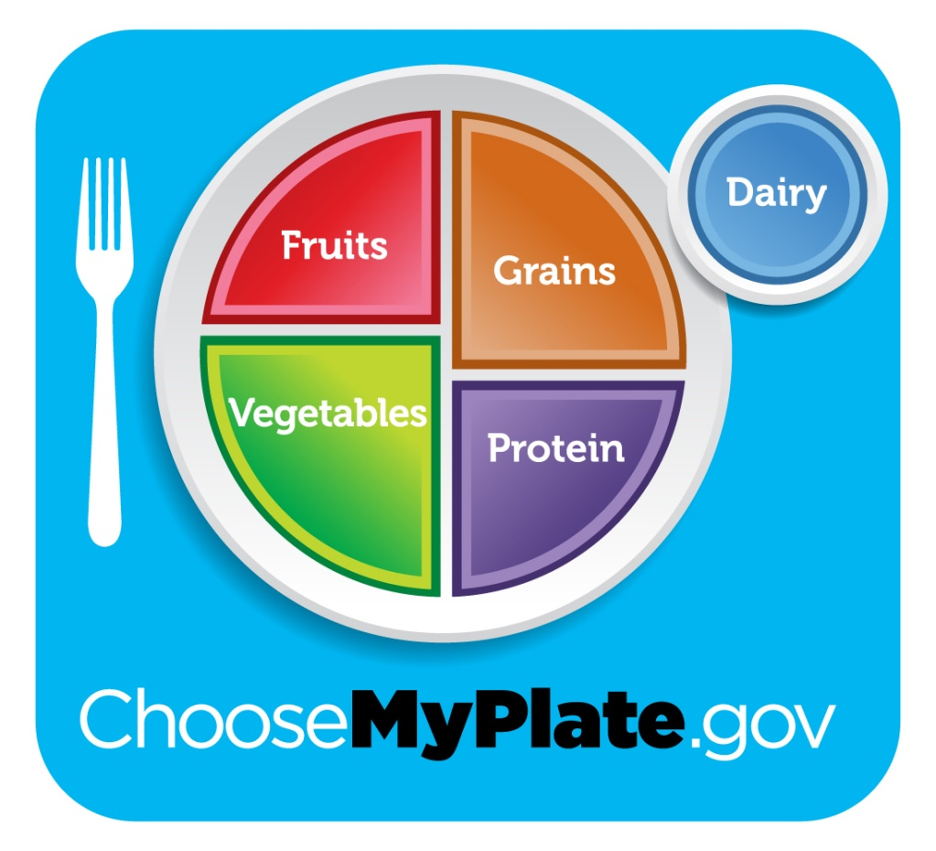
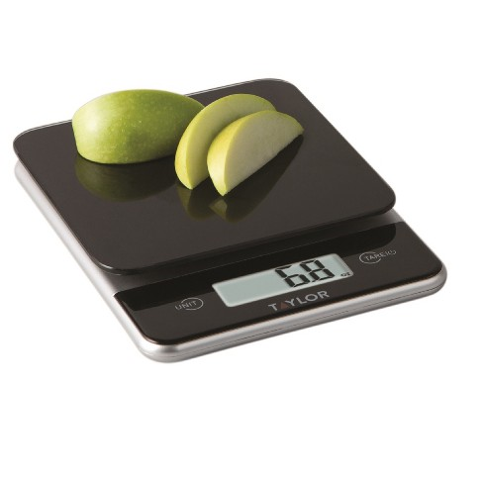

Nutrition Education
Carbohydrate counting
Appropriate meal/snack timing and insulin dosing
Snack management
Exercise management
Balancing meals for blood sugar control
Nutritional adequacy of the diet
Adequate intake of fluids
Using technology to assist in carb counting, dose calculation, blood sugar tracking
Notes:
Nutrition education is a common intervention used in diabetes clinic. Education topics can vary on patient needs, length of time diagnosed with diabetes, and more.
Common topics include:
-Carbohydrate counting, including techniques for measuring or weighing foods
-There is some evidence to suggest that dosing for fat and/or protein can optimize post-prandial glucose, however there is no consensus for how to calculate the additional insulin needed.
-Appropriate meal/snack timing and timing of insulin dosing
-Snack management – better choices, when to include, whether or not to dose
-Exercise management – including adequate physical activity, appropriately managing blood sugars with activity through self-blood glucose monitoring (SBGM) or carbohydrate replacement if necessary
-Balancing meals for blood sugar control – including protein/fat or lower glycemic index foods to slow the glycemic response to a meal
-Ensuring nutritional adequacy of the diet – including more fruits, vegetables, dairy as needed; encouraging vitamin/mineral supplementation when necessary
-Ensuring adequate intake of water and total fluids
-Using technology to assist in carb counting, dose calculation, blood sugar tracking

Slide 24
Nutrition Counseling
Motivational-interviewing for diabetes self-cares
Social support: discussing issues related to division of responsibility for cares, adequate supervision of cares, school support
Problem-solving: addressing barriers to completing self-cares, creatively brainstorming potential solutions
Goal setting: encouraging realistic goals to work toward changing difficult behaviors
Notes:
END:
While working with patients with diabetes, it is important to be open and see where they are in the desire to make changes. Motivational interviewing is a great tool to determine one’s readiness to make changes.
(Probably don’t need to discuss the following stages in-depth, just state the stages?)
Pre-contemplation stage: At this point your patient does not even consider making changes. Frequently many of these individuals are in denial that change needs to occur, though occasionally you will find individuals who do not know what changes need to happen.
Contemplation stage: This stage patients are ambivalent about making changes. These see that changing a behavior will cause them to feel a sense of lost despite an overall gain. This point as a clinician we can help patient’s assess their barriers and help them problem solve. Most barriers perceived are time, expense, hassle, and fear. Many will often admit that they know that they need to make a change but they need more support to help making these changes.
Preparation Stage: Patients prepare to make a specific change and they may start out small and then become more determined to make more changes with success. So an example is that a patient maybe checking their blood sugar 1-2 times per day which is not enough but by adding an additional blood sugar check every week with meals they will eventually see improved glucose control making them more open to making future changes.
Action Stage: This is the point where our patients make the changes. This stage is where most healthcare practitioners are eager for their patients to be but frequently this is a very difficult stage. Patients require support and praise for making the change. Lifestyle changes are very difficult as individuals have likely been living in this specific way for a long time.
Maintenance and relapse prevention stage: This is the point where the patient has made this a long term change though relapse can occur and many patients feel demoralized as they feel they failed at the lifestyle change. But as a coach for our patient we need to explain that sometimes we make mistakes and we learn from them and we continue. You need to provide positive reinforcement of positive behaviors that they are doing to help re-establish there confidence. Frequently patient will cycle through all of these stages several times but we will help them as a coach and continue to provide positive reinforcement.
Barriers to patient, whether real or believed, play a significant role in making behavior changes. Some patients do not have adequate social support whether they require supervision with the care or with school.
Problem solving: Addressing barriers to completing self-cares. Most patients understand what changes they need to make though putting aside our need to try to address many problems take the time to discuss 1-2 problems with barriers. Discuss and help the patient come up with solutions. More frequently when you take the time and engage with the patient to help them problem solve behaviors they will follow through.
Finally, goal setting is extremely important. Goals need to use the SMART Acronym: Specific, Measurable, Achievable, Realistic, and Timely. The RD and patient/family should create goals that have these components which will help guide them on achieving their goal.

Slide 25
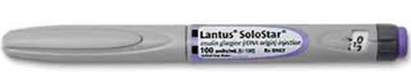
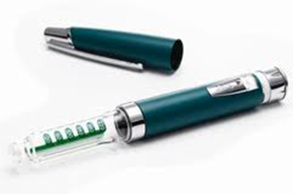
Insulin
Insulin is given via injections or by insulin pump
Injections:
  Short-acting insulin is given with meals and large snacks
  Long-acting insulin provides background coverage
  Pens or syringes
Pumps:
  Only short-acting insulin is used
  Insulin is delivered at a slow continuous rate, with larger bolus amounts given with meals and snacks
Notes:
Adam start:
The primary treatment of T1DM is giving insulin, which is given by injections either using syringes or pens, or via insulin pumps.
Short-acting insulin is given with meals and large snacks.
Long-acting insulin is given most often once daily and provides background coverage
Insulin pumps only use short-acting insulin, but is programed to give insulin continuously at a slow, continuous rate, with larger bolus amounts given with meals and snacks.

Slide 26
Insulin
Type of Insulin | Brand Name | Onset | Peak | Duration | Timing of Dose
Rapid Acting (prandial and correction)
Lispro | Humalog | 15-30 min | 30-90 min | 3-4 h | Take 15 min before meals or immediately after meals
Aspart | NovoLog | 15 min | 45-90 min | 3-5 h | Take 5–10 min before meals
Glulisine | Apidra | 20 min | 50-60 min | 5-6 h | Take 15 min before meals or 20 minutes after meals
Long Acting (basal)
Detemir | Levemir | 1-3 h | 3-14 h | 5-23 h | Take once daily before evening meal or bedtime or once every 12 h
Glargine | Lantus | 1-3 h | No peak | 24 h | Take once daily or twice per day at the same times. Cannot be mixed with any other type of insulin but can be used in combination with other insulins
Tresiba | degludec | 30-90 min | No Peak | Up to 48 h | Take once daily or twice per day at the same times. Cannot be mixed with any other type of insulin but can be used in combination with other insulins
    (American Diabetes Association, 2008).
Notes:
Insulin has 3 characteristics:
-Onset is the length of time before insulin reaches the bloodstream and begins lowering blood sugar.
-Peak time is the time during which insulin is at maximum strength in terms of lowering blood sugar.
-Duration is how long insulin continues to lower blood glucose.
Pause this slide to review graph more.

Slide 27
Insulin Dosing Terms
Correction dose: amount of insulin given to lower a blood sugar back into target range (Rapid-acting insulin)
Correction Factor or Sensitivity: how much 1 unit of insulin will drop your blood sugar (Rapid-acting insulin)
Insulin to Carb Ratio or Bolus: determines insulin given to cover food
(1 unit of insulin covers ___ grams of carb) (Rapid-acting insulin)
Basal: the insulin your body needs between meals and at night (Long-acting insulin)
Notes:
The correction dose is determined by subtracting your current blood glucose minus your target number then dividing it by your Correction Factor or Sensitivity.
In order to dose for the carbohydrates you eat, you need to determine the amount of carbohydrates you are going to eat. Take the grams of carbohydrate divided by the insulin to carbohydrate ratio. Some patients may have multiple insulin to carbohydrate ratios during the day because their bodies may be more sensitive to insulin at different times per day. For example, breakfast could have an ICR of 12, while dinner’s ICR may be 16.
Basal insulin such as Lantus, Levemir, or Tresiba may be taken 1 -2 times per day at the same time every day. Long-acting basal works on the glucose released from the liver.

Slide 28
Guidelines for Rapid-Acting Insulin
Typically begins to work within 15 minutes after injection, peaks within an hour, and continues to work for 2 to 4 hours
Recommended to be administered before meals to match the amount of carbohydrate eaten at meals/snacks
Young children may benefit from post-prandial bolus insulin due to unpredictable carb intake
It can also be administered to correct for high blood glucose levels
    (American Diabetes Association, 2008).
Notes:
Rapid-acting insulin typically begins to work within 15 minutes after injection, peaks within an hour, and continues to work for 2 to 4 hours.
It is recommended to be administered before meals to match the amount of carbohydrate eaten at meals/snacks
Rapid-acting insulin can also be administered to correct for high blood glucose levels
Young children, most often under the age of 5, may benefit from postprandial bolus insulin, because their carbohydrate intake can be unpredictable. To best control blood glucose levels, meals should have been eaten within 20 minutes of postprandial insulin administration
Sometimes we educate parents on split-meal dosing which has improved insulin coverage versus post-meal dosing, but it requires two injections at meal times rather than just the one. Split dosing covers the correction of high blood sugar and minimum carbs for the first dose at the beginning of the meal, and the second dose is only for the additional carbs the patient will eat and is dosed mid-meal or at the end of the meal.

Slide 29
Guidelines for Long-Acting Insulin
Provides continuous action with minimal or no peak
Also called basal (background) insulin
Manages blood glucose levels between meals and snacks, as well as overnight
Duration of action ranges from 5 to 23 hours
May need to be administered either once or twice daily; most patients give basal insulin at bedtime
    (American Diabetes Association, 2008).
Notes:
Use the above slide. Explain that the long acting insulin works on managing the glucose released by the liver.

Slide 30
Guidelines for Mixed Insulin
Mixed Insulin is an option for patients who have difficulty administering multiple insulin injections to manage blood glucose levels
Novolog Mix 70/30 (insulin aspart protamine and insulin aspart)
  Combination of two forms of insulin – intermediate-acting insulin and fast acting insulin
Administered twice daily, usually before breakfast and dinner
    (American Diabetes Association, 2008).
Notes:
The use of mixed insulin in clinic is infrequent but it is used for patients that struggle with giving multiple injections daily. It is a blend of intermediate acting insulin and fast acting and is given typically twice per day. This is not as an effective treatment as using the long and rapid acting insulin.

Slide 31
Flexible Meal Plan Regimen
    Flexible insulin regimens allow the patient to eat at flexible mealtimes, as well as eat an amount of food based on hunger rather than a predetermined amount of carbohydrate.
    The patient’s use of basal/bolus insulin therapy and the total carbohydrate amount at meals and snacks are the primary determinants of bolus insulin doses and blood glucose response
    Most patients take multiple daily injections of fast-acting insulin at meal times and long-acting insulin once daily (around bedtime) on this regimen
    (American Diabetes Association, 2008).
Notes:
-The overall goal for patients is to use a flexible meal plan which allows them to eat variable amounts of carbohydrates and be more flexible with timing.
-Flexible insulin regimens allow the patient to eat at flexible mealtimes, as well as eat an amount of food based on hunger rather than a pre-determined amount of carbohydrate.
-The patient’s use of basal/bolus insulin therapy and the total carbohydrate amount at meals and snacks are the primary determinants of bolus insulin doses and blood glucose response
-Most patients take multiple daily injections of fast-acting insulin at meal times and long-acting insulin once daily (around bedtime) on this regimen

Slide 32
Insulin: dose calculation
Correction(Fix) + Carb dose (Food) = Total Insulin dose (Bolus)
“FIX”: _______ - _______ = ­______ ÷ ________= _____ . _____ _____ units
Blood sugar Target # Sensitivity
“FOOD”: _________ ÷ __________ = _____ . _____ _____ units
Grams of carb insulin : carb ratio
Total (FIX + FOOD)= _____ . _____ _____ units.
Insulin Dose using Rounding Rules: _____ . _____ units
247
130
117
50
2
3
4
63
22
2
8
6
5
2
0
5
0
Notes:
To calculate the total amount of insulin on the flexible meal plan, follow this equation:
Correction or Fix for the blood sugar determines how much insulin to lower the blood sugar into target range by taking the blood sugar minus the target blood sugar, divided by the correction factor/sensitivity.
To cover carbs eaten at the meal or snack, take the grams of carb divided by the insulin to carb ratio to get how much insulin for food.
Add the fix and the food together to determine the total insulin dose to be given for the meal or snack.
Rounding Rules:
0.1-0.3 round down to whole unit (1.2 units = 1.0 unit to inject)
0.4-0.7 round to the half unit (1.6 units = 1.5 units to inject)
0.8-0.9 round up to the whole unit (1.9 units = 2 units to inject)
Walk through an example: Explain the blue and green are the patient’s doses, while the red blood sugar and carbs are the variables. CLICK FOR EACH NUMBER TO APPEAR ON SCREEN ☺
BG 247
Target 130
Sensitivity 50
Carbs 63
ICR 22

Slide 33
Insulin: split-dosing
An option for patients to split their mealtime bolus into two doses when they don’t know how much food they’ll eat.
First dose: for blood sugar correction and minimum amount of carbs they know they’ll eat.
Second dose: only for extra carbs. Be sure to not correct for blood sugar again.
Notes:
Insulin split-dosing is a very effective method of covering the amount of carbohydrates if you do not know how much a child will eat. Also this is effective with foods that are high in fat and cause delayed rises in blood glucose. So foods like pizza, lasagna, fried chicken will be better covered when split-dosed.

Slide 34
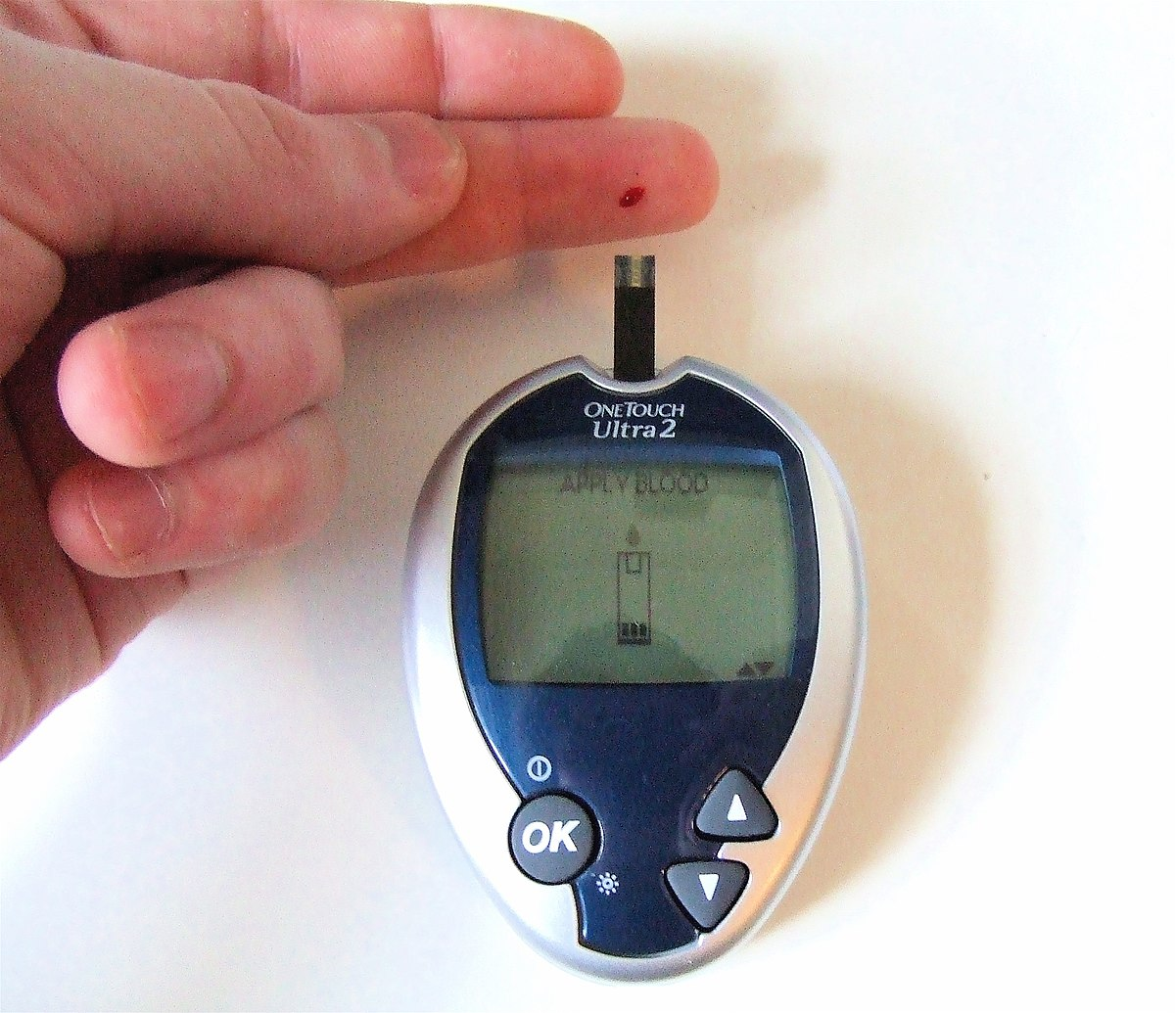
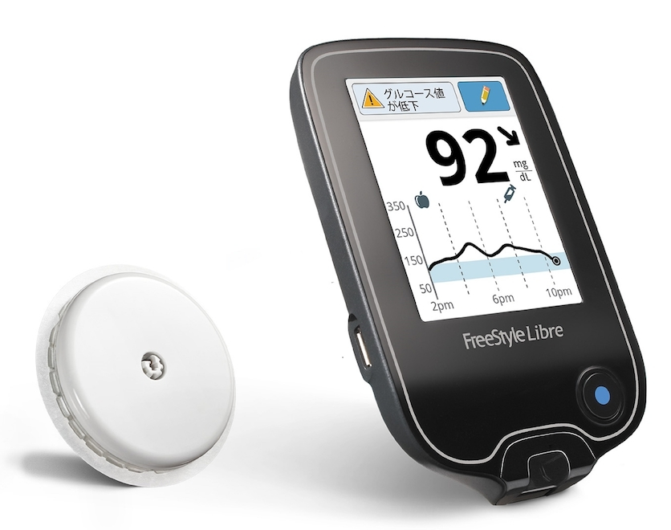
Technology: BG/ CGM
Blood Glucose Monitor
  These take a snap shot at one time of someone’s capillary blood glucose
Continuous Glucose Monitors
  These can track trends of blood glucose levels of interstitial tissue
Notes:
Blood sugars can be checked by a blood glucose monitor, which take a snap shot at one time of someone’s capillary blood glucose. Blood sugars can also be monitored by a continuous glucose monitor (CGM) which can track trends of blood glucose levels of interstitial tissue. These can be placed on multiple areas of the body.

Slide 35
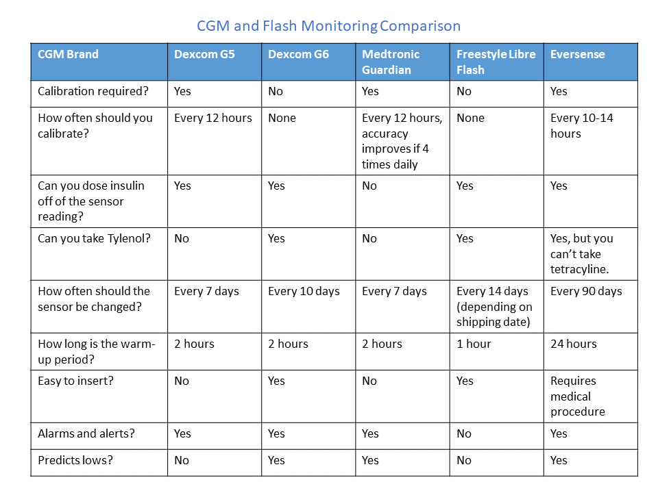
CGM Capabilities
Notes:
https://t1dtoolkit.org/glucose-monitoring/cgm-and-flash-monitoring-comparison-chart/
Pause this slide to review graph more.

Slide 36
Technology: Insulin pumps
Pump Features | Omnipod DASH | Omnipod 5 system | Tandem T: Slim
Bolus Calculator | Yes on Personal Diabetes Manager | Yes, SmartBolus Calculator | Yes on pump
Basal Dose Increments | 0 -30 units per hour in 0.05 unit per hour increments | 0.05-30 units per hour. | 0.001 units/ hour
Integrated meter | No | Yes with Dexcom G6 | Yes with Dexcom G6, G7, Libre 2 Plus
Adjusts for Active Insulin on board from previous bolus | No. Does have ability for temporary basal rates. | Yes, has HypoProtect mode only when in automated mode, and personal Adaptive Smart Adjust | Yes, correction and carbohydrate bolus. Has Basal, and IQ technology
Notes:
-Special bolus settings like square wave/extended or dual wave/combination) available on a pump to manage the delayed absorption of high-fat and high-carb meals like pizza
-Using the pump bolus features correctly can help to prevent post-meal hyperglycemia
Pumps are great so that people can eat over a longer period of time. So going to the movies you can determine how much popcorn you are going to eat and then put the carbohydrate amount into the pump and the time you are giving the bolus over.
We will find that kids just starting with a pump will have a tendency to gain weight as they tend to eat more as they have to inject less often.
Pause this slide to review graph more.

Slide 37
Technology: Insulin pumps
Pump Features | MiniMed 770G | MiniMed 780G | iLet Bionic Pancreas
Bolus Calculator | Yes on Personal Diabetes Manager | Yes, SmartBolus Calculator | Yes on pump
Basal Dose Increments | 0 -30 units per hour in 0.05 unit per hour increments | 0.05-30 units per hour. | 0.001 units/ hour
Integrated meter | No | Yes with Dexcom G6 | Yes with Dexcom G6, G7, Libre 2 Plus
Adjusts for Active Insulin on board from previous bolus | No. Does have ability for temporary basal rates. | Yes, has HypoProtect mode only when in automated mode, and personal Adaptive Smart Adjust | Yes, correction and carbohydrate bolus. Has Basal, and IQ technology
Notes:
-Special bolus settings like square wave/extended or dual wave/combination) available on a pump to manage the delayed absorption of high-fat and high-carb meals like pizza
-Using the pump bolus features correctly can help to prevent post-meal hyperglycemia
Pumps are great so that people can eat over a longer period of time. So going to the movies you can determine how much popcorn you are going to eat and then put the carbohydrate amount into the pump and the time you are giving the bolus over.
We will find that kids just starting with a pump will have a tendency to gain weight as they tend to eat more as they have to inject less often.
Pause this slide to review graph more.

Slide 38
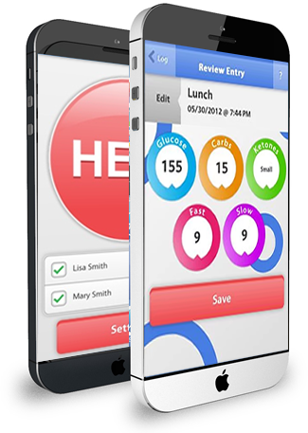
Technology: BlueLoop
BlueLoop
  Patients and families have the ability to document, store and share diabetes information real-time: blood glucose, carbohydrates, medication (insulin, Lantus, Metformin, etc), notes and more
  Insulin dose calculator based on blood glucose and carbohydrates
    Ability to override dose (exercise, sick, adrenaline, gut instinct, bedtime, unsure of carbs, insulin on board, etc)
  Communication between patients, families, school personnel, healthcare team
  How it works: https://youtu.be/sksO72-v2EQ

Slide 39
Technology: websites/apps
    CW Carb Factors: website that has the carb factors in food categories with a built-in calculator that can be added to phone’s home screen to look like app/shortcut
    Calorie King Food Search: database with verified carbohydrate counts for foods with and without labels and also chain restaurant nutrition facts
MyFitnessPal: app to help with carb counting, has barcode scanner
Spark People: recipe calculator to find carb amount
Notes:
CW Carb Factors: https://childrenswi.org/carbload#/home
Calorie King Food Search: https://www.calorieking.com/us/en/
MyFitnessPal: https://www.myfitnesspal.com/ Will caution with the use of MyfitnessPal as it does allow for people to post unverified nutritional information. So some recipes with nutritional information may not be as accurate in their carbohydrate counting.
Spark People: https://recipes.sparkpeople.com/recipe-calculator.asp

Slide 40
Exercise Management
Exercise is a great way to help insulin work more efficiently and effectively at using glucose in the bloodstream. It can lead to different challenges by causing either hypoglycemia or hyperglycemia.
Hypoglycemia can occur when the body has used most of the available glucose from muscles and liver quickly for energy. This can also be delayed in some people as you can be more sensitive to insulin for 12-16 hours after exercise, leading to hypoglycemia in the night or next morning.
High intensity sports can cause adrenaline highs (causing high blood sugars), but will correct themselves typically after completion of the activity within two hours.
Notes:
Exercise management is important subject as it can be very beneficial and at times difficult to manage. Exercise and physical activity are very important aspects of daily living.
Exercise can be a great weight to lower your blood sugar especially when in honeymoon and you are not correcting blood sugars between meals. It also improves insulin sensitivity as many kids progress towards puberty their body can become more resistance to the insulin and may require more. By exercising more your body will use the insulin more effectively as it needs the energy.
Sports on the other hand can cause hypoglycemia without proper management. Having snacks and slightly higher blood sugars prior to activities will help prevent hypoglycemia.
Intense sports can also cause adrenaline highs which cause elevated blood sugars but do not correct them as they typically normalize within 2 hours.

Slide 41
Adjusting for Exercise
If exercise is planned (sports or gym class), patients may subtract ½ to 1 unit of insulin before exercise within 2 hours.
Unplanned exercise may require an extra snack (10-15 gm of complex carbohydrate + protein source) before the activity to reduce lows with activity
May need to check blood sugars more frequently (before, during, and after) especially if it is a new activity.
For additional information regarding Physical Activity and Exercise with T1DM see handouts: Exercise and Diabetes, Exercising and T1DM, and Competitive Sports and Diabetes.

Slide 42
Case Study
Type 1 Diabetes and Soccer

Slide 43

Situation: Danny
Danny is a 10 year old soccer player.
  He has practice 2 times a week for 1½ hours each
  He has games 1 time a week for an hour
  Glucose records show:
    Blood sugars are 125-150 before practice/games
    Sugars drop into the 60’s after practice.
    On game days he is high – 250-300 afterwards.

Slide 44
What Else Do You Need to Know?
When are the practices/games?
What are blood sugars during practice/game?
When and what does he eat before?
What eat/drink during or after?
How soon after practice does he go low?

Slide 45
What You Found Out…
Practices are 6-7:30pm
  Family eats dinner at 5:00, but Danny tries to not eat too much so he doesn’t get a side-ache
Games are 10:00am on Saturdays
  Danny eats breakfast at 8:00
Danny does not check his blood sugars during practices/games, but is low as soon as he gets home after practice
Danny drinks water during practices but Gatorade during games
Team always goes out for lunch after games

Slide 46
Possible Solutions
Discuss possible solutions with content expert

Slide 47
Next Steps
Complete post-test
Review any additional materials in Q-drive
Debrief with content expert

