Slide 1



Homemade Tube
Feeding
Notes:
Welcome to the learning module for Homemade Tube Feeding

Slide 2
Objectives
Understand what homemade tube feeding is and why patients choose homemade tube feeding
Review patient selection for successful transition to homemade tube feeding
Learn how to develop a homemade tube feeding recipe
Describe how to assess a current homemade tube feeding recipe
Notes:
By the end of this learning module, you should be able to:

Slide 3
What is Homemade Tube Feeding (HTF)?
A tube feeding in which smooth or liquid food is given in addition to or in place of commercial formula
HTF Continuum
Small amount of food + commercial formula |  | Food + commercial formula |  | All blended whole foods
Notes:
Homemade tube feeding, shortened as HTF, is a tube feeding in which smooth or liquid food is given in addition to or in place of commercial formula. Homemade tube feeding exists along a continuum, where a patient can be receiving just a small amount of food in addition to their commercial formula all the way to receiving all whole, blended food and no commercial formula at all.
Homemade tube feeding is also called blenderized tube feeding. Another form of giving food by tube is called pureed by G-tube diet which follows very specific recommendations for the thickness of the formula in order to treat reflux. We will be focusing on general homemade tube feeding, or blenderized tube feeding, for this learning module.

Slide 4
Family interest in HTF
Perceptions that HTF is more natural than commercial formulas
Concerns with ingredients in commercial formulas
Desire to give increased variety of foods
Ability to provide the foods the family is eating
Cost concerns (if insurance doesn’t cover commercial formula)
Notes:
Why do families want to give their child a homemade tube feeding? There are many perceived benefits of giving homemade blends in place of giving commercial formulas. Some of the top reasons include that families have:

Slide 5
Advantages
Disadvantages
Increased connection with caregivers
Increased dietary diversity
Decreased cost*
Potential increase in oral intake
Improved feeding tolerance
Increased preparation time
Required supplies
Complications with feeding delivery
Risk of infection/contamination
Increased nutrition monitoring
Risk for macro- & micronutrient deficiencies and excesses
Notes:
While there are several advantages in switching to homemade tube feeding, there are also a few disadvantages that families should be aware of when they are considering switching to homemade tube feeding. While they may experience increased connection with feedings, increased dietary diversity, decreased cost, potential for increased oral intake, and improved feeding tolerance, they may also have increased preparation time for tube feeding, have to acquire new supplies to make and store the homemade tube feeding. There is a chance of complications with feeding delivery, especially as homemade blends are often not as smooth as commercial formulas. There is an increased risk of infection and contamination with preparing tube feedings at home, as well as the increased effort to monitor the child’s nutrition. Lastly, they may be at higher risk for macro and micronutrient deficiencies or excesses.

Slide 6
Patient Selection
Notes:
Next we’ll discuss how to select patients that can appropriately receive homemade tube feeding

Slide 7
Which patients are appropriate for HTF?
Medically stable
Adequately nourished
Age
  >6 months
  >12 months
Special considerations for certain medical conditions
  Metabolic disorders, renal disease, multiple food allergies, weakened immune systems, fluid restrictions
Feeding tube
  Gastrostomy tube ≥14 French
  Bolus by syringe
Access to equipment
  Refrigeration, freezer
  Storage containers & measuring cups, utensils
  High quality blender
Health literacy, motivation of caregiver
Notes:
Before considering a patient as a candidate for homemade tube feeding, they need to be medically stable and adequately nourished.
Prior to 6 months of age, an infant should only be receiving human milk and/or infant formula, so introducing other foods by G-tube before this age is inappropriate. Starting at 6 months of age, the family could mimic initial food introduction by mouth by giving similar foods and volumes by G-tube. Don’t forget, the primary purpose of introducing foods at this age is for oral skill development, not nutrition intake, so the family needs to still prioritize giving human milk and/or infant formula with small amounts of blended food.
At or above 12 months of age, the child can now be transitioned to homemade tube feeding entirely, just as a typical oral eater would transition to foods and a nutritious beverage at 12 months old.
Some medical conditions will make it much more difficult to provide the child 100% of their nutrition needs from homemade tube feeding. Some of these conditions include metabolic disorders, renal disease, multiple foods allergies, weakened immune systems as seen in the oncology population, and fluid restrictions as seen at times in cardiac patients. While none of these conditions definitely rule out the possibility of giving homemade tube feeding, the family and medical providers need to discuss that this may look much different than the family is anticipating.
In order for a homemade tube feeding to run efficiently through a tube, the tube needs to be at least 14 French in size, and ideally fed bolus by syringe. While bolus by pump is an option, homemade tube feeding is not shelf stable like commercial formula, and should not be hung at room temperature for longer than 2 hours.
Families wishing to provide HTF need to have access to appropriate refrigeration, and possibly a freezer if they plan to make and freeze meals ahead of time. They will need a high quality blender if they plan to blend whole foods. They also likely need basic cooking equipment, like measuring utensils and storage containers.
The health literacy of the caregivers is important to take into consideration as making homemade tube feeding can be quite complex. The family also needs to be motivated to put in the effort that making daily tube feeding will entail.

Slide 8
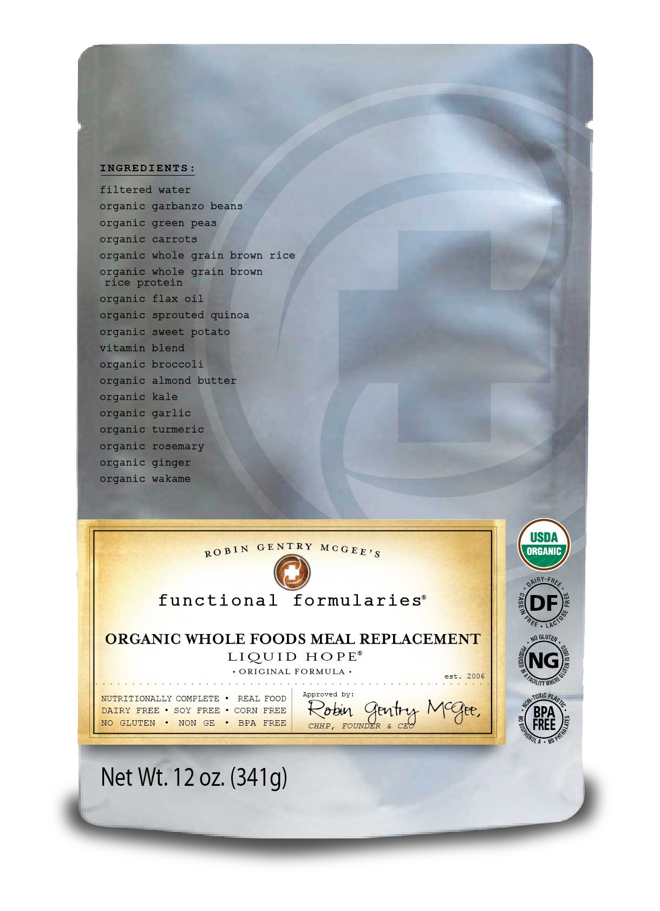
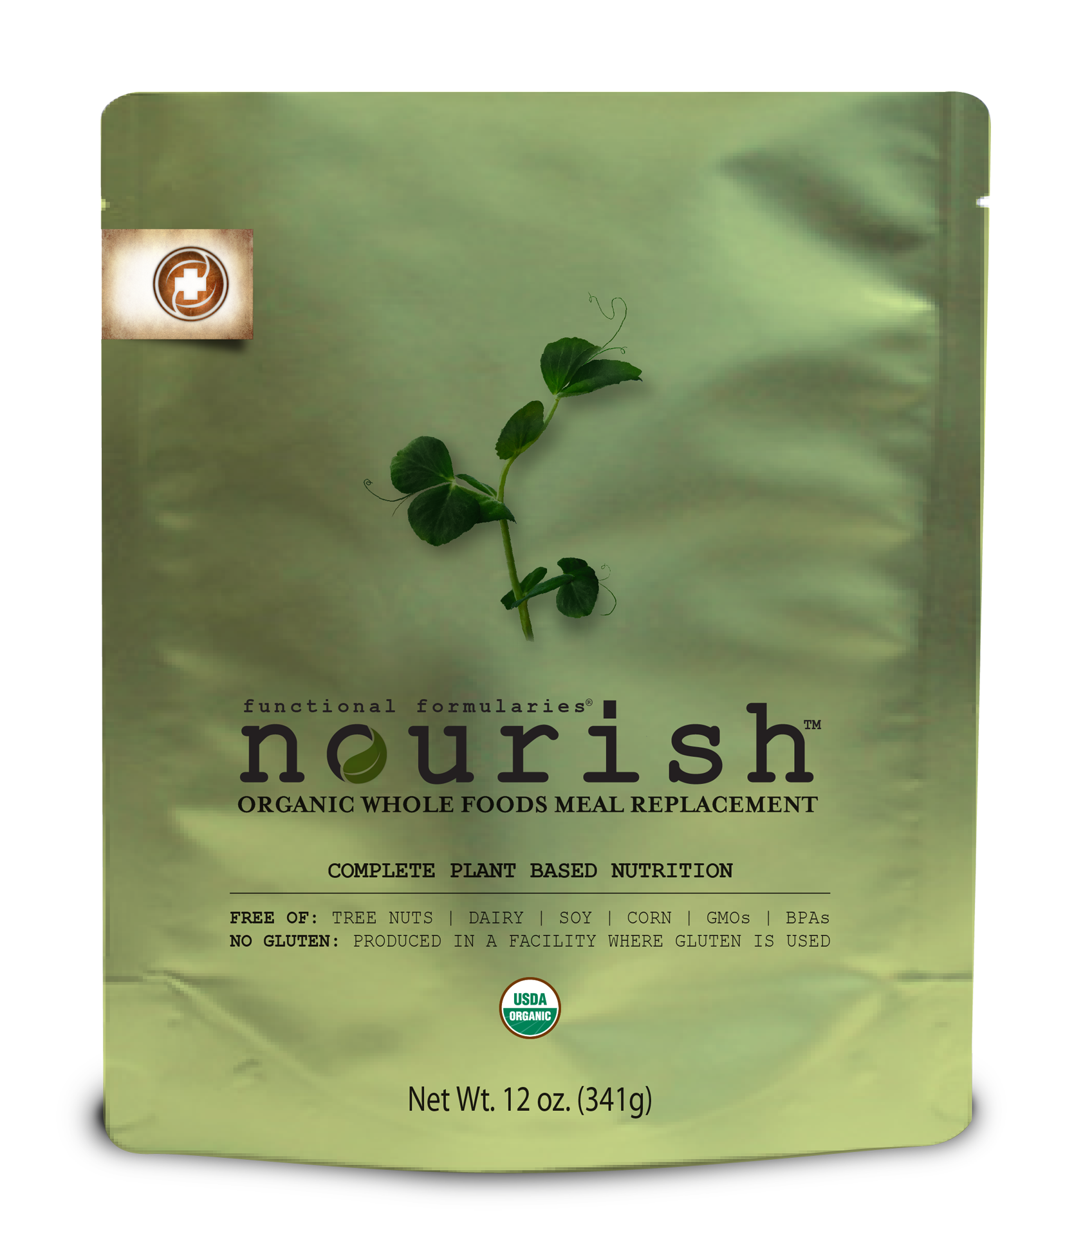
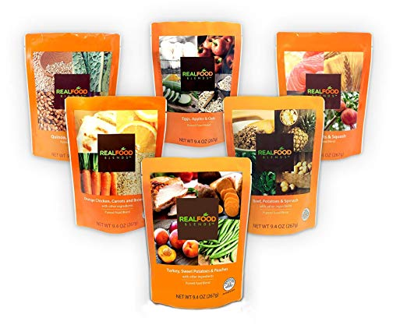
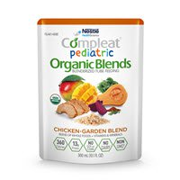
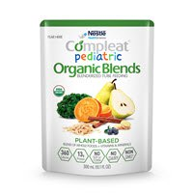
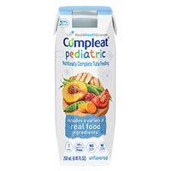
Food Based Formulas
Notes:
While many patients and their families are great candidates for homemade tube feeding, some may still choose one of the many food-based formula options currently available on the market today. These are helpful for patients who aren’t good candidates for HTF, such as those with continuous feeds or those whose caregivers have lower healthy literacy. These food based formulas can also be helpful as back-ups for families that usually make their own homemade tube feeding. They can use these when traveling or during long power outages, just to give a few examples.

Slide 9
Developing a HTF recipe
Notes:
When a family expresses interest in using HTF, talk with the family about the expectations of making homemade tube feeding and give them a timeline of when you plan to send them the initial draft of their child’s recipe. It is especially helpful for these families to sign up for MyChart if able, as this allows for easier communication in relaying recipe information.

Slide 10
HTF Recipe Development
Start with calorie level that patient is currently thriving on
Use MyPlate guidelines for serving sizes at each calorie level
Allow as much flexibility as possible in the choices
Food allergies
Epic SmartPhrase .NUTRHTF
Notes:
How do you start making a HTF recipe for a patient? Look at the calorie leve the patient is currently thriving on or adjust the current level they are receiving if they need a calorie increase or decrease based on your most recent assessment. Then, use the MyPlate guidelines for serving sizes of each of the major food groups for that calorie level. Allow the family as much flexibility as possible in their food choices within each food group. For example, instruct them to give 1 cup fruit (variety) instead of ½ cup of chopped apple and ½ cup of chopped peaches.
Don’t forget about the potential for food allergies. For infants/children who haven’t been exposed to foods before, they need to start with 1 new, single ingredient food at a time, and then wait at least 3 days before starting the next new food.
There is a helpful Epic SmartPhrase that is built “dot NUTRHTF” that we’ll look at on the next slide.

Slide 11
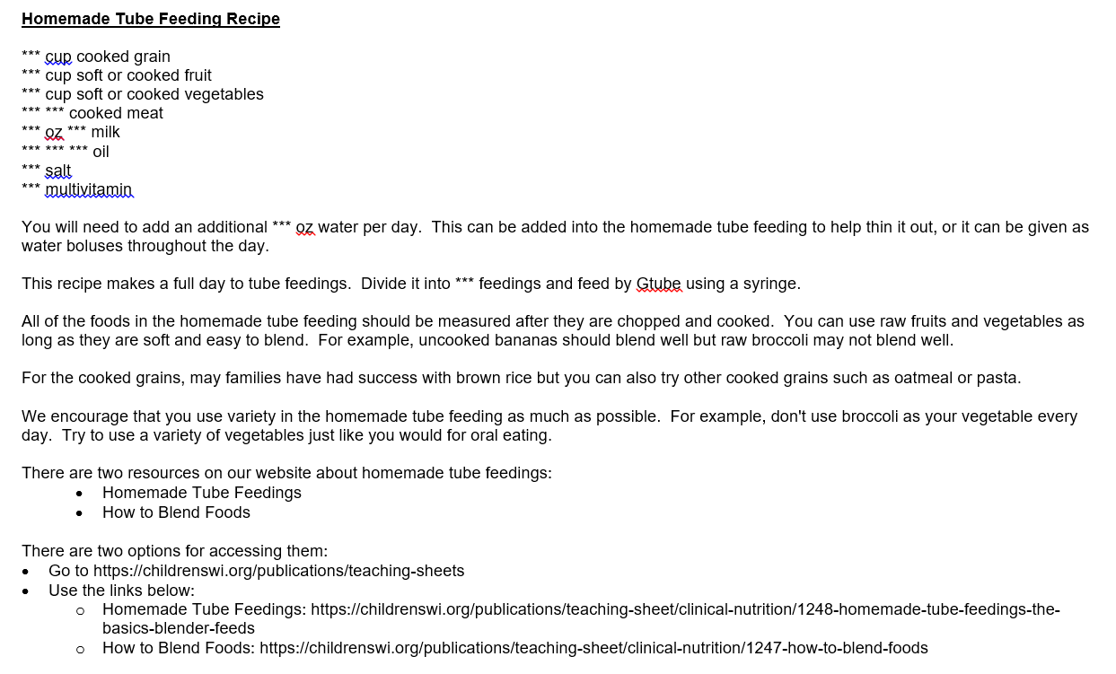
Epic SmartPhrase .NUTRHTF
Notes:
This SmartPhrase can be pulled into AVS or MyChart Encounter to share with families. This not only saves time when communicating the recipe to the family, but also helps guide the dietitian in developing the recipe itself.
As you can see, it starts with the actual recipe itself, and then gives additional instruction of how much water the family needs to add daily, as well as how many feedings they should divide the recipe into. The remainder is further instructions that can be helpful for families attempting to make HTF for the first time. Last, there are links to teaching sheets for the family to access as needed. Feel free to individualize to each patient.

Slide 12
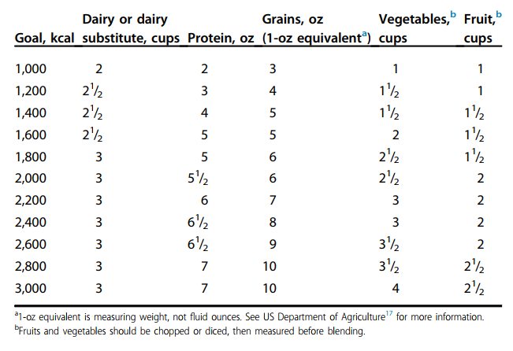
HTF Recipe Development
MyPlate recommended portions based on calorie goal
Walia et al. 2017
Notes:
Here is the MyPlate chart you use to figure out serving sizes for each food group when developing a HTF recipe for a patient.
Of note, a 1 oz equivalent of grain is equal to 1 slice of bread, 1 cup of ready-to-eat cereal, or ½ cup cooked rice, cooked pasta, or cooked cereal like oatmeal.

Slide 13
HTF Recipe Development
Check your work with nutrient analysis software like Nutritionist Pro
Common macro/micronutrients that are not met by HTF
  Essential fatty acids (Link to Resource Binder)
    Flaxseed and canola oils are high in Linolenic acid which is often the one that needs to be supplemented
  Vitamin D
    Often add liquid Vitamin D supplement if a complete multivitamin isn’t already being added
  Sodium
    Minimum sodium requirement is 2 mEq/kg = 46 mg/kg Na⁺
  Fluid
    Estimate volume of food in recipe then multiply by 75% to estimate fluid content
Notes:
After you have come up with your recipe using the MyPlate guide, check your work using Nutritionist Pro or another nutrient analysis software. This is helpful in determining how many calories the patient will receive, along with grams of protein. You can also look to see if they are receiving too much or too little of certain nutrients.
It is not uncommon to need to add oil in order to meet a patient’s essential fatty acid needs for linoleic and linolenic acid. Use the link here to jump to the tip sheet for meeting EFA needs in the Resource Binder.
You may find yourself adding a children’s complete multivitamin with iron which will likely help meet a patient’s Vitamin D needs, but if you don’t add one, you will likely need to add a Vitamin D supplement to meet the patient’s needs.
Sodium is added as table salt and commonly used to meet the minimum requirement of 2 mEq/kilogram of body weight.
Lastly, you want to ensure that the patient is meeting their fluid needs. Based on the serving sizes used from MyPlate, you can estimate the volume of the HTF mixture then multiply this number by 75% to estimate it’s fluid content. Add extra water to meet patient’s fluid needs. Of note, extra water can also be given as separate water boluses if the family prefers and the patient can tolerate.

Slide 14
HTF Monitoring
Monitor for appropriate growth, as well as tolerance while transitioning to HTF
Determine if any labs will need to be drawn in the future
Reassess HTF to ensure that it continues to meet the patient’s needs (i.e. change in medical status, change in age that adjusts DRIs)
Notes:
Patient’s starting a new HTF recipe may be more frequent monitoring to ensure they are meeting their nutrition needs as well as tolerating the transition to HTF. Weight checks or RD visits can be utilized, especially at the beginning, to ensure adequate growth or maintained weight.
It can be helpful to request a 3 day food record of the HTF from the family to ensure that the patient is overall meeting their needs.
During the next clinic visit, look for major red flags when reviewing a typical HTF recipe from the family, then analyze with nutrient analysis software later to ensure all needs are met.
At times, additional labs may be drawn when a patient is receiving HTF. Talk with the patient’s nutrition team to determine if labs are needed.
Continue to reassess the patient’s status and make adjustments accordingly.

Slide 15
HTF Resources
Children’s WI Teaching Sheets
  #1248 “Homemade tube feeding: The basics”
  #1247 “How to Blend Foods”
  #1611 “Food Safety”
  #1498 “Homemade tube feedings: What to expect in the hospital”
Notes:
These are the teaching sheets that are currently available to help support patients receiving homemade tube feeding.

Slide 16
Case Example 1: HTF Initiation
4 year old, 100% G-tube dependence, complex medical history including Trisomy 21, global developmental delays, congenital heart disease, milk protein allergy, Stage 3 chronic kidney disease
Mom expressed interest in switching to HTF, discussed with nephrologist who agreed to transition as long as labs were closely monitored during transition
Patient currently receiving 2.5 pouches Real Food Blends + 22oz water + multivitamin split between 5 bolus feeds
Notes:
Let’s review a case example of how to develop a new HTF.
This is a case of a 4 year old who is 100% G-tube dependent with a complex medical history that includes Trisomy 21, global developmental delays, congenital heart disease, milk protein allergy, and Stage 3 chronic kidney disease. Mom is interested in switching from the patient’s current formula of Real Food Blends to homemade tube feeding. She discussed this with their nephrologist who agreed with making this transition as long as labs are closely monitored during this time.
Right now, the patient receives 2.5 pouches Real Food Blends plus 22 oz water and a multivitamin daily. This is split between 5 bolus feeds. This is a higher volume of water than most HTF recipes for a 4 year old because nephrology has a higher fluid goal given her compromised kidneys.

Slide 17
Case Example 1:
Review of Current Feeds
Current feeds provide approximately:
  800 kcals
  27.5 grams protein
  40 oz fluid
Patient previously tolerated soy milk when given in the past
Patient has already been exposed to a wide variety of foods via small volume tastes by mouth
Notes:
The current feeds are providing approximately 800 calories, 27.5 grams protein, and 40 oz fluid per day. Mom reports that the patient had tolerated soy milk in the past when given, and that she’s been exposed to a wide variety of foods from all food groups as small volume tastes by mouth. Mom would like the patient’s homemade tube feeding to be made without the need for any formula, but is still planning to use Real Food Blends as needed, such as when traveling.

Slide 18
MyPlate Portions
MyPlate recommended portions based on calorie goal
Walia et al. 2017
Notes:
Start by looking at the MyPlate portion sizes based on calorie levels

Slide 19
Case Example 1:
MyPlate Portions HTF Recipe
HTF Recipe
1 cup grain
1 cup fruit
1.5 cups soft or cooked vegetables
2 oz cooked meat
16 oz soy milk
2 teaspoons flaxseed oil
¼ teaspoon salt (~2 mEq/kg)
Animal Parade Liquid gold multivitamin
Notes:
Then, translate this into the patient’s current intake of 800 calories per day. Of note, a 1 oz portion of grain is typically about a 1/2 cup of cooked grain.
In this example, the grain portion was decreased to save some calories given that patient doesn’t need 1000 kcals/day. Vegetables were increased to give a better ratio of calories from carbohydrates without adding as many calories as grains. 2 teaspoons flaxseed oil were added to meet 3% kcals from linoleic acid and 0.5% kcals from linolenic acid. Salt was added to ensure the patient receives the minimum 2 mEq/kg/day. A liquid multivitamin with iron was added to meet Vitamin D and iron needs.

Slide 20
Case Example 1:
Nutrition Breakdown
HTF Recipe
880 calories
  52% CHO, 17% Pro, 31% Fat
36.9 grams protein
38 oz total free water
  26 oz free water from HTF + 12 oz water
Previous Feeds
800 calories
  30% CHO, 14% Pro, 55% Fat
27.5 grams protein
39 oz total free water
  17 oz free water from formula + 22 oz water
Notes:
This is a comparison of the new HTF recipe to what the patient is receiving in her current feeds of RFB. Of note, RFB are rather high in percentage of calories from fat. When making the HTF recipe, we looked to provide a more typical macronutrient distribution. This is why the ratio of calories from carbohydrates increased and the ratio of carbohydrates from fat decreased in the HTF recipe. Protein increased as well, but is still appropriate for patient. Given the patient’s kidney disease and fluid requirements from the Nephrology team, the goal for total free water stayed almost exactly the same.

Slide 21
Case Example 1:
MyChart message to family:
This recipe will be ~34 oz when blended (as an estimate). It will likely vary based on the types of foods you use, especially the grains, as they may absorb more or less of the fluid from the other foods. Let me know if the volume of your blended recipe at home is drastically different than the 34 oz estimate.
You will need to add an additional 12 oz water to this recipe to keep the volume similar to her current recipe. Her nephrologist would like to draw labs after you start giving this new recipe, so please reach out to them to schedule these.
Notes:
Here is an example of the MyChart message sent to family, along with a copy of the recipe from Slide 19. Because of the patient’s tenuous fluid status, the family was asked to reach out if their homemade blended formula ended up with a drastically different volume once blended as this estimation was being used to ensure the patient’s fluid intake remained stable.
The mother’s response to this MyChart message was really telling of why so many families would like to give foods by tube. She said, “For the first time ever, I get to cook dinner for my kid! Yeah!”

Slide 22
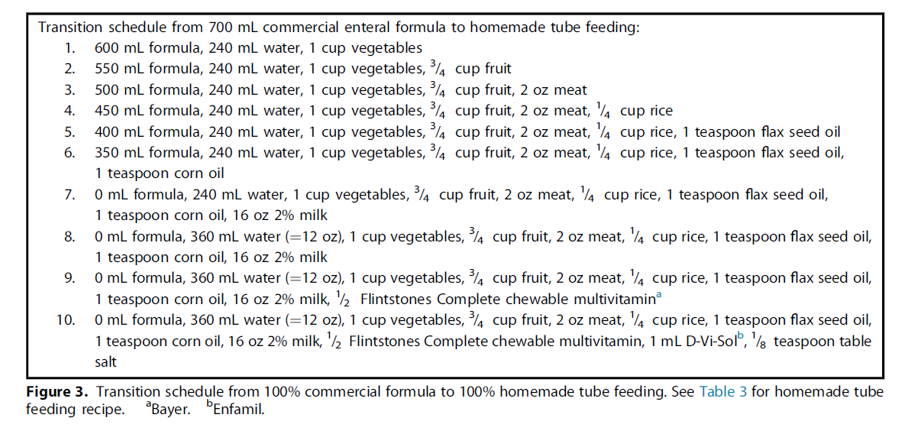
HTF Initiation:
Example of Transition Schedule
Notes:
Switching to all foods by tube instead of formula, especially commercial formula, can be a big change for a patient’s GI system. Because of this, some families are instructed to slowly transition to the HTF recipe the dietitian makes for them. This is an example of how a family can transition successfully, as well as ensuring that the steps happen rather quickly (transitions lasting too long put a patient at risk for nutrient deficiencies).
For patients that are already receiving a food-based formula by tube, the transition to HTF may not need to be as regimented as above because the patient’s GI system is already used to receiving blended foods.

Slide 23
Assessing Current HTF
Notes:
Next, we’ll discuss how to assess the recipe for a patient who is already receiving HTF

Slide 24
HTF Assessment
Assessing current HTF
  Review recipe for nutrient adequacy
    Create a list of necessary changes
  Develop goal recipe
  Set expectations for making changes
    Prioritize changes needed (most important to least)
    Change one thing at a time
    Explain rationale for adjustments needed
    Discuss alternatives that patient family is agreeable to
Notes:
Some patients may come to us already on a HTF recipe. We need to assess the family’s recipe to ensure that the patient’s nutrient needs are being met. This does not need to be completed during the patient’s clinic visit. During the visit, obtain adequate information from the family about the HTF they are giving the patient. You may also need to have them complete a 3 day food record and send it back to you if the family gives different foods every day.
After analyzing the recipe using nutrient analysis software like Nutritionist Pro, you can make a list of the changes that need to be made in order for the recipe to be nutritional adequate.
Based off these changes, develop a goal HTF recipe for the patient.
If more than 1 change is required, prioritize the changes based on most to least important from a nutrition and overall health standpoint. For example, ensuring that the patient is meeting their calorie needs may be of high nutrition importance, especially if they are currently not growing well. Another example is a patient currently struggling with constipation who we’d want to ensure is receiving adequate fluid as a higher priority.
Changes should be made one at a time to decrease overwhelming the family as well as optimizing the patient’s tolerance of the changes.
When discussing the changes with the family, explain your rationale for needing to make adjustments. If the family is not accepting of a particular change, discuss an alternative that they are willing to try.

Slide 25
Case Example: HTF Assessment
11 year old male
PMH includes developmental delay, cerebral palsy, 100% G-tube dependence
Chief complaint: constipation, weight loss
Notes:
Let’s review an example of a patient who presents to clinic already receiving a HTF.
An 11 year old male presents to clinic. He is 100% G-tube dependent and was receiving commercial formula at their last office visit. Patient was then lost to follow-up, and family has since switched him to a HTF recipe made entirely from food. The patient now returns to clinic with a new complaint of constipation, along with weight loss.

Slide 26
Case Example: HTF Assessment
Family’s HTF Recipe
Breakfast
  1 banana
  1 small apple
  5 prunes
  3/8 cup flax seeds
  ½ cup orange juice
Lunch
  1 avocado
  ½ cup vegetables
  5 prunes
  3/8 cup flax seeds
  ½ cup orange juice
Dinner
  3/8 cup flax seeds
  ½ cup mixed vegetables
  ½ cup pasta
  2 oz meat
Supplements:
  Complete multivitamin
  1600 mL water per day
Notes:
The family gives the above recall of patient’s current HTF recipe. They recently started adding the prunes in hopes this would help alleviate the patient’s new complaints of constipation.

Slide 27
Case Example: HTF Assessment
Family’s HTF Recipe
Breakfast
  1 banana
  1 small apple
  5 prunes
  3/8 cup flax seeds
  ½ cup orange juice
Lunch
  1 avocado
  ½ cup vegetables
  5 prunes
  3/8 cup flax seeds
  ½ cup orange juice
Dinner
  3/8 cup flax seeds
  ½ cup mixed vegetables
  ½ cup pasta
  2 oz meat
Supplements:
  Complete multivitamin
  1600 mL water per day
Notes:
At first glance, there are some obvious concerns with this recipe, including very little protein, quite a bit of juice without a nutritious beverage like cow’s milk, and an excessive amount of flax seeds. So while the patient is meeting their fluid needs with the additional 1600 mL water per day, they are exceeding their fiber intake by quite a lot, which is likely a large factor in his new onset of constipation.

Slide 28
Case Example: HTF Assessment
Recipe Analysis
Not meeting needs for:
  Calcium
  Vitamin D
  Linoleic acid
  Linolenic acid
  Calories
  Protein
  Sodium (<0.5 mEq/kg)
Needs more variety in food groups
Exceeding fiber needs
  Constipation
Meeting fluid needs and most other vitamin/mineral needs
Notes:
After running the recipe through nutrient analysis software, the patient is not meeting their calcium, vitamin D, linoleic or linolenic acid, calorie, protein, or sodium needs. Many of these are likely the cause of the patient’s weight loss since he was lost to follow-up. He would also benefit from more variety of food groups being offered, like more grains and calcium-rich foods. He is receiving way too much fiber with the addition of large amounts of flaxseed. He is meeting his fluid and other vitamin and mineral needs.

Slide 29
Case Example: HTF Assessment
Goal Recipe
Breakfast
  ½ cup fruit
  5 prunes
  ½ cup grain
  1 Tbsp flaxseed
  8 oz 1% milk
Lunch
  ½ cup fruit
  ½ avocado
  1 cup vegetables
  ½ cup grain
  3 oz meat
  ½ Tbsp flaxseed oil
  1 Tbsp flaxseed
  8 oz 1% milk
Dinner
  ½ cup fruit
  ½ cup avocado
  1 cup vegetables
  ½ cup grain
  3 oz meat
  1 Tbsp flaxseed
  8 oz 1% milk
Supplements
  ½ tsp salt
  Complete multivitamin
Notes:
The dietitian created a new goal recipe for the family so the patient’s HTF recipe was nutritional adequate. The family wanted to keep flaxseed, but agreed to decrease the amount. They also agreed to add grains and meats more often, as well as substituting milk for the orange juice for greater protein and calcium intake. Flaxseed oil and salt also needed to be added to ensure the patient is meeting his minimal EFA and sodium needs respectively.

Slide 30
Case Example: HTF Assessment
Plan to Revise Recipe
Decrease flaxseed to 1 Tbsp per meal
Add oil
Take out orange juice and add 1% milk
Add meat
Add vegetables
Add fruits
Add grains
Add salt
Notes:
How were the changes prioritized? To start, the flaxseed needed to be decreased to help alleviate the ongoing constipation issues. Then, oil was added to ensure the patient wouldn’t develop EFAD as well as for additional calories. The orange juice was then replaced with milk to increase his protein intake. More food groups and variety in those food groups were added next, improving his overall distribution of calories as well as his total intake of calories. Last, salt was added.
In instances like this, it’s important to be in communication with the family about how the changes are going and ensuring that the changes are being made. Utilizing MyChart or scheduling an RD only visit can help keep the family on track in making these important nutrition changes.

Slide 31
Notes:
This concludes the training module on Homemade Tube Feeding. Every patient is unique so every patient’s Homemade Tube Feeding recipe ends up being unique as well. Please don’t hesitate to reach out to your colleagues or the content expert if you have questions as you are creating or modifying a HTF recipe.

Slide 32
References
Walia, C., Van Hoorn, M., Edlbeck, A., & Feuling, M. B. (2017). The registered dietitian nutritionist’s guide to homemade tube feeding. Journal of the Academy of Nutrition and Dietetics, 117(1), 11-16.
Trollip, A., Lindeback, R., & Banerjee, K. (2019). Parental perspectives on blenderized tube feeds for children requiring supplemental nutrition. Nutrition in Clinical Practice, DOI: 10.1002/ncp10368.
Johnson, T., Spurlock, A., Epp, L., Hurt, R., & Mundi, M. (2018). Reemergence of blended tube feeding and parent’s report experiences in their tube fed children. Journal of Alternative and Complementary Medicine, 24(4), 369-373.
Pentiuk, S., O’Flaherty, T., Santoro, K., Willging, P., & Kaul, A. (2011). Pureed by gastrostomy tube diet improves gagging and retching in children with fundoplication. Journal of Parenteral and Enteral Nutrition, 35(3), 375-379.
Hron, B., Fishman, E., Lurie, M., Clarke, T., Chin, Z., Hester, L., Burch, E., & Rosen, R. (2019). Health outcomes and quality of life indices of children receiving blenderized feeds via enteral tube. Journal of Pediatrics, 211, 139-145.

