Slide 1

Inflammatory Bowel Disease

Slide 2
What is IBD?
IBD is an umbrella term used to describe disorders that cause chronic inflammation in the gastrointestinal tract
Two most common diagnoses are Crohn’s disease and ulcerative colitis
Cause of IBD is not completely understood but it involves both genetic and environmental factors

Slide 3
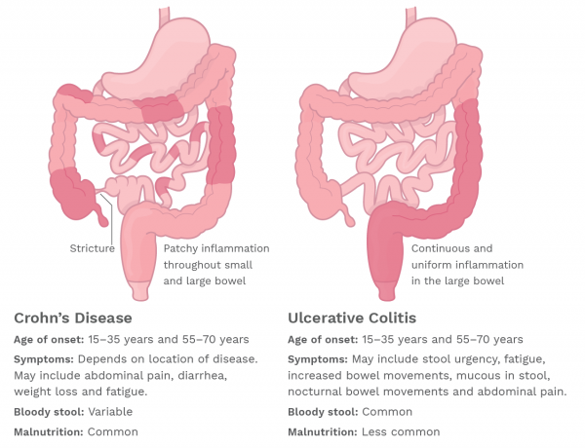
Crohn’s vs Ulcerative Colitis
Notes:
Here we can compare and contrast Crohn’s disease vs ulcerative colitis. The age of onset for both conditions is quite similar with average age of onset between 15-35 years or 55-70 years. Of note, we do see patients with both of these diseases that are much younger than 15 years at age of onset. The biggest difference between these two diseases are the symptoms and location of the disease.
The symptoms of Crohn’s disease, which appears on the left in this graphic, depend on the location of disease and may include abdominal pain, diarrhea, weight loss, and fatigue.
Bloody stools are variable, with some patients experiencing them while others do not and a malnutrition diagnosis is common. In Crohn’s there can be strictures and can affect both the small and large bowel with patchy inflammation.
UC appears on the right in this graphic, and symptoms may include stool urgency, fatigue, increased bowel movements, mucous in the stool, nocturnal bowel movements, and abdominal pain.
Bloody stool is more common in UC and malnutrition is less common. Ulcerative colitis has continuous inflammation and is present in the large intestines only.

Slide 4
Crohn’s Disease
Can affect any part of the GI tract from the mouth to anus
  Mostly commonly affects the end of the small bowel (ileum) and the beginning of the colon
Can affect the entire thickness of the bowel wall
Inflammation can “skip” or leave normal areas between patches of diseased intestine
Characterized by abscesses, fistulas, strictures, and partial or complete bowel obstruction

Slide 5
Ulcerative Colitis
Only affects the colon
Affects only the innermost lining of the colon
Inflammation of the intestine does not “skip”
Bleeding is more common in UC than Crohn’s

Slide 6
Nutrition Assessment

Slide 7
Potential Nutrition Related Concerns
Anemia
Poor appetite
Food aversions and fear of eating
Malabsorption
Weight loss
Malnutrition
Micronutrient deficiencies
Notes:
Anemia can be due to blood loss or poor intake
Poor appetite can be due to nausea, abdominal pain, bloating
Food aversions and fear of eating cause be due to abdominal pain, bloating, nausea, diarrhea, and goal to decrease trips to bathroom
Malabsorption can be due to inflammation, surgical resections, vomiting, diarrhea

Slide 8
Micronutrient Concerns
Iron
Ferritin
Vitamin D
Vitamin A
Vitamin E
Zinc
Selenium
Copper
B12
RBC folate
Notes:
Children with IBD at risk of developing nutrient def. due to reduced intake, restrictive diets, malabsorption, and excessive nutrient loss
-iron deficiency anemia common in IBD patients even under complete remission
-1 study found correlation between copper, serum iron, and zing deficiency at diagnosis; copper essential for absorbing iron from gut, when levels low, body may absorb less iron
-symptoms of micronutrient def: fatigue

Slide 9
Commonly Used Medications
Medication Class | Examples | Usual Route | Treatment Frequency | Immune Suppression | Starts to Work
Aminosalicylates (5-ASA) & Mesalamines | Sulfasalazine Mesalamine | Oral Suppository Enema | 1-2 times/day | No | 1 week
Corticosteriods | Budesonide Prednisone Methylprednisolone | Oral | 1-2 times/day | Yes with high doses | 24-72 hours, not for long term use
Immunomodulators | Azathioprine 6MP Methotrexate | Oral Injection | 1 time/day or 1 time/week | Yes | 4-6 weeks
Biologics (anti-TNF) | Infliximab Adalimumab Vedolizumab | Infusion Injection | Every 1-2 weeks or every 1-2 months | Yes | Varies, most start to see relief after 2nd dose
Notes:
The goal in treatment of IBD is to induce and maintain remission
Every patient responds differently to medications, this is just a guideline.

Slide 10
Estimating Nutrition Needs
Calories
  Needs are similar to those of healthy individuals
  Inflammation may increase needs – however, this is often offset by a decrease in activity
  EER x 1.0-1.4 or REE x 1.2-1.6
Protein
  RDA in remission
  120-150% RDA with active disease
Fluid
  100% maintenance
Vitamins and Minerals
  Provide DRI-RDA/AI for age
  Needs may be higher in individuals with malabsorption
  Therapeutic doses may be necessary for individuals with deficiencies

Slide 11
Common Nutrition Diagnoses
Altered GI function
Malnutrition
Impaired nutrient Utilization
Inadequate Oral Intake
Inadequate Vitamin/Mineral Intake
Document using PES statement and best clinical judgment

Slide 12
Goals of MNT
Improve quality of life
Help control symptoms of IBD
Maintain/Improve nutrition status
Maintain age appropriate growth/Prevent growth retardation
Prevent/Treat malnutrition

Slide 13
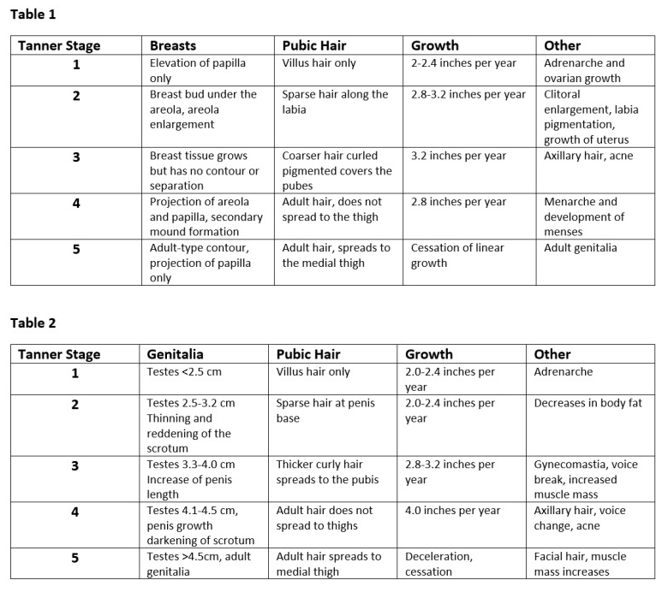
Tanner Stages
Poorly controlled IBD can lead to delays in puberty
IBD providers utilize Tanner Staging in pre-visit paperwork for patients ~11 years and older as an objective tool to assess pubertal stage
Delays in puberty often coincide with malnutrition
Notes:
On the right is an example of Tanner Staging for females in Table 1 and males in Table 2

Slide 14
Nutrition Interventions

Slide 15
Meals and Snacks
Age appropriate, general healthy diet including a variety of foods from all food groups
  Recent evidence supports the use of the Mediterranean Diet in treatment and prevention of flares in IBD
  Recent evidence also supports avoidance of Ultra-Processed Foods in treatment and prevention of flares in IBD
May eliminate foods that result in worsening symptoms
Diets that may be recommended in certain circumstances:
  Low fiber/Low residue – used short-term if strictures present
  Low lactose – used for lactose intolerance
Oral Nutrition Supplements as needed to meet estimated needs
Notes:
Foods that may trigger symptoms vary between individuals, so the patient will need to learn which foods cause discomfort. Once learned, these should be avoided in the diet.

Slide 16
Diet Education
Teaching Sheet: “Nutrition with Inflammatory Bowel Disease”
Popularized diets within the world of IBD, such as the Specific Carbohydrate Diet (SCD) and the Crohn’s Disease Exclusion Diet (CDED) are not currently used in our practice due to lack of evidence in superiority of treating IBD versus conventional methods that don’t heavily restrict foods for children/adolescents

Slide 17
Enteral Nutrition
Enteral Nutrition Therapy
  Polymeric formula may be given PO, via NG, or a combination.
  Provide 90 or 100% of calorie/protein needs with age-appropriate formula for 8-12 weeks.
  If 90% EN, patient can consume 10% of calories from any foods they choose, unless otherwise specified by care team.
  In addition to formula, patient may have water, sugar-free flavored water, Pedialyte, and clear, hard candies.
  Evaluate response after 4-6 weeks
Enteral nutrition may be otherwise indicated if patient unable to meet needs orally.

Slide 18
Different Diets
Notes:
Diets in IBD in general are constantly evolving but here are a few that have been popular or researched in recent years

Slide 19
Different Diets
Specific Carbohydrate Diet
Cinnamon and Benzoate Free Diet
Crohn’s Disease and Exclusion Diet
Mediterranean Diet
Notes:
Diets in IBD in general are constantly evolving but here are a few that have been popular or researched in recent years

Slide 20
Specific Carbohydrate Diet
Grain-free diet low in sugar and lactose thought to alter microbiome from ‘bad’ bacteria to ‘good’
Used as maintenance therapy, may still need nutrition therapy or medications to induce remission
Little evidence to support
Not taught or prescribed at CW, but support patients following this diet
RD role: assess nutrient intake

Slide 21
Specific Carbohydrate Diet
 | Not allowed | Nutrition Concerns/Solutions
Dairy | All milk and products high in lactose (mild cheddar, yogurt, cream, sour cream, ice cream). Lactose free milk not allowed. | Most milk substitutes not allowed- contain guar gum. Consider Calcium supplement such as Cal-EZ.
Meat & Protein | Canned/processed meats. Some legumes. | Eliminates many preferred kid foods.
Fruits/Vegetables | Canned produce with added ingredients or syrup.
Grains | All grains including corn, wheat, wheat germ, barley, oats, rice, other. | Try home baked goods using nut flours, coconut flour. Cauliflower rice. Plantain chips or almond crackers.
Nutrition Concerns:
  Weight loss
  Low calcium intake
Notes:
Weight loss due to high fat products such as dairy not allowed
-foods allowed/not allowed in IBD folder in GI folder

Slide 22
Cinnamon and Benzoate Free Diet
Used to treat orofacial granulomatosis, a condition associated with Crohn’s Disease
Affects mouth and lips
  Symptoms: swelling, redness, mouth ulcers, cracked lips
Helps 70% of people with orofacial granulomatosis
Notes:
Recommended to follow diet for 12 weeks and monitor improvements. Symptom diary
Read all labels, best to keep to fresh or home cooked food

Slide 23
Cinnamon and Benzoate Free Diet
Cinnamon
  Natural substance, does not always need to be stated on food labels
  Look for the words spices, spice extracts, ground cinnamon, mixed spice, cinnamon oil, cinnamal, or cinnamic aldehyde
Benzoates
  Most added to food and drinks as a preservative
  Fizzy drinks and processed foods
  Can occur naturally in certain foods
Flavorings
  Chemicals added to processed foods to improve flavor
  Recommended that products labelled with ‘flavorings’ or ‘natural flavors’ be avoided
Notes:
-Natural benzoate foods: tomato puree (very concentrated, tomatoes are fine), dried fruity, berries, spinach, prunes, peaches, papaya, nectarines, avocado, pumpkin, kidney beans, soy beans, chocolate, tea
-Even cosmetics, toiletries, and hygiene products can contain derivatives of cinnamon and benzoates used as preservatives or perfume agents. Unclear if contributes to OFG symptoms, but regardless advised to avoid

Slide 24
Crohn’s Disease Exclusion Diet
Whole foods diet that excludes or limits exposure to foods that may alter intestinal barrier function or affect microbiome
Always combined with partial enteral nutrition
Ideal for patients unwilling to use exclusive enteral nutrition
Three phases
Notes:
https://www.ntforibd.org/therapeutic-diets/crohns-disease-exclusion-diet/

Slide 25
Crohn’s Disease Exclusion Diet
Induction Phase – 1 (6 weeks)
  Limits insoluble fiber to prevent bowel obstructions
  50% of calories from formula
Induction Phase – 2 (6 weeks)
  Adds back in many vegetables by week 10
  25% of calories from formula
Maintenance Phase – 3
  Used after remission is achieved and to sustain remission

Slide 26
Mediterranean Diet
A study found that Mediterranean diet may be preferred to Specific Carbohydrate Diet in those with mild to moderate Crohn’s disease symptoms due to ease of following and other health benefits associated with Mediterranean diet
Focuses on foods in their natural forms
  Focuses on fruits, vegetables, whole grains, beans and legumes, nuts and seeds
    Limit processed, packaged, or canned foods
Allows for variety
  Not as restrictive as other diets, can eat different foods
Supports healthy lifestyle

Slide 27
Lab and Supplementation Guidelines

Slide 28
Lab Guidelines
Yearly labs (ideally in spring)
  25 OH Vitamin D
  Ferritin
  Blood Iron &TIBC w/ % saturation
Other labs to consider
  Zinc
  Vitamin B12
  MMA
  CBC with auto differential
  Reticulocyte count
Notes:
-Zinc: check annually for all Crohn’s patients
-VB12: history of ileal or ileocolonic resection or ideal pouch anastomosis; consider where B12 malabsorption suspected
-MMA: if serum B12 is low (<400)
-CBC w dif: if not drawn in last 3-6 months
-reticulocyte: consider in patients with low Hgb, on PO or IV iron supp

Slide 29
Supplementation
Multivitamin
  ≤ 8 years: standard complete multivitamin
  9+: prenatal vitamin
Vitamin D
  Supplement if <30
  Weight based daily dosing or weekly/monthly dosing for patient’s with poor compliance of daily supplements
  Available in chewable, gummy, tablet, or liquid over the counter
  D2 for weekly/monthly dosing, usually needs to be ordered through pharmacy
B12
  Consider supplementation if low and MMA > 400
  Intranasal, subcutaneous, or high dose oral supplement
Zinc
  Consider supplementation if below reference range
  Tablet or capsule
Notes:
MVI: 8 – flintstones complete chewable; 9: naturemade multi prenatal tablets
-do not provided enough iron, D, zinc to replace depleted stores but may help prevent future deficiency
Prenatal is recommended for those >9 due to increased iron and folic acid content

Slide 30
Iron Supplementation
Oral/enteral
  Recommended for patients with mild anemia (Hgb ≥ 10 g/dL), patients with quiescent disease
    Dosing:
      Mild-moderate deficiency: 2-3 mg elemental iron/kg/day divided into 1-2 doses
      Severe deficiency: 4-6 mg elemental iron/kg/day divided into 3 doses
      Give maximum of 130 mg/day elemental iron
IV
  Consider for patients with moderate to severe anemia (Hgb < 10 g/dL), active disease, history of intolerance to oral iron
  Ensure IV iron is needed
    Hemoglobin/hematocrit, consider reticulocyte count
    Ferritin, serum iron, TIBC, transferrin saturation
    Blood transfusions or IV iron infusions within past 6 months
    Inflammatory status
      May consider delaying infusion if patient has severe inflammation
      or infection
Notes:
Ensure IV iron is needed, multiple assessments should be reviewed before prescribing

Slide 31
Supplementation Monitoring
Iron
  After starting supplementation:
    Repeat CBC and iron studies in 1-3 months
      If poor response to oral iron, consider changing to IV iron and/or consider if patient has anemia of chronic disease
  After HgB has normalized:
    Continue supplementation for 4-6 months if patients are in remission, recheck 3-6 months after stopping supplementation
All other micronutrients
  Recheck nutrients 3-6 months after supplementation
  Recheck labs yearly after normalizing
Notes:
Mention the IBD nutrition lab guidelines that are on the GI Q drive that have additional information on dosing

