Slide 1


Neonatal and Infant Nutrition

Slide 2
Outline
Classifying Neonates
The Premature Infant
  Macronutrient Requirements
  Micronutrient Requirements
  Growth Velocity
  Formula, Fortifiers, and Modulars
The Term Infant
  Macronutrient Requirements
  Micronutrient Requirements
  Growth Velocity
  Formula and Modulars
General Feeding Guidelines and Beyond

Slide 3
Gestational Age and Stages of Infancy
Gestational age (GA)
Preterm <37 wga
Term 37-42 wga
Post-term >42 wga
Stages of Infancy
Neonate: up to 30 days of life
Infant: 0-12 months

Slide 4
Growth Classifications
Birth Weight
Large for gestational age (LGA) | >90%ile
Small for gestational age (SGA) | <10%ile
Intrauterine growth restriction (IUGR) | <10%ile for GA
Low birth weight (LBW) | <1500-2500 grams
Very low birth weight (VLBW) | <1000-1500 grams
Extremely low birth weight (ELBW) | <750-1000 grams
Micropremie | <750 grams
Notes:
The table shows how to classify infants based on their growth. (read chart?)

Slide 5
The Premature Infant
Notes:
Next we will be discussing specific recommendations for the premature infant.

Slide 6
Adjusting for Prematurity
If patient was born prior to 37 weeks, “correct/adjust” until 24 months chronologic age
  How to adjust for prematurity:
    Adjustment for prematurity = 40 weeks – gestational age at birth
    Corrected gestational age (CGA) = chronological age – adjustment for prematurity
    Example: you are seeing a 3 month 2 week old patient born at 32 weeks
      Adjustment for prematurity = 40 – 32 = 8 weeks
      Corrected gestational age = 3 months 2 weeks – 8 weeks = 6 weeks corrected gestational age or 1.5 months CGA
        Assume there are 4 weeks in each month
  This can be viewed by clicking the box to the right of the growth chart that says “Show gestation-adjusted age chart”
Notes:
Infants born premature require you to correct their age to account for prematurity. To do this ***You may calculate CGA In weeks or months. Ex: 6 weeks CGA is equivalent to 1.5 months CGA

Slide 7
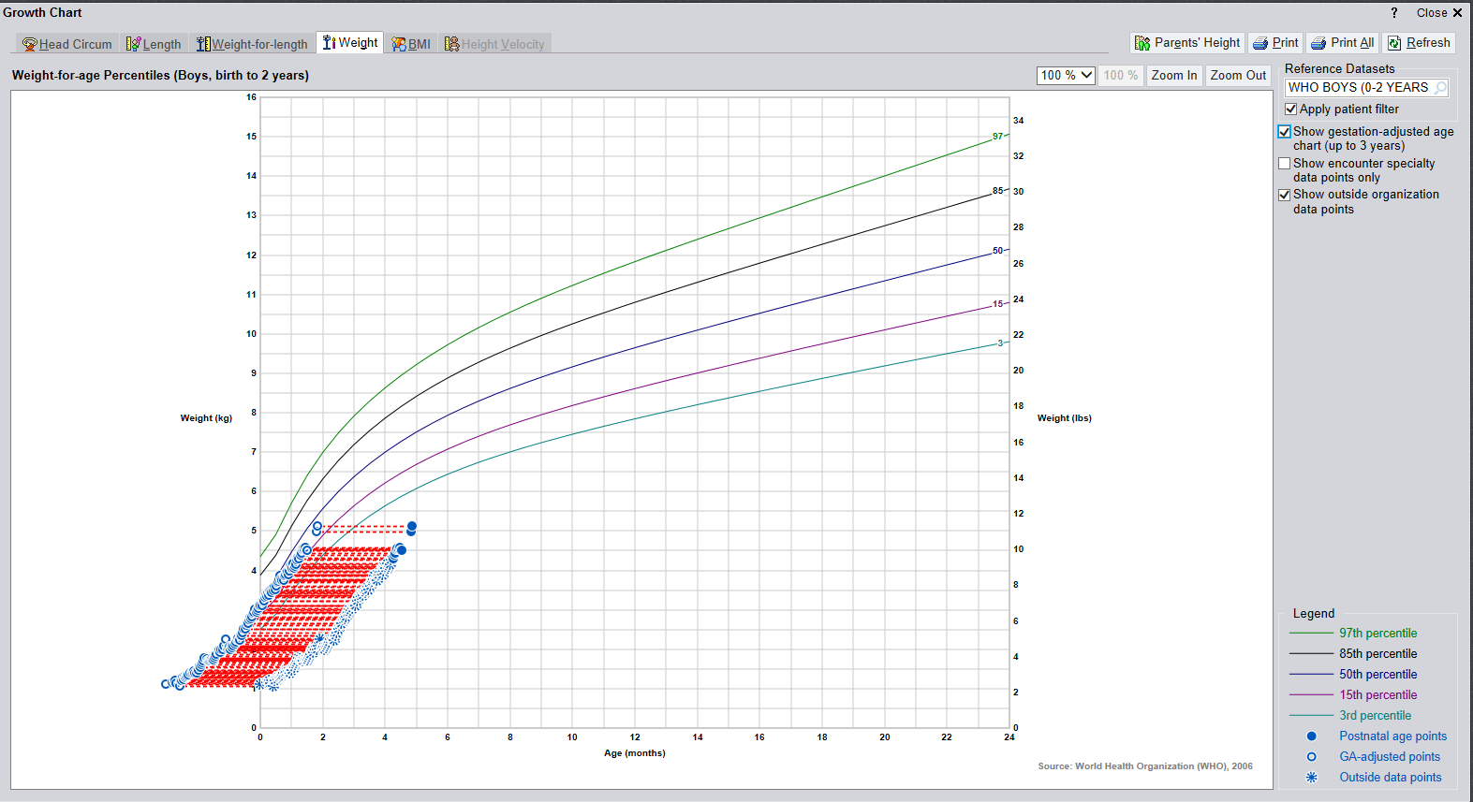
Sample WHO Growth Chart
Corrected for Prematurity
Notes:
When looking at the WHO growth chart, you can check the box that says show gestation adjusted age chart to find the corrected Z score. These are the Z scores you will use for documentation. You will start using the WHO growth chart once a pt corrects to 44 weeks GA ***

Slide 8
Case Study – Calculate the CGA
Baby boy is 6 months 3 weeks old, born premature at 27 weeks.
Baby girl is 1 year 3 months old, born premature at 30 weeks.
Baby girl is 2 year 5 months old, born premature at 36 weeks.
Notes:
14 weeks
54 weeks or 1 year 2 weeks
Do not calculate CGA after 2 years of age

Slide 9
Macronutrient Needs
Weight | Calories (per kg) | Protein (per kg) | Fluid (per kg)
<1500 grams | 110-135 | 4-4.5 | 135-200
1500-1800 grams | 110-135 | 3.5-4 | 100-180
>1800 grams | 110-135 | 3-4 | 100-180
*Based on ESPGHAN Recommendations
Notes:
Macronutrient needs including calories, protein and fluid will vary based on birth weight. ( Read chart ?).

Slide 10

Micronutrient Needs: MVI and iron
Required for all premature infants
Each 1 mL MVI with Fe provides 11 mg elemental iron and 400 units Vitamin D
Dosing:
Continue supplementation until 1 year corrected gestational age
Notes:
Preterm infants or term infants at risk for anemia should receive iron to promote brain development

Slide 11
Micronutrient Needs: Sodium
Essential electrolyte for neurological development and adequate growth
Requirements for Na may be much greater for individual infants due to renal immaturity, growth, or administration of natriuretics (i.e. theophylline, caffeine, diuretics, or dopamine).
Hyponatremia my be a problem after the first week of life due to excessive fluid administration and increased urinary excretion of sodium.

Slide 12
Sodium Requirements
Daily requirement:
  2-5 mEq/kg/day
  Not required in the first 24 hours of life until urine output is established.
Sodium Dosing for Preterm Infants
Gestational Age | Na dosing
23-25 week gestation | 4 mEq/kg
26-28 week gestation | 2-3 mEq/kg
29-32 week gestation | 2-3 mEq/kg or as necessary

Slide 13
Micronutrient Needs: Sodium
Monitoring
  Monitor total fluid intake and sodium load including maintenance fluids, medications, and medication drips.
  For preterm infants, obtain a urine sodium at 4 weeks of life to determine if supplementation is adequate.
  Goal is urine sodium >20. If <20, will need to provide supplementation.
    No need to obtain urine sodium level if pt is on diuretics as level will be inaccurate.

Slide 14
Micronutrient Needs: Zinc
Role: part of many enzymes; involved in immune reactions, wound healing, and normal development of fetus
Acquired in third trimester of pregnancy, therefore increased needs in preterm infant
TPN:
    <37 weeks GA: 400 mcg/kg/day
    37 weeks GA – 1 year CGA: 250 mcg/kg/day
    Increased needs with GI losses
Enteral
    For premature infants, start supplementation based on fortifier.
    Continue fortification until pt is 37 weeks or on premature discharge formula
Formula | HM + Powder HMF or Prolacta | HM + Liquid HMF | Enfamil Premature Regular or High Protein
Dose | 1 mg/kg/day | 0.75 mg/kg/day | 0.5 mg/kg/day

Slide 15
Micronutrient Needs: Magnesium, Phosphorus, Calcium, Vitamin D
Indications:
  Radiographic evidence of osteopenia of prematurity
  Underlying conditions such as long term TPN use, malabsorption/high ostomy output or chronic diuretics/steroids.
Lab indications:
  Significantly elevated alkaline phosphatase without evidence of cholestasis
  Hypocalcemia
  Hypophosphatemia
  Hypomagnesemia
Dosing:
  Refer to the NICU handbook for dosing of bone supplements
Monitoring:
  Monitor ionized calcium, phosphorus, alkaline phosphatase, magnesium every 1-2 weeks. Consider checking 25 OH Vitamin D Total.
Notes:
Called bone supplements in the NICU for osteopenia of Prematurity

Slide 16
Growth Goals
  Weight
    <2 kg or <35 weeks: 15-20 g/kg/day
    >2 kg or >35 weeks: 25-35 g/day (or ~15 g/kg/day)
    3-6 months CGA: 15-21 g/day
  Length and OFC
    Increase 0.5-1 cm/week

Slide 17
Case Study
Sam is a 2.5 week old, ex 29 6/7 weeker who is advancing feeds with 24 kcal/oz EBM + Liquid HMF and is coming off TPN. Weight at birth was 1.34 kg and current wt is 1.5 kg.
What are his micronutrient needs and goal feeds?
What supplements do you need to add?
What weight gain goals do you expect?
Notes:
Calories: 110-135 kcal/kg, Protein 4-4.5 g/kg, Fluids 135-200 ml/kg. Advance to 150 ml/kg or 28 ml q 3 hours to provide 149 ml/kg, 119 kcal/kg and 3.6 g/kg protein

Slide 18
The Term Infant

Slide 19
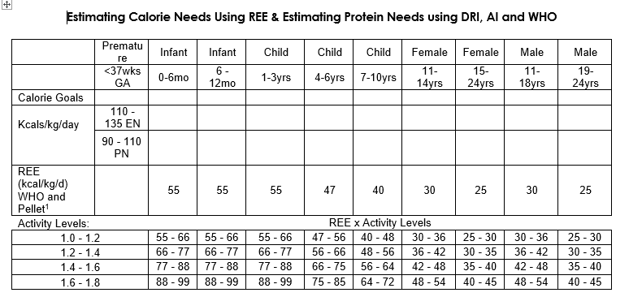
Macronutrient Needs: Calories
Notes:
For patients on TPN, calculate REE based on activity level, then subtract 12% -15% of the calories to take into account the thermic effect of food which is absent when TPN is provided which drops calories down an activity level. For example: If providing 99 kcal/kg EN (1.6-1.8), decrease to 88 kcal/kg for PN (12% decrease or REE x 1.4-1.6)

Slide 20
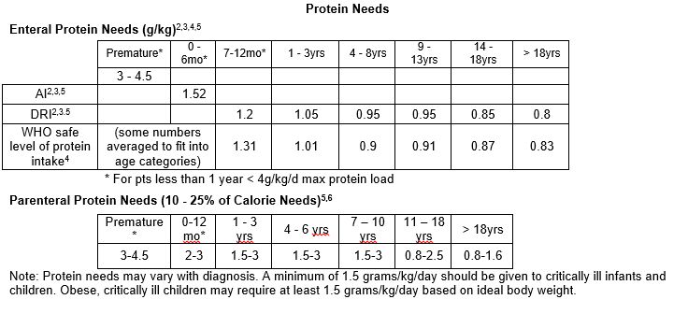
Macronutrient Needs: Protein

Slide 21
Macronutrient Needs: Fluids
Calculating Fluid Needs: Holliday Segar Method
<10 kg | 100 ml/kg
>10 - <20 kg | 1000 ml + 50 mls/kg for each kg above 10 kg

Slide 22
General Feeding Guidelines: Human Milk and Formula
 | Birth to 6 months | 6-7 months | 8-9 months | 10-12 months
Human Milk | 8-12 feeds per day with 6 or more wet diapers per day by 5-7 days of life | After solid food introduction, baby should not be feeding any sooner than every 2-3 hours
Infant Formula | Birth: 2-3 oz every 3-4 hours By 1-2 months: 4 oz per feed every 4 hours | 4-5 feedings with 6-8 oz formula per feed | 3-4 feedings with 7-8 oz formula per feed | 3-4 feedings with 24-32 oz formula per day
*Do not prop your baby’s bottle. When bottle feeding, cradle your baby in a semi upright position and support their head.
*Infants less than 6 months of age do not need extra water for hydration even in hot, dry climates. If your baby is sick, talk with their doctor before giving your baby fluids other than breast milk or infant formula.

Slide 23
Micronutrient Needs – Vitamin D
Term Infants
  Provide 400 units Vitamin D for infants taking <1L of formula or receiving human milk.
Continue supplementation until 1 year unless infant is taking >1L of formula
Provide MVI in place of Vitamin D when:
  Additional micronutrients are needed such as s/p surgery, wound healing, malnutrition and in LGA infants due to increased blood volume.
  An infant is unable to start solid foods at 6 months of age, as iron stores accumulated during the third trimester have been depleted.
Notes:
Dosing on next page for MVI

Slide 24
Micronutrients – MVI and Fe
Each 1 mL MVI with Fe provides 11 mg elemental iron and 400 units Vitamin D
Dosing:

Slide 25
Growth Velocity
Weight Velocity for Males (g/d)
Age (months) | 3rd-5th | 15th-25th | 50th | 75th-85th | 95th-97th
0-3 | 23-33 | 23-36 | 26-39 | 30-39 | 30-46
3-6 | 10-20 | 13-20 | 13-20 | 13-23 | 16-23
6-9 | 7-10 | 7-10 | 10-13 | 10-13 | 10-16
9-12 | 3-10 | 7-10 | 7-10 | 7-10 | 10
Peditools provides goal weight gain to continue current trend
If infants were born prematurely, their weight gain goals are based on corrected age until they turn 2 years old (chronologic age)
Weight Velocity for Females (g/d)
Age (months) | 3rd-5th | 15th-25th | 50th | 75th-85th | 95th-97th
0-3 | 20-26 | 20-30 | 23-33 | 26-36 | 30-39
3-6 | 10-16 | 10-16 | 13-20 | 13-20 | 16-23
6-9 | 7-10 | 10 | 10 | 10-13 | 10-16
9-12 | 3-7 | 7 | 7-10 | 7-10 | 10

Slide 26
Case Study
Nala is a 2 month old female, born at 40w4d, with no past medical history who is presenting with poor weight gain. Family reports she takes 2.5 oz Similac Pro Advance q 3 hours x 6 feeds daily.
  Weight History:
    Birthweight (4/23): 3.03 kg
    2 weeks (5/7): 3.46 kg
    2 months (6/23): 4.23 kg
What is patient’s current nutrient intake?
What is your macronutrient prescription?
What supplementation would you recommend?
Notes:
Gaining 16 g/day average x 47 days
A1: Currently receiving 106 ml/kg, 71 kcal/kg, 1.48 g/kg protein.
A2: Nutr rx: >100 ml/kg, at least 88-99 kcal/kg, >1.52 g/kg protein
A3: 400 units cholecalciferol daily

Slide 27
Formula, Fortifiers, and Modulars

Slide 28
Premature Infant Formula
Category | Indications | Brand Name(s)
Human Milk Fortifier (HMF) (Hospital Only) | < 1800g and/or < 34 weeks GA Higher in protein, vitamins, and minerals Not for use > 3.5 kg Only used when added to breast milk, not for use alone | Enfamil Powder HMF (CW) Enfamil HMF Acidified Liquid (not at CW) Enfamil Liquid HMF HP (trial) Enfamil Liquid HMF Standard Protein (trial) Similac HMF (powder & liquid) Similac HMF Hydrolyzed Liquid (liquid) (CW) Prolacta (CW – per protocol only)
Premature (Hospital Only) | < 1800g and/or < 34 weeks GA Higher in whey protein, lower in lactose, higher in MCT Higher in protein, vitamins, and minerals | Enfamil Premature (CW) Enfamil Premature High Protein (CW) Similac Special Care Similac Special Care High Protein
Premature Discharge/ Transition | >34 weeks for up to 12 months corrected age. May be indicated in the late preterm infants (34 – 37 weeks). Higher in protein, vitamins, minerals than term home formulas. | Enfamil (NeuroPro) EnfaCare (CW) Similac Neosure

Slide 29
NICU Fortifier – Prolacta
Only for mom’s who are providing 100% breast milk
Protocol for reference
  23 – 26 wga
  NO IUGR or NEC
  BW < 1250 g
  Continue until 32 weeks (4 step transition off)
  Fortification begins at 80 mL/kg
Calorie Levels
  +4 (24 cal/oz)
  +6 (26 cal/oz)
  +8 (28 cal/oz) – +6 with added cream to make 28 cal/oz
Considerations
  Growth, serum lytes
    Automatically on NaCl supplementation
  Lower in protein and iron
Notes:
Based off of Texas Children’s Hospital. All human milk fortifier that reduces the risk of NEC

Slide 30
Term Infant Formula
Category | Indications | Brand Name(s)
Standard, cow’s milk based formula | Term infants | Enfamil NeuroPro Infant (CW) Good Start Gentle Similac Pro-Advance
Soy | NOT ideal for the preterm infant. For the pure vegetarian Not hypoallergenic Galactosemia (lactose free) | Enfamil Prosobee (CW) Good Start Soy Similac Soy Isomil
Low Lactose | Lower amount of lactose (not lactose free) Not evidenced based (except NAS) | Enfamil NeuroPro Gentlease – 30% lactose (CW) Similac Pro-Total Comfort– <1% lactose (CW) Good Start Soothe Similac Sensitive
Added Rice Starch | Thickens in acidic environment of stomach (concurrent PPI use is discouraged). Only up to 24 kcal/oz NOT ideal for preterm infants | Enfamil AR (CW) Similac for Spit Up

Slide 31
Infant Formula
Category | Indications | Brand Name(s)
Hydrolysate | Considered hypoallergenic For cow’s milk protein allergy/intolerance | Nutramigen (CW) * with and without probiotics (LGG) Pregestimil (CW) Similac Alimentum (CW) Gerber Extensive HA
Elemental | 100% amino acid Hypoallergenic For cow’s milk protein intolerance that does not respond to hydrolysate formula | EleCare for Infants (CW) Neocate Infant PurAmino Alfamino

Slide 32
Modulars
Liquid Protein
  Liquid, extensively hydrolyzed liquid protein fortifier
  Only available for NICU through the milk kitchen
  1 gram protein/6 mL = 4 calories
SolCarb
  Powder additive
  Provides additional calories from carbohydrate
  23 kcal/TBSP
Beneprotein
  Powder additive
  Provides calories from whey protein
  17 kcal, 4 g protein/TBSP

Slide 33
Modulars
MCT Oil
  Used to increase fat calories in pts with malabsorption (ex. Short bowel, pancreatic insufficiency), liver disease, chylous effusion
  7.7 kcal/mL
Vegetable Oil
  Can use Canola, Olive, any other family preferred oil
  Adding fat calories to patients with no malabsorption/GI concerns
  8 kcal/mL
Generally not recommended to add oil to formula when pt has risk of aspiration

Slide 34
Modulars
Duocal
  Powder additive
  Provides additional calories from fat (59%) & carbohydrates (41%)
  42 kcal/TBSP
Pectin
  Liquid additive
  Used to slow down intestinal transit time
  Primarily used in infants with short gut/ostomies
  RD will help to determine appropriate dose
    Typically start at 1% volume and increase to max 3%
  Can be found outpatient

Slide 35
Modulars
Thickeners
  Only for use when recommended by speech therapy.
Rice Cereal
  Should never be added to bottles as a thickening agent
    Digestive system is not ready until 6 months of age
    Increase likelihood of gagging and/or aspiration when added to a bottle
    Exposure to solids before 4 months can lead to increased risk of developing food allergies.
    Can lead to overfeeding with inappropriate macronutrient distribution.

Slide 36
Case Study
Alex is a 48 day old term infant admitted for bronchiolitis who is gaining 12 grams/day.
  Weight: 3.3 kg
  Nutrition: NPO, currently receiving 20 kcal/oz Enfamil NeuroPro Infant at 50 ml q 3 hours via NG tube
What nutrition changes do you recommend?

Slide 37
Case Study
Advance total fluids:
  Infants can increase to 150-180 ml/kg.
Increase fortification:
  Start by fortifying to 22 vs 24 kcal/oz and monitor weight trends. If trends remain poor, further increase to 27 kcal/oz.
Adding modulars:
  Consider addition of oil (MCT, vegetable, olive), Duocal or Beneprotein.
Consider checking urine Na and adding NaCl to promote growth, especially if history of prematurity
Notes:
*Voice over- discuss progression - first step of fluids, if unable to tolerate volume, fortify. If fortification is not tolerated or is maxed out, then add modulars.

Slide 38
Calculating Formula Recipes
Notes:
We will now go through how to calculate formula recipes.

Slide 39
Calculating Formula Recipes
Items to know:
  Displacement – amount of fluid each gram of powder will displace
  Grams of powder per scoop
  Calories per gram of powder
Example: Create a recipe for 600 ml of 24 calorie per ounce Enfamil NeuroPro Gentlease
  8.7 grams powder per scoop
  44 kcals per scoop OR 5.1 kcal per gram powder
  Displacement: 0.76
Notes:
In order to make a formula recipe or determine the calorie concentration a family has been making, we need to know 3 things: - how much water each g of powder displaces, how many grams of powder are in a scoop, and how many calories in each gram of powder.

Slide 40
Calculating Formula Recipes
Steps
  Calculate the total calories needed: 600 ml x 0.8 (24 cal/30 ml) = 480 kcals
  Determine amount of grams needed: 480 kcals / 5.1 cal per gram = 94 grams powder
  Calculate displacement: 94 grams powder x 0.76 (displacement factor) = 71 ml
  Calculate total volume of water to add: 600 ml (total volume) – 71 ml (displacement) = 529 ml water OR 525 ml water to round to 17.5 oz for ease of mixing.
  Instruct family to mix 525 ml water + 94 grams Enfamil NeuroPro Gentlease powder to make ~600 ml of 24 cal/oz formula.
Notes:
Displacement is how much water will be displaced when the powder is added further increasing the volume.
8.7 grams powder per scoop
44 kcals per scoop OR 5.1 kcal per gram powder
Displacement: 0.76
Make 600 mL of 24 cal/oz formula: Take 600 mL * (24 calories/30 mL) = 480 kcal.
Determine how many grams of powder needed: 480 calories / 5.1 calories/g = 94 g powder
Determine displacement from powder: 94 g powder * 0.76 mL/g = 71 mL
Calculate total volume of water needed: 600 mL (total for recipe) – 71 mL (displacement) = 529 mL water
Recipe for family = 529 mL + 94 g Enfamil NeuroPro Gentlease = ~600 mL 24 cal/oz ( can then work backwards to double check work)

Slide 41
Case Study
Family reports Henry (7 month old, weighing 7.5 kg) is taking Good Start Gentle, mixing as 5.5 oz + 4 scoops. He drinks 6 oz per feed 6 times per day. He does not yet consume solid foods.
  Calculate the concentration of the reported recipe.
  Calculate the amount of fluid, calories and protein the patient is receiving
  What formula do you put the patient on when inpatient?
  What other concerns do you have?
Notes:
1. 27.8 cal/oz and a total volume of 6.4 oz
2. 144 ml/kg, 133 kcal/kg and 2.9 g/kg protein
3. Enfamil NeuroPro Infant
At risk for iron deficiency due to no solid food intake. Recommend changing to 1 ml MVI with Fe. Consider speech consult
Take some time to work through this case study on your worksheet.

Slide 42
Introducing Solids
Notes:
When baby is developmentally ready, families should begin introducing solid foods.

Slide 43
Introducing Solids
American Academy of Pediatrics recommendations:
  Exclusive breast feeding until 6 months of age
  Introduce solid foods around 6 months of age
Complementary foods may start around 6 months of age
  Try one new “single-ingredient” food at a time. Wait 2 to 3 days before starting another. Monitor for allergic reactions such as diarrhea, rash or vomiting.
  Keep your baby in a highchair when feeding solids.
Notes:
The AAP recommends human milk or infant formula exclusively for about 6 months. When baby can hold their head up, open their mouth when food is coming their way, and no longer has the tongue thrust reflex, then they may be ready to start complementary foods.

Slide 44
General Feeding Guidelines
Continue to feed based on hunger cues such as putting hands and fingers in their mouth or turning their head away when full
Feedings should last no longer than 20-30 minutes
At 6 months of age, infants have used their iron stores and now require iron fortified foods such as fortified infant cereals or meats.
Notes:
Families should continue to honor baby’s hunger and satiety cues.

Slide 45
General Feeding Guidelines
 | Birth to 6 months | 6-7 months | 8-9 months | 10-12 months
Oral Feeding Skills | Coordinated suck-swallow-breath | Inconsistently opens mouth for spoon; attempt to close lips on spoon More consistent mouth opening and lip closure on spoon | Pick up solids and bring to mouth; attempts to bite pieces; early up-down chewing | Efficient skills for spoon feeding; tongue mashing pieces Improved chewing; moves food to side with tongue
Appropriate Textures | Thin liquids (breast milk, formula) | Smooth, thin purees Smooth, thicker purees | Fork-mashed solids Easily dissolvable solids | Textured purees Diced/chopped solids 1/2 “ or smaller
Notes:
Adapted from Pediatric Nutrition 4th edition. Samour and King. Table 5-12
Here is an overview taken from the Pediatric Nutrition textbook from Samour and King (Table 5-12) of the progression of feeding skills and the appropriate textures.

Slide 46
General Feeding Guidelines: Solids
 | 6-7 months | 8-12 months
Grains | 1-2 servings 2-4 tbsp. infant cereal | 2 servings 2-4 tbsp. infant cereal / ½ slice bread / 2 crackers / 3-4 tbsp. pasta
Fruits and Vegetables | 1-2 servings 2-3 tbsp. pureed fruits and/or vegetables | 2-3 servings 3-4 tbsp. fruits and/or vegetables
Proteins | 1-2 servings 1-2 tbsp. pureed meat or legumes | 2 servings 3-4 tbsp. meat / 4 tbsp. legumes / ½ oz cheese / ½ cup yogurt
Notes:
Here are further guidelines for appropriate serving sizes and daily intake.

Slide 47
Foods to Avoid
Do not give honey or Karo Syrup under one year of age as it can cause botulism.
Avoid small pieces of food that are hard and sticky such as:
  *Babies can choke on thick clumps of peanut butter. Instead, mix it into a puree or spread thinly on a cracker
Fruit juice, Kool-Aid®, fruit punch, soda, sugar water, tea or coffee.
Fried foods, high fat gravies, sauces or processed meat such as bologna.
Grapes | Raw Vegetables | Raisins | Gum
Nuts | Pretzels | Chips | Popcorn
Candy | Hot Dogs | Fruit Leather | Peanut Butter *
Notes:
While we want baby’s diet to include a variety of healthy foods, here are foods that should be avoided in the first year of life. Babies can choke on small pieces and hard, thick, or sticky food such as those included in the table.
Healthy babies don’t need extra water, however starting at 6 months babies may have 1-2 oz water when solids are started. This is a good opportunity for families to start practicing using an open cup.

Slide 48
Introducing Food Allergens
May introduce common allergens once solids are started.
Offer peanuts, wheat, eggs and fish in a safe form:
  Add 2 teaspoons of creamy peanut butter or powder peanut butter to oatmeal or a puree such as banana
  Offer peanut puffs
  Whole wheat infant cereal
  Scrambled eggs, small pieces of flaky fish
  Offer jarred or premade infant foods that contain these allergens (such as PB/Banana pouch)
Notes:
Common allergens, including peanuts, can be introduced in a safe form once solids are started. Current research indicates that peanut avoidance is associated with greater frequency of peanut allergies than with peanut consumptions. Families should talk to their pediatrician if baby has severe eczema or an immediate allergic reaction to any food.

Slide 49
Baby Led Weaning (BLW)
What is it?
  Skips purees and instead offers soft table foods as first foods, allowing the baby to self-feed
    Also known as Baby Led Solids
    “Baby leads the way”
BLISS: Baby Led Introduction to Solids
  No difference in BMI-for-age z-score at 12 and 24 months
  No difference in rate of choking or iron deficiency
  Less fussiness and greater enjoyment of food
Notes:
BLISS study (2015): 206 New Zealand families randomized to modified BLW vs control group, Baby Led Introduction to Starting Solids
A common approach that families may utilize to introducing solids is baby led weaning. Presumed advantages include: lower risk of obesity, better diet quality (short vs long term), favorable caregiver feeding practices, encourages fine motor development. Presumed disadvantages: iron (and potentially other nutrient) deficiencies, increased incidence of choking, growth faltering, inappropriate family foods, inattentive feeding by caregivers

Slide 50
Implementing BLW
Encourage to be a good fit
  Family able to perform infant CPR
  Understand difference between gagging and choking
  Can parent be fully attentive
  Will other children or distractions be present?
Be prepared for a mess
Emotional readiness
  Stay neutral, not reactive, promote positive environment
  Allow exploration – may be several weeks before taking adequate amounts to provide nutrients
  Not all babies/parents will be successful – this is okay!
Notes:
Here are some considerations for BLW, but remember that the approach to introducing solids can be a spectrum and include components of both traditional spoon feeding and baby led weaning. Ultimately, it comes down to what will work best for a family.

Slide 51
Women, Infants and Children Program (WIC)

Slide 52
WIC –Women, Infants and Children Program
https://www.dhs.wisconsin.gov/wic/index.htm
National Program
Eligibility
  Meet the income guidelines found on the website using the link above
  Have a health or nutrition need
  Be in any of these categories
    Pregnant
    Breastfeeding a baby under 1 year of age
    Had a baby or was pregnant in the past 6 months
    Baby under age 1
    Child younger than age 5
WIC form will need to be completed for the state the patient resides in
  Ex: Michigan resident being followed at Children’s would need a Michigan WIC form.
Notes:
Case study – fill out wic form. What to tell family. Where to get specialty formula (Elecare) WIC form – when it is needed. What WIC provides food vs formula, link to amt they provide.
WIC is a national, federally funded program that provides supplemental nutrition for Pregnant, Breastfeeding, and post partum women, infants, and children younger than 5 years old at nutrition risk. WIC provides nutrition education, breastfeeding education and support, supplemental nutritious foods, and connection to other community services. Special formulas can be provided to families with a completed WIC form. This form is state specific .

Slide 53
WIC Food Benefits
Provides
  Fruits and vegetables (fresh, frozen, canned)
  100% juice
  Whole wheat/whole grain foods: 100% whole wheat bread, brown rice, soft corn or whole wheat tortillas
  Cereals
  Beans, peas, lentils (canned or dried)
  Peanut butter
  Canned fish (light tuna or pink salmon)
  Milk, eggs, cheese
  Infant cereals, fruits and vegetables, and meats
Formula
  Standard contract formula (no WIC form needed)
  Exempt (special) formula for infants and children with a WIC prescription
Notes:
Here is a list of benefits provided from WIC. Always check the brand of formula WIC will be providing as it varies by state and can change yearly.

Slide 54
WIC – How it works!
If eligible, parents should call to make a WIC appointment prior to discharge.
Cannot be seen in WIC office until infant is discharged.
Bring a WIC form if needed for specialty formula
WIC will provide a card to obtain formula at stores. They do not provide cans of formula.
  It is considered supplemental and therefore family may need to purchase some formula out of pocket
If using a specialty formula (such as Elecare), family will need to have a pharmacy order it.
Notes:
Here is how it using WIC works. Family makes a WIC appointment. If specialty formula is needed, they should bring their WIC form. After their appointment, family’s card will be loaded with their benefits. Family then goes to the store to obtain foods/formulas. Note that specialty formulas may not be as readily available as standard formulas, requiring extra steps to obtain.

Slide 55
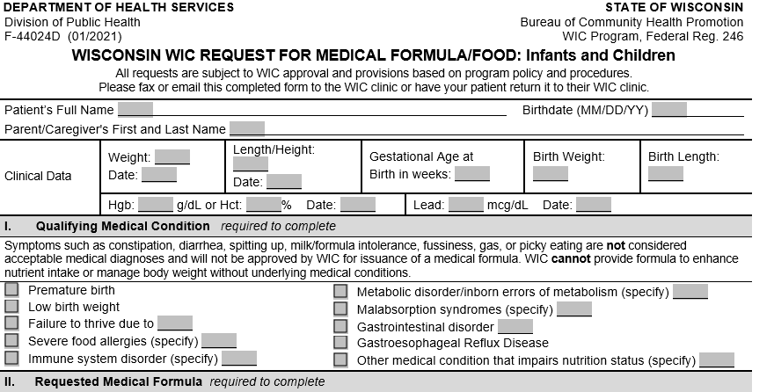
WIC Form
Fill out Parent/Patient Name and DOB along with any weight, length and lab information you have
Section I: Check the qualifying condition and specify rationale if needed
Notes:
Here is the Wisconsin WIC form. Again, this form is state specific. You need to fill out Patient’s name, date of birth, caregiver name, height, weight, and any other clinical information you have.

Slide 56
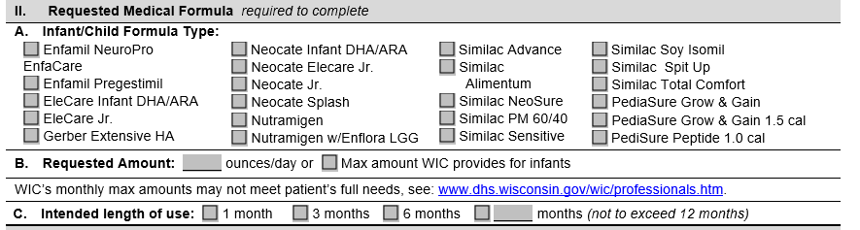
WIC Form
Section A: Check the appropriate formula. Remember you do not need a WIC form for standard formula
Section B: Fill out the requested amount. Use the link in the form to determine max amount of formula the patient will receive.
Section C: Choose an intended length of use
Notes:
Fill out all sections under Requested Medical Formula

Slide 57
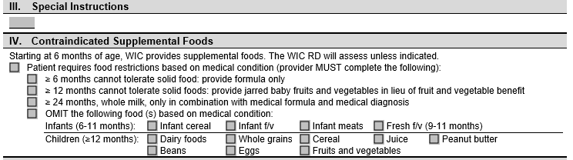
WIC Form
Section III: Fill out special instructions if needed.
Example:
Home feeding regimen
If the pt has a trach and vent, fill out this section to say ‘patient is exempt from WIC visits due to complex medical needs.’
Section IV: Choose contraindications if necessary
Notes:
Contraindications such as pt is all tube fed and does not take PO, so check the appropriate box to provide only formula OR omit PB for allergies.

Slide 58
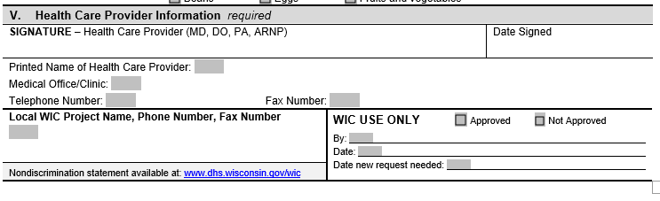
WIC Form
Section V: Must be signed and dated by a provider.
Use RD telephone and fax number for questions. Place RD name either in special instructions or next to telephone number

Slide 59
Case Study
Henry is now being discharged on 27 cal/oz Elecare For Infants PO ad lib and qualifies for WIC.
He does not consume solids and will work on this with speech as an outpatient.
Discharge Weight 7.7 kg (11/2/2020)
Height 27 inches (10/30/2020)
Fill out a WIC form for Henry
What education do you need to provide family when giving them the WIC form?
Notes:
2) Formula mixing education. Call WIC office to set up a visit in order to receive benefits. Will need to call a pharmacy to order Elecare as it is not found in stores. This should be done ASAP as it can take awhile to receive the formula.
Take some time to work through this case study on your worksheet. This is the last case study on the work sheet and concludes the Neonate and Infant power point.

