Slide 1
My patient has a CVAD….
What does that mean?
Martha Kliebenstein, MSN, RN
Clinical Educator

Slide 2
What is a CVAD?
Central Venous Access Device
A catheter placed via:
  Subclavian vein
  Superior/Inferior vena cava
  Right atrium
  Common femoral vein
  Umbilical vein
The ideal position is the distal end of the superior vena cava

Slide 3
Types of CVAD
Tunneled
  Broviac,Hickman,Cook,Groshong
  Implanted Ports
    Mediport
Non Tunneled
  Cook, Arrow
  Peripheral Inserted Central Catheter
    PICC

Slide 4
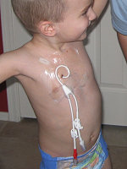
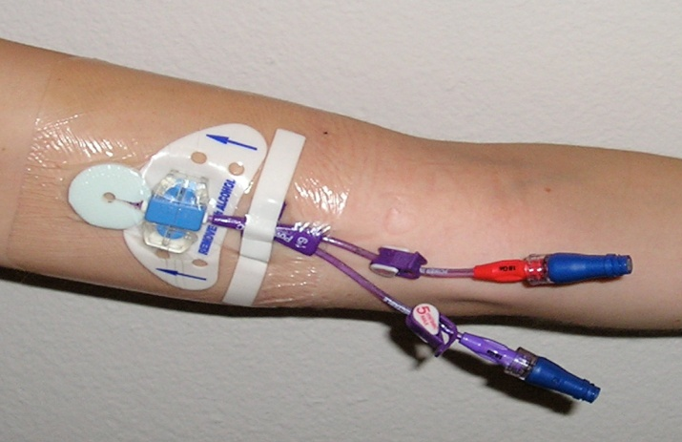
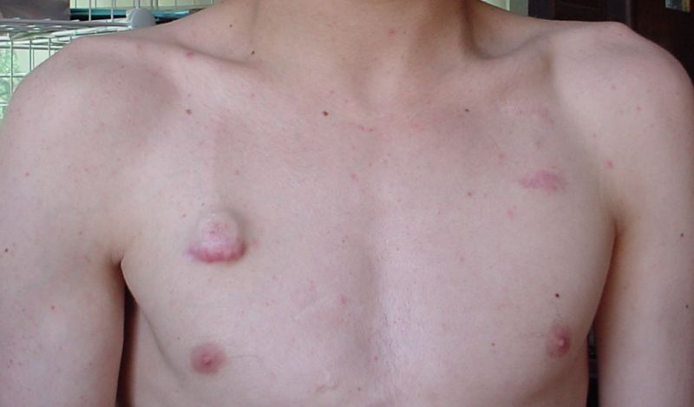
Broviac - PICC - Port

Slide 5
Why is a CVAD placed?
On West 11:
  Intravenous antibiotics
  TPN/IL
Other units:
  Long term IV access need
  Chemotherapy
  Blood products
  Frequent lab draws

Slide 6
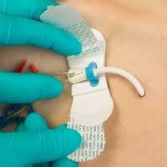
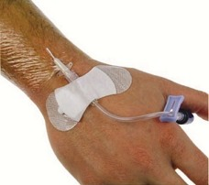
General Care for all CVADs’
Ensure line is secure
Use ‘grip-lok’
Assess dressing - occlusive and clean
Biopatch for children > 2 months

Slide 7
General Care
  Dressing change Q 7 days if transparent; Q 2 days if gauze dressing and prn
  If dressing becomes non-occlusive or soiled - needs a dressing change done
  Tubing and cap change Q 3 days: tubing change for intralipids -> daily
  Daily Chlorhexidine bath
  Clothes and linen change daily

Slide 8
General Care
  Whenever flushing/capping line need to use 10 cc syringe
  Flush with normal saline followed by heparin/vanco solution (MD order) if ‘capping’ line
  Normal Saline: 2 ml
  Vanco/hep: 3 ml
  Usual capping solution for Broviac/PICC: Vancomycin 25 mcg/ml and heparin 9.9U/ml

Slide 9
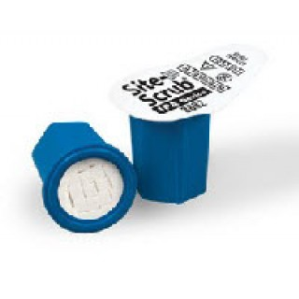
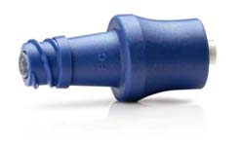
  General Care: Site scrub and Clave caps
  Cleaning/Scrubbing cap/connection
    Site Scrub: scrub for 10 sec., air dry 5 sec.
  ‘Positive pressure/Pulsing’ motion when flushing (clear the CVAD/CVL of blood or meds that may adhere to internal surface; positive pressure flushing while clamping the CVAD/CVL)
  ‘Clave’ caps on all catheter hubs

Slide 10
General Care: Dual Cap
  DualCap Dark Blue: protects the male luer lock (the exposed end of the IV tubing
  DualCap Light Blue: protects access ports on central line tubing (Nano-clave T-connector, blue clave, injection ports)
  If a patient has a CVAD and a PIV – the PIV line must also have DualCaps

Slide 11
General Care: Dressing change
Children over 2 months of age
  Chlorhexidine ( 2% chlorhexidine and 70% alcohol)
  Biopatch
Children under 2 months of age
  Betadine swabs
  Wipe off betadine using sterile saline
  Chlorhexidine: increased risk of skin irritation and drug absorption

Slide 12
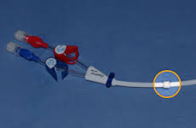
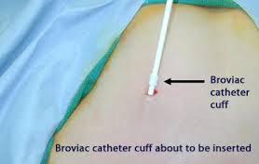
Tunneled (Broviac)
‘tunneled’ through subcutaneous tissue under skin into vein
Dacron cuff – stability and antibiotic
Single to multiple lumens

Slide 13
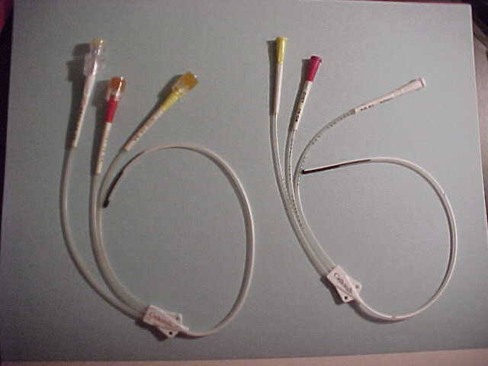
Tunneled (Broviac)
Placement is surgical procedure with general anesthesia
Sutures in place for 6-8 weeks
Placement verified by chest X-ray
Removed by surgeon or radiologist

Slide 14
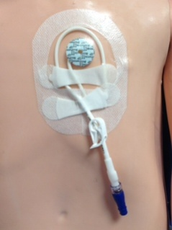
Specific Care for Broviac
Loop catheter under sterile dressing
Remember the ‘tension relieving’ loop under the dressing incorporating all the tubing to the thick ‘clamp here’ portion
Ensure lines are secure
and not pulling

Slide 15
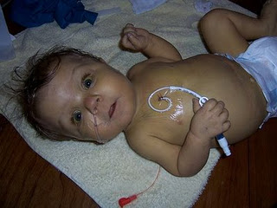
Broviac catheter
What’s the worry here??

Slide 16
Non tunneled (PICC)
Goes through skin and directly into the vein at insertion site
Used for short term use
Placement typically in Interventional Radiology but can be done at the bedside
Placement verified by chest X-ray

Slide 17
PICC
No cuff
Several weeks – months
Usually placed subclavian or femoral
Single or double lumen
Kids < 2 years old, sutured in place
Kids > 2 years old, ‘stat-lock’
RN may remove with MD order

Slide 18
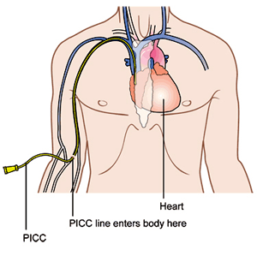


PICC line

Slide 19
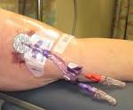
Specific Care for PICC lines
Measure arm circumference 2 inches above insertion site Q shift and document
Ensure dressing is secure and lines are not pulling
If Ace wrap covering – must remove wrap to fully assess site
What’s the worry here? →

Slide 20
Tunneled: Ports
Entire device is implanted under the skin
Surgically implanted and removed
Several months to years
Huber needle for access
When not access (in use) flushed with 100 U of heparin every 4-6 weeks for maintenance

Slide 21
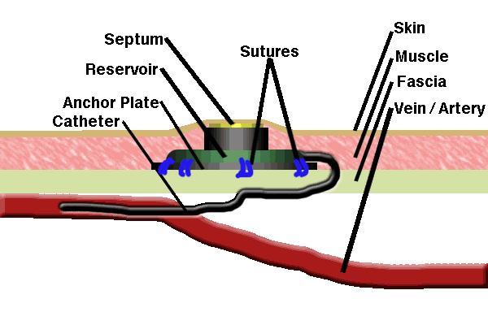
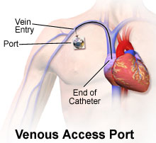
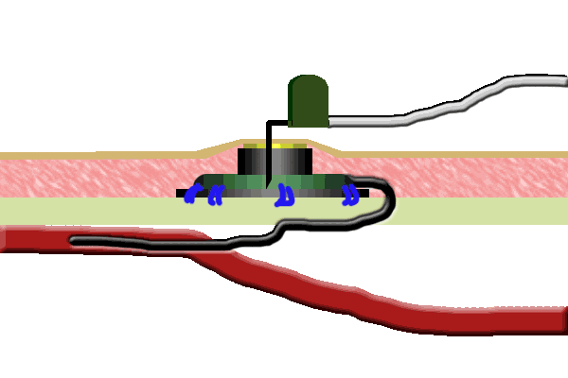
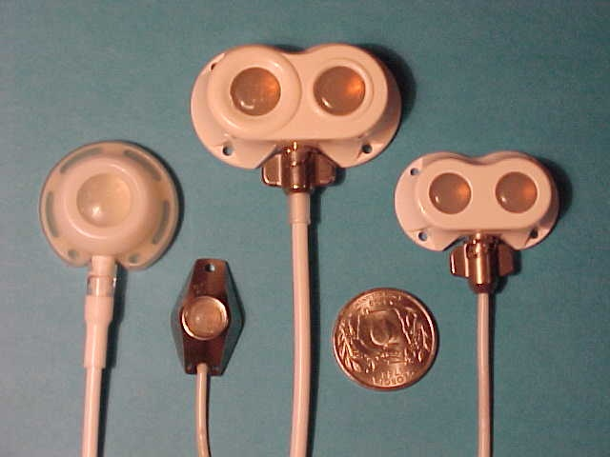
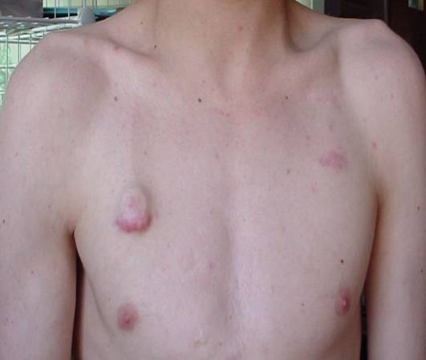
‘Ports’

Slide 22
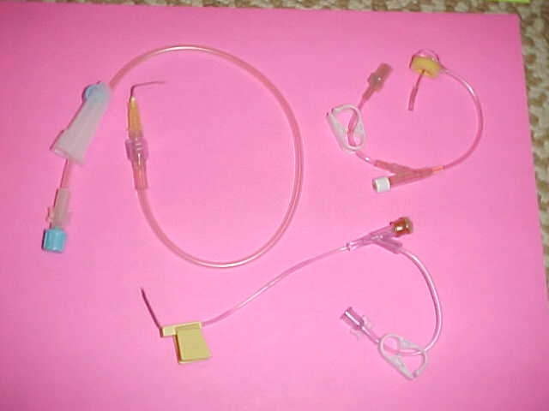
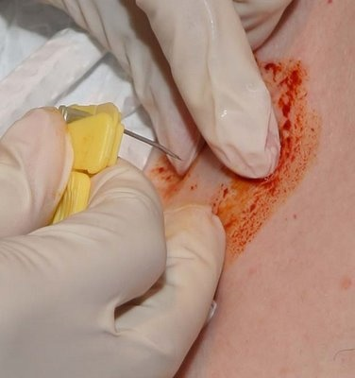
Huber needle
To Access
  Must use Huber Needle
  Need to know length and diameter
    IE: 1 inch 20 gauge
Per policy, students cannot access port

Slide 23
Specific Care for Ports
  Huber needle change Q week with dressing change
  When ‘deaccessing’ use heparin -> flush with 10ml normal saline and then lock/cap with 3 ml of 100 unit/ml Heparin.

Slide 24
What to think about with all CVADs’
Infection prevention
General guidelines
Patency and securement
Safety measures
Comfort care
Single or Multi lumen catheters

Slide 25
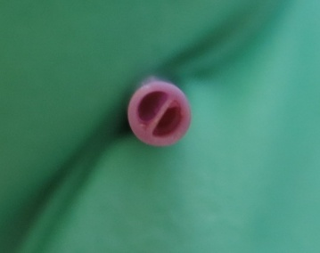
Multi Lumen Catheters
Two separate lumens
all the way to the tip
Treat each lumen as a separate line
  Flush both lumens
  Draw blood cultures from both lumens
Can run incompatible meds through each lumen

Slide 26
Complications - insertion
Malposition
Pneumothorax: air in pleural space (between lung & chest wall)
Hydro/hemothorax: fluid/blood in the pleural cavity
Arterial puncture

Slide 27
Complications – general
Line become occluded
  Flushing with ‘pulse’ technique
  Flush before and after medication (5-10 ml)
  Check drug compatibility
  Use of t-PA
Line breaks
  Clamp with padded clamp between the break and the patient
  Follow P&P

Slide 28
Removal
Broviac and Port: Surgical procedure
PICC: RN can remove w/ MD order
Sterile procedure
P&P
Measure catheter once removed
Check tip for line patency
Document removal

Slide 29
Complications - removal
  Contact MD immediately if:
Line is stuck (resistance)
  Do not force removal; ? vasospasm
Differences in catheter measurement or tip is not patent

Slide 30
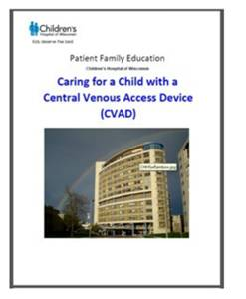
Resources
Policy and Procedure: Central Venous Access Device and Central Venous line Care
Patient/Family Education: Caring for a child with a Central Venous Access Device (CVAD)
Central Access Team (CAT)

