Slide 1
My patient has a
feeding tube…
What does that mean?
Martha Kliebenstein, MSN, RN
Clinical Educator

Slide 2
Types of tubes
Gastrostomy (G-tube)
Gastrostomy jejunostomy (G-J tube)
Naso gastric (NG tube)
Naso jejunal (NJ tube)
Jejunostomy (J tube)

Slide 3
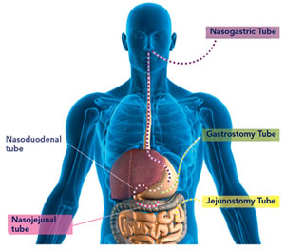
Where does it go?

Slide 4
Naso gastric tube
NG placement
Initial insertion
pH test
X-ray verification
measurement
Confirmed placement
Measurement Q shift
Prior to feeds/meds

Slide 5
How are they placed? Gastrostomy tube:
Surgical gastrostomy tube placement
Open incision
laparotomy
Percutaneous Endoscopic Gastrostomy Tube placement
(PEG)
Done via endoscopy
First tube change typically in 3 months

Slide 6
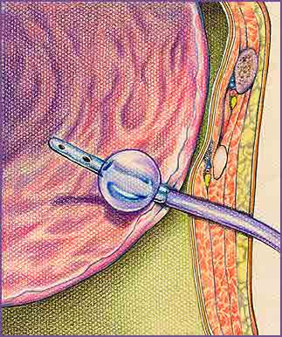
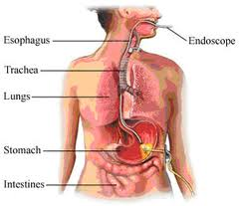
Gastrostomy placement

Slide 7
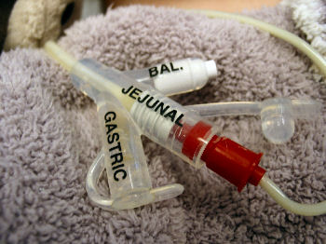
How are they placed? Gastrojejunal
Placed through the catheter of the gastrostomy tube

Slide 8
How are they placed? Gastro-Jejunostomy tube
Used when gastric feeds not tolerated
Placed in interventional radiology (after initial tube is placed)
Often placed through gastrostomy tube
Two options
Gastric outlet – vented, clamped, some meds
Jejunal outlet – feeds, meds
Clogs very easily
Flush, flush, flush

Slide 9
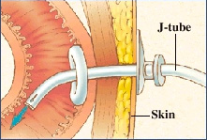
How are they placed? Jejunostomy tube
Placed directly into the jejunum
Surgical procedure
Placed when a child’s probability of tolerating gastrostomy feeds is unlikely

Slide 10
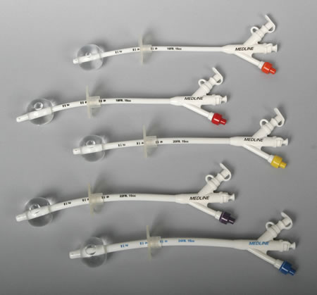
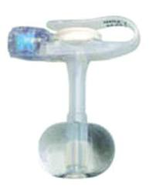
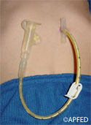
Long VS Button

Slide 11
Nursing cares to think about with all tubes
Policy and Procedures
Site care management
Enteral formula orders
Emergency management for dislodgement
Management for blocked/clogged tube
Management of complex site care
Family teaching needs

Slide 12
Nursing cares to think about with all tubes
What type of tube
Type of skin care
Bolster dressing or split gauze
Any creams being applied
Time frame for feeds

Slide 13
Nursing cares to think about with all tubes
Flushing
use bottled water; seltzer water if sluggish
What volume do you flush with?
2 -3 ml for gtube after meds/feeds
5 ml Q 4 hours j-port of g-j tube even if feeding is infusing
Do you flush before and/or after meds; between each med?
Use 5 ml syringe or greater when flushing – less negative pressure on tube

Slide 14
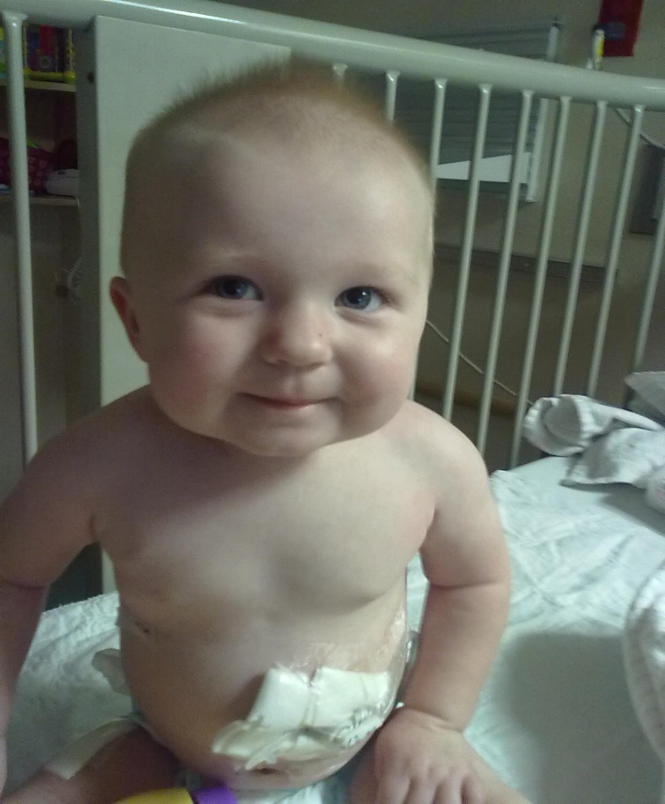
open to air OR split gauze?

Slide 15
Giving meds though a enteral tube
Meds via Gtube or J tube
Meds in liquid form preferably
Capsules/pills – must be crushed well
FLUSHING
before and after meds are given

Slide 16
Gastrojejunostomy OR Jejunostomy tube
Many children will have BOTH gastrostomy tube for venting and some meds AND jejunostomy tube for feeds and some meds
ORDERS TO CLARIFY
Which port is for meds? For feeds?
Is the g-tube clamped or to gravity?
Do we ‘replace’ GTube output?
Make sure MD order is correct with route – may need to call MD to reflect accurate route
Jejunostomy tube feeds must be given as a continuous infusion NOT bolus feed

Slide 17
Giving meds though a enteral tube
Meds via Gtube or J tube
Meds in liquid form preferably
Capsules/pills – must be crushed well
FLUSHING
before and after meds are given

Slide 18
How to care for the site
Clean with soap and water Daily and prn
Assess site for redness, drainage, bleeding, granulation tissue
Diaper creams can be used; If fungal –> Nystatin cream -- Need MD orders
Stomahesive powder can be sprinkled at site
May use ProNet to secure tube

Slide 19
Stabilization of the tube
Holds the balloon/mushroom against the stomach wall
Prevent stomach contents from leaking
Prevent tube from sliding to far into the stomach or into small intestine
Prevent skin erosion around insertion site
Remove extension set from button tube

Slide 20
Feeding techniques
Bolus
Specific amount over shorter time period
Usually 20-60 minutes
Can give via gravity (syringe or feeding bag) or enteral feeding pump
If given too fast can cause stomach discomfort
Bolus feeds NEVER given into jejunostomy tube

Slide 21
Feeding techniques
Drip/continuous feeds
At a continuous rate over a period of time
Do not need to be given over 24 hours
usually over 18 – 24 hours
Necessary when patient has jejunal feeds
Must flush Q 4 hours and when feeds disconnected as well as before/after medications
Breast milk/specially prepared formula can ‘hang’ no greater than 4 hours
Commercial formula can ‘hang’ no greater than 8 hours

Slide 22
Venting? Gravity?
Venting:
Allows stomach to be vented or ‘burped’
Can be done before, during or after feeds
If stomach contents come up, typically allow contents to return into stomach
Gravity:
Allow stomach to drain
Similar to ‘decompression’ of stomach
May require fluid replacement of contents that are secreted

Slide 23
Residual?
Routinely not done
Done only in specified situations
Need MD order
Often done if abdominal distention, feeding intolerance
Must make clinical assessment

Slide 24
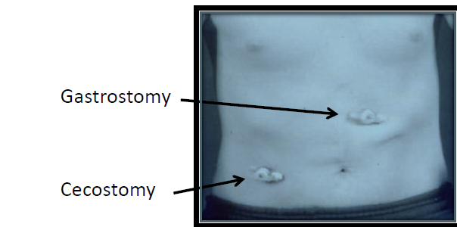
Cecostomy tube
CHRONIC CONSTIPATION
Antegrade
VERSUS
Retrograde
Less invasive
Independent management easier for children

Slide 25
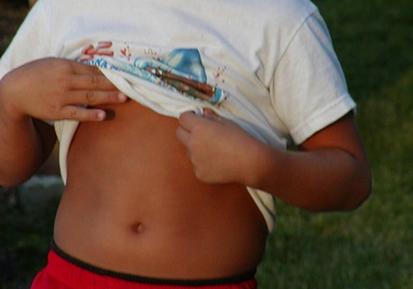
Where should they be?
Gastrostomy tube?
Gastrojejunal tube?
Jejunostomy tube?
Cecostomy tube?
Always verify placement with family and check the LDA

Slide 26
Trouble shooting
Granulation tissue
Pink, moist tissue
May have yellow, green and bloody drainage
Keep site clean and dry
Triamcinolone 0.5% or silver nitrate treatment
Leaking at site
Gently pull back on tube to ensure snug against stomach wall
May need to change button if size incorrect
May need stabilization tube
Check balloon for appropriate water volume
Remember: primary tube issues must contact GT RN or MD

Slide 27
Trouble shooting
Yeast
Tiny, red bumps
Tends to look ‘moist’
May use nystatin cream or powder (MD order)
Site red, irritated
Dampness, gastric leakage
Dry dressing when moist – need to keep site dry
Barrier shield wipes may be used
Stomahesive powder
Kaltostat
Moisture barriers (desitin, triple paste, etc)

Slide 28
Trouble shooting
Tube clogged
Refer to P&P
key points are:
Check for kinks; Flush with water, may need carbonated water
IF GJ tube – need to go to IR for re-insertion
Tube out
Not an emergency
Place gauze over site and contact MD/GT nurse on call
Have about 1 hour before stoma will start to close
If primary tube – do not replace; notify surgery
If established tract – trained RN or GT nurse on call can replace

Slide 29
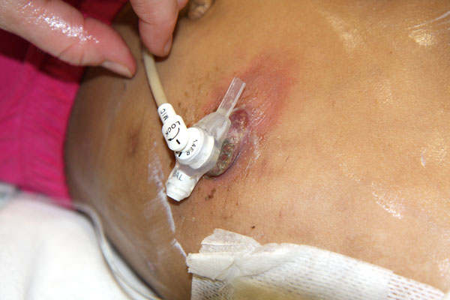
What’s the problem? What’s your nursing intervention?
Tube flange laying along skin causing irritation
Small granuloma at top of site; scar tissue on side
Tube is to short causing tube imbedding into skin – needs to be re-measured
May need ointment following new tube

Slide 30
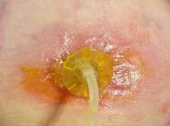
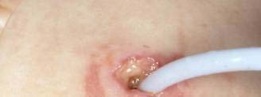
What’s the problem? What’s your nursing intervention?
Fungal infection, need for nystatin cream and/or powder; clean with warm soap and water, 2x2 gauze
Tube opening enlarged, possibly due to tube movement; need to stabilize and use kaltostat cream to allow closure hopefully

Slide 31
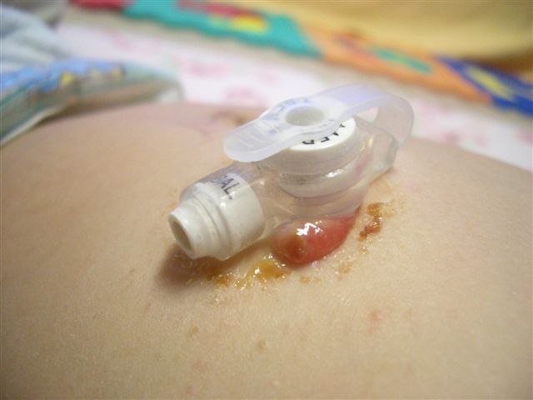
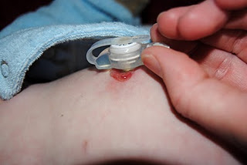
What’s the problem? What’s your nursing intervention?
Tissue prolapse possibly – often bleeds easily; keep clean and use barrier cream (A&D, desitin)
Tube has not been rotated sufficiently or tube to short causing skin breakdown and also small blister; consider mepilex dressing

Slide 32
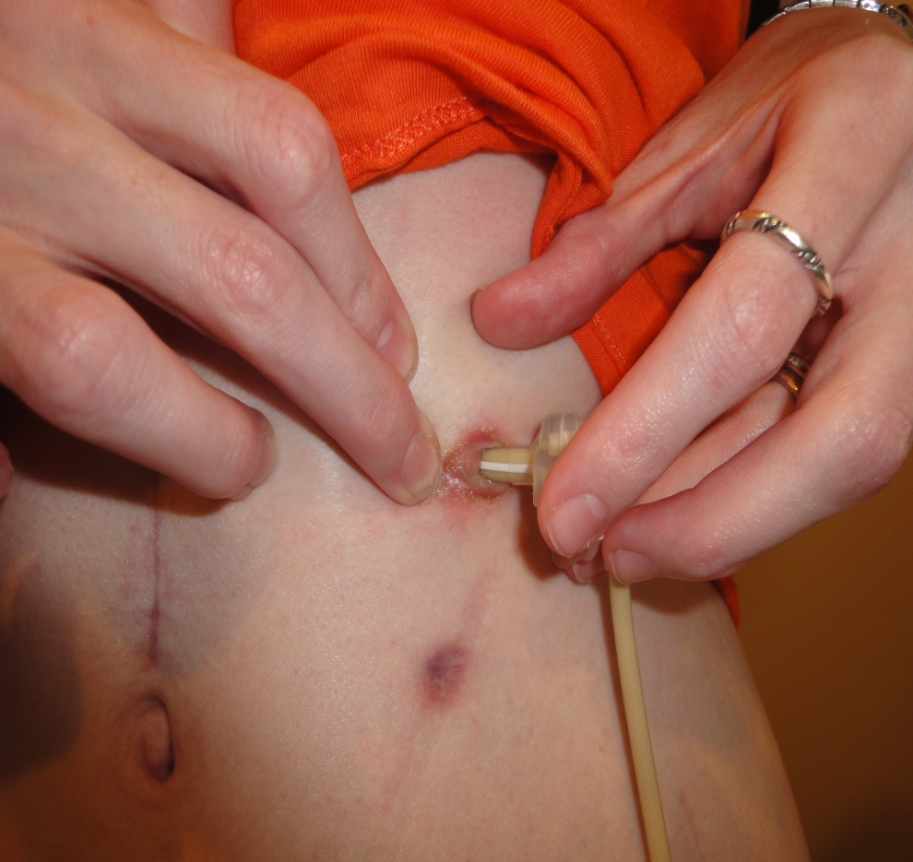
What’s the problem? What’s your nursing intervention?
Tube is to long – can cause leaking and/or skin issues; tube needs to be re-measured; check water balloon -

Slide 33
Where do I find info?
Policy and Procedures
Enteral Feeding
G/J tube site care and maintenance
Patient and Family Education: Caring
for a child with a g-tube
On line Resource
Gtube resource page on Children’s Connect
www.chw.org/gtube (videos and content)

