Slide 1
Pediatric Physical Assessment
Family Centered Nursing Care in Children

Slide 2
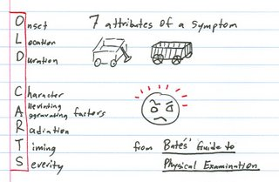
Performing a Health History
Identifying information—name, etc.
Chief complaint: In child or parent’s own words. For eg. “partial collapsed lung”, “headaches”, “constipation”, “sore throat”
Present illness

Slide 3
Assessment
Current medications
Immunizations
Pain history
Psychosocial history
Family medical history
Sexual history
Review of systems

Slide 4
General Approached to Pediatric Physical Exam
Head-to-toe sequence for assessing adult clients
Sequence for pediatric assessments generally altered to accommodate child’s developmental needs

Slide 5
Infant and Toddler Vital Sign Measurement
Count respirations FIRST (before disturbing the child)
Count apical heart rate SECOND
Measure blood pressure (if applicable) THIRD
Measure temperature LAST

Slide 6
Developmental Milestones
Holding up head steadily
Sitting alone without support
Walking without assistance
Meaningful speech
Present grade in school
Scholastic performance
Friends/interactions with others

Slide 7
Other History
Sleep history
Sexual activity
Substance use/abuse
Family structure
Other psychosocial factors

Slide 8
Nutritional Assessment
Nutritional intake—healthy plate
Clinical exam of nutritional status
Anthropometry
Skinfold thickness
Weight and height
Biochemical analysis
Notes:
—labs—cholesterol, urinalysis-for eg. ketones?

Slide 9
Physical Examination
Growth measurements
Recumbent length for infants up to age 36 months + weight and head circumference
Standing height + weight after age 37 months
Plot on growth chart
By gender and prematurity if appropriate
Less than 5th or greater than 95th percentile considered outside expected parameters for height, weight, head circumference

Slide 10
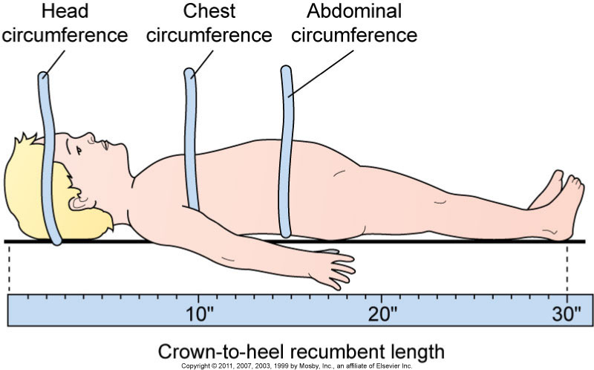
Measuring

Slide 11
Growth
Ethnic differences
Expected growth rates at various ages
Use of skinfold thickness and arm circumference for evaluation of body composition of muscle and adipose tissue
Significance of head circumference measurements

Slide 12
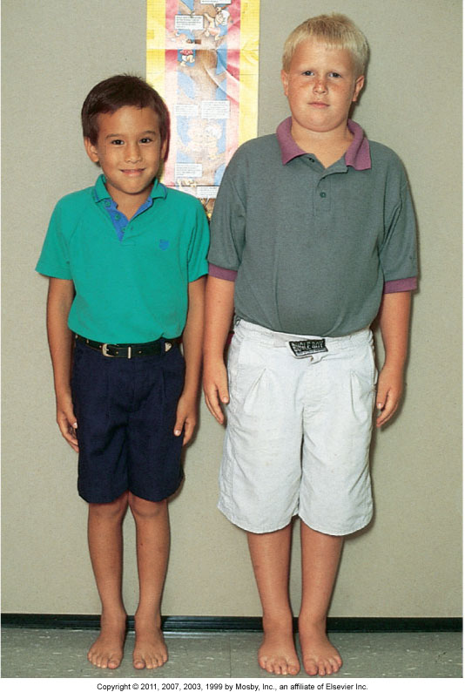
Size Variations

Slide 13
Physiologic Measurements
Importance of physiologic measurements in overall pediatric assessment
Comparison with normal values for each age group

Slide 14
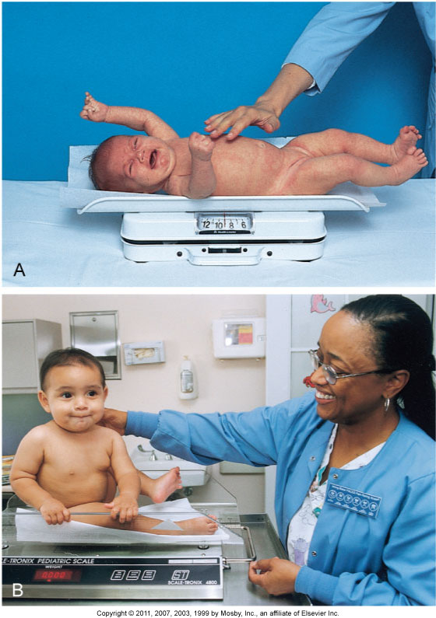
Weighing

Slide 15
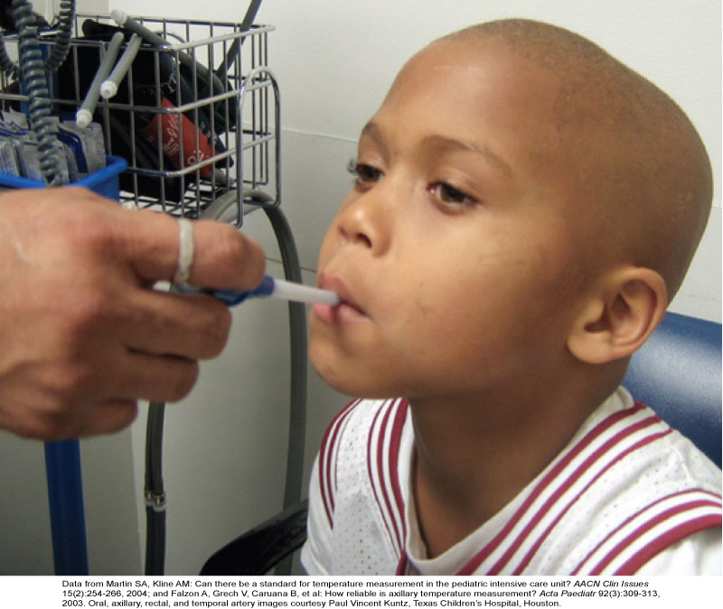
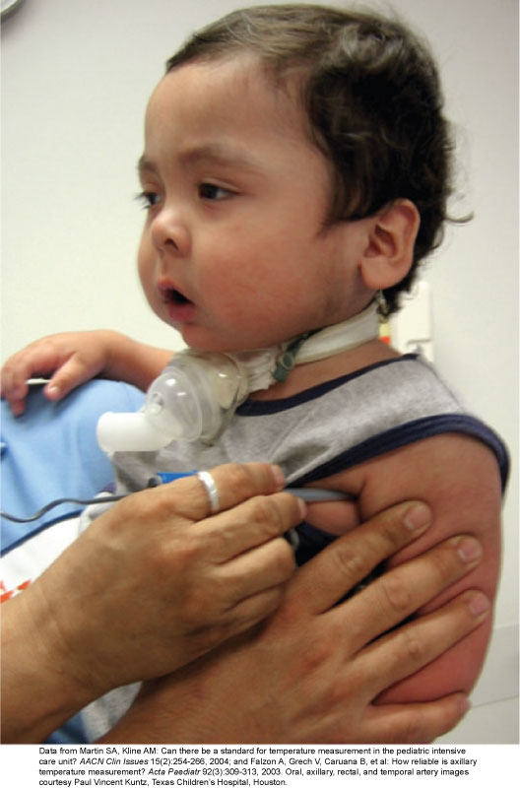
Temperature Measurement

Slide 16
Pediatric Blood Pressures
Measurement devices
Cuff selection
Cuff placement
Interpretation of BP measurement

Slide 17
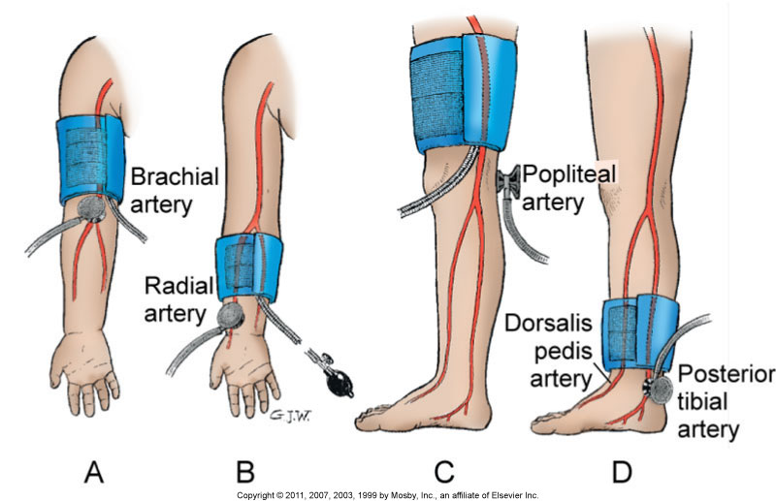
Blood Pressure

Slide 18
Physical Assessment
General appearance
Skin
Hair, nails, hygiene
Lymph nodes
Head and neck
EENT

Slide 19
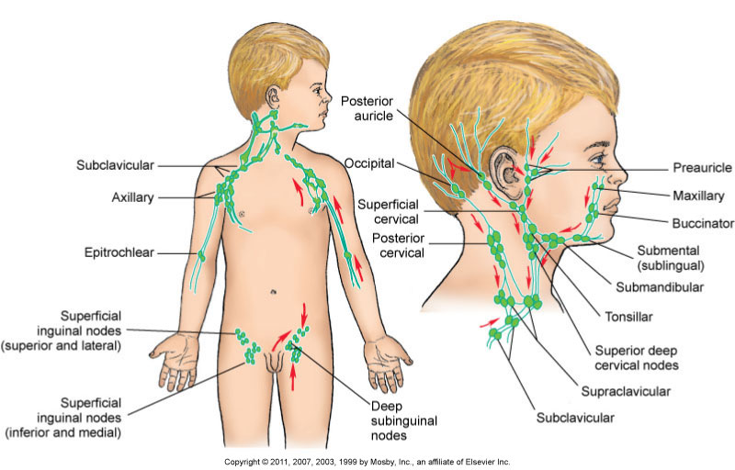
Lymph Nodes

Slide 20
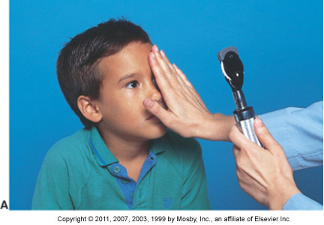
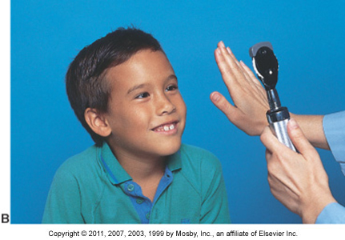
Strabismus

Slide 21
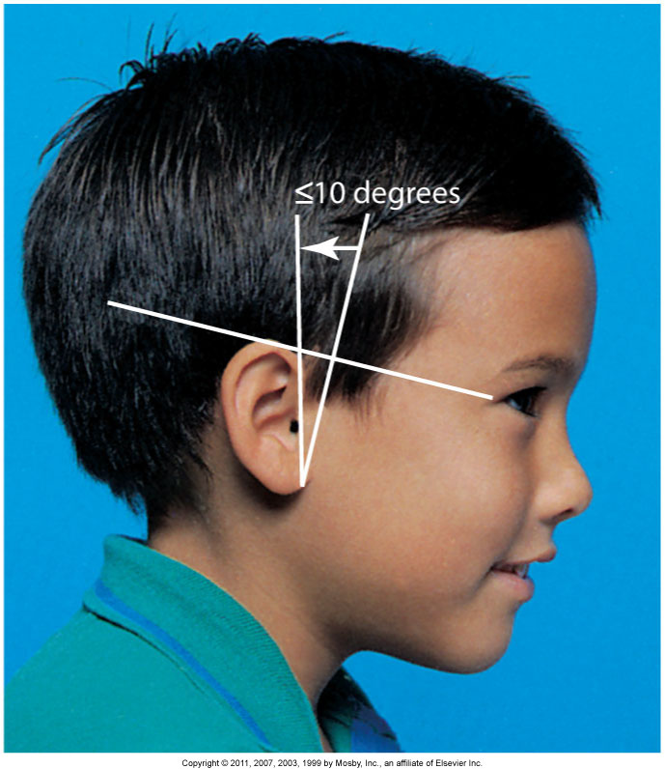
Ear Alignment

Slide 22
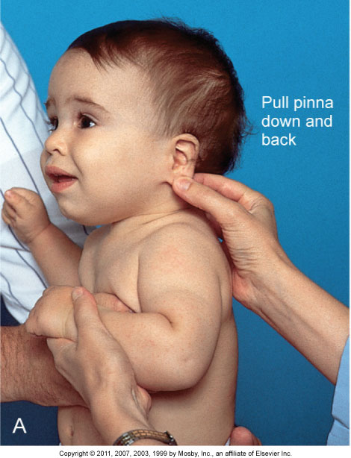
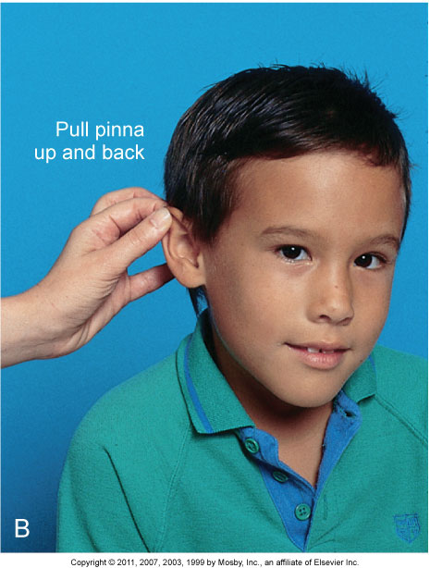
Positioning to Examine Eardrum

Slide 23
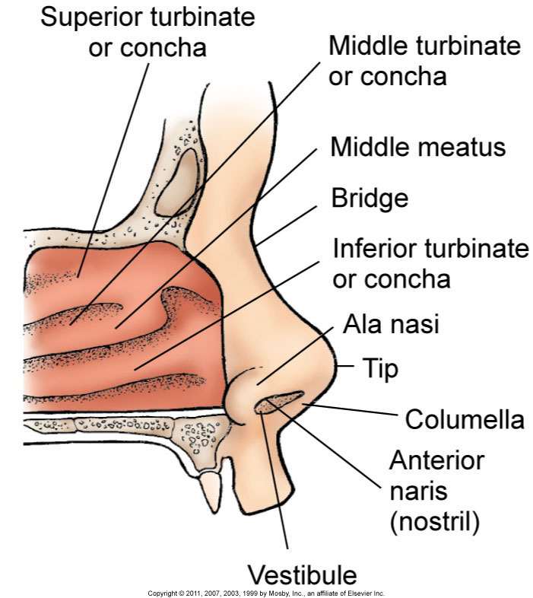
Nose

Slide 24
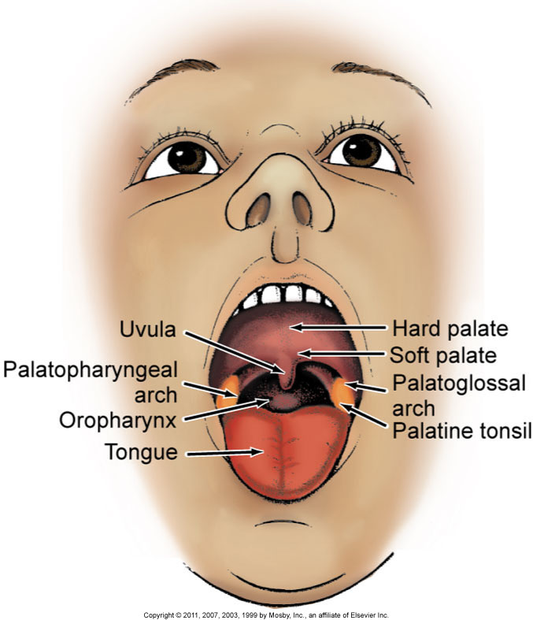
Mouth

Slide 25
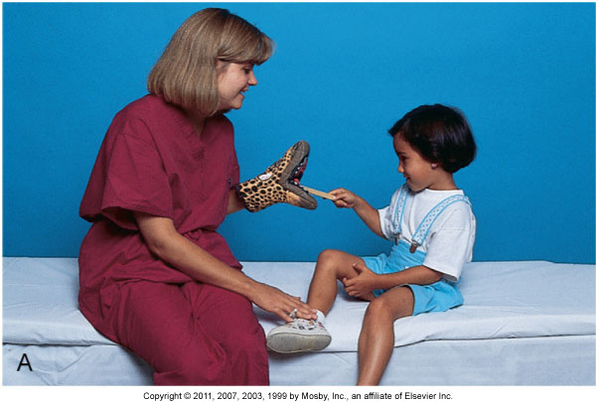
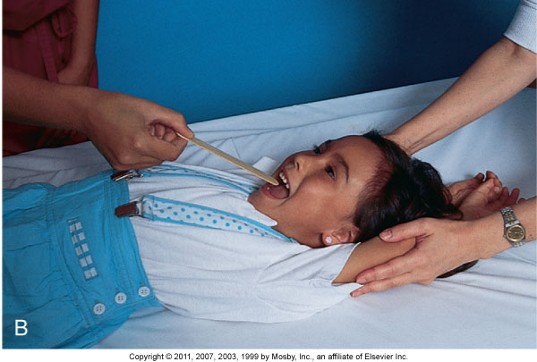
Mouth Exam

Slide 26
Physical Assessment
Chest
Heart
Lungs
Abdomen
Genitalia
Back and extremities
Neurologic assessment

Slide 27
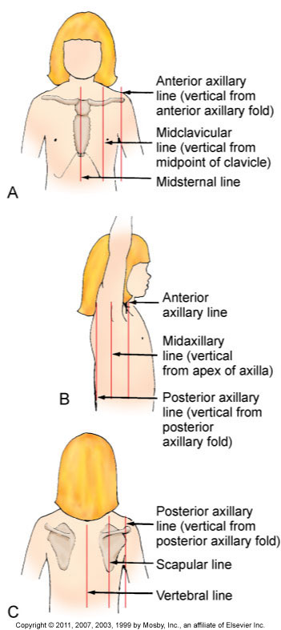
Chest Landmarks

Slide 28
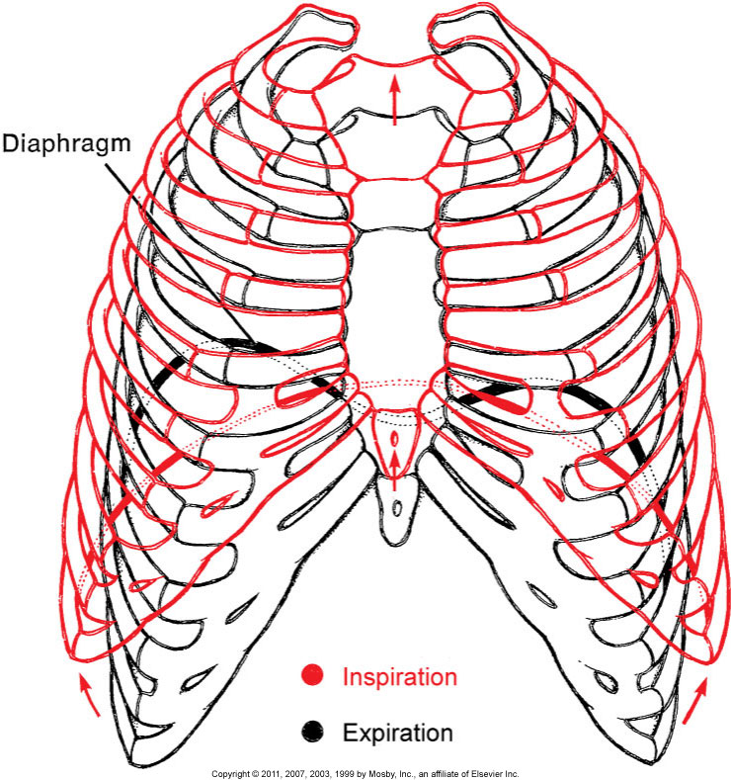
Chest Movement with Respiration

Slide 29
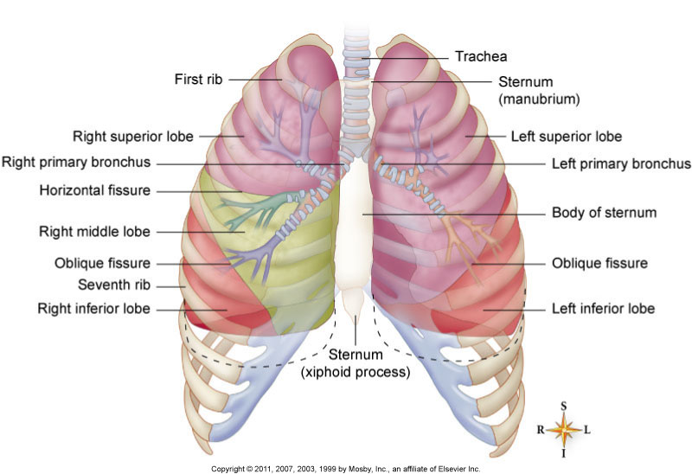
Lobes of Lung

Slide 30
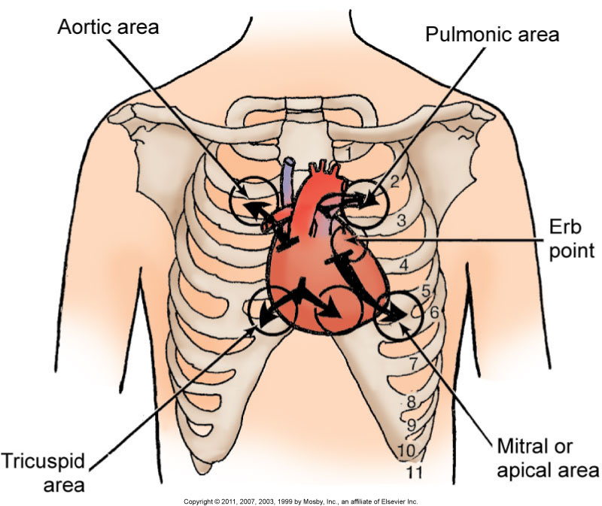
Heart Auscultation

Slide 31
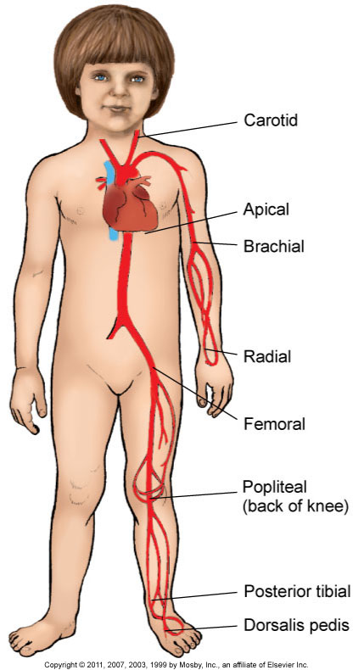
Pulse Locations

Slide 32
Abdomen
Inspection
Auscultation
Palpation
Percussion

Slide 33
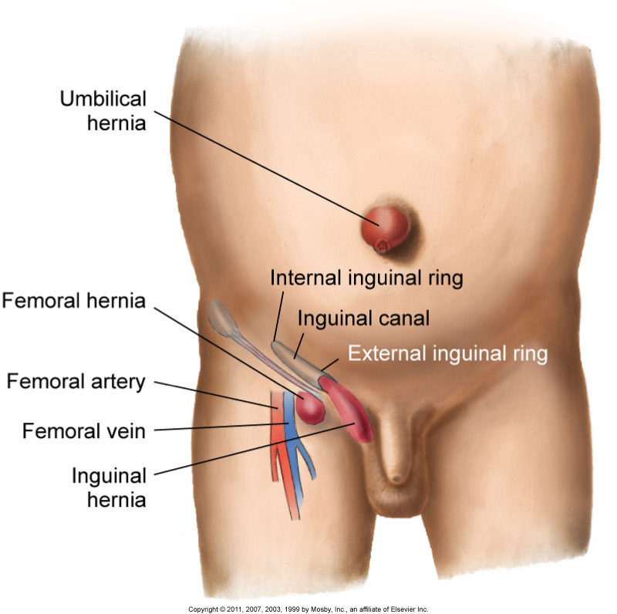
Hernias

Slide 34
Palpating Femoral Pulses

Slide 35
Palpating Scrotum

Slide 36
Extremities
Inspection
Function
Gait

Slide 37
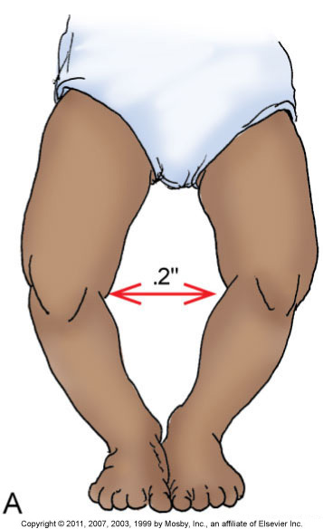
“Bowleg”: Genu Varum

Slide 38
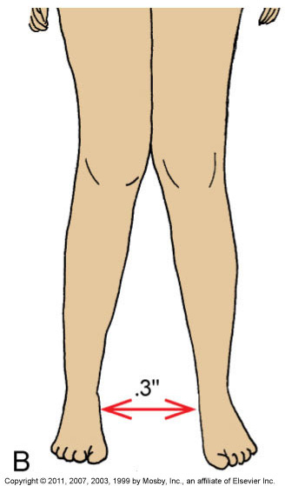
“Knock-Knee”: Genu Valgum

Slide 39
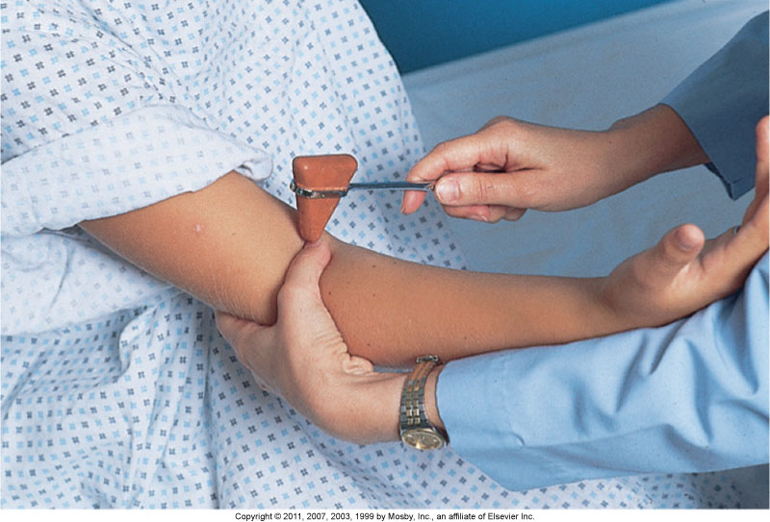
Biceps Reflex
Notes:
Can you please combine the next 4 slides so they can scroll on where to check reflexes

Slide 40
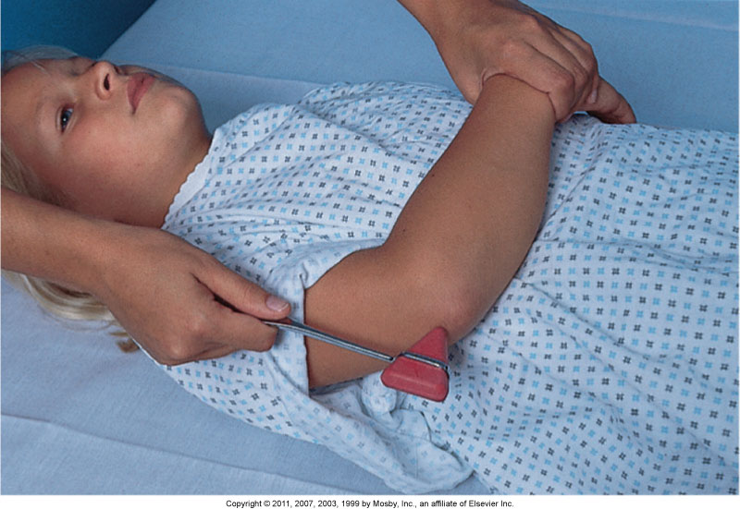
Triceps Reflex

Slide 41
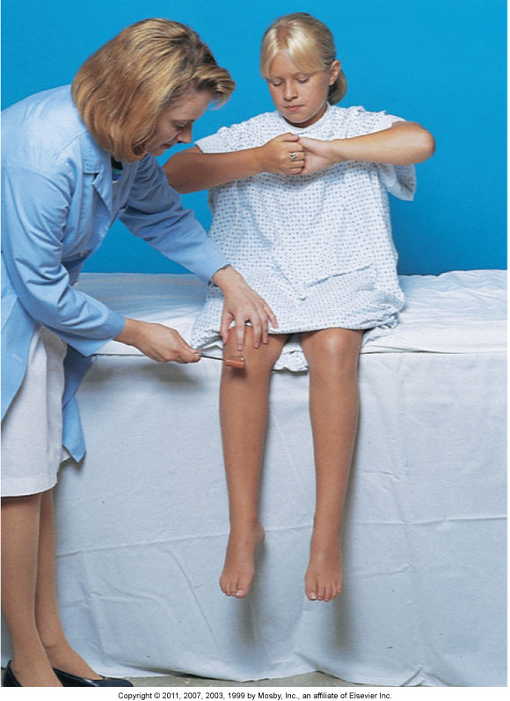
Patellar Reflex

Slide 42
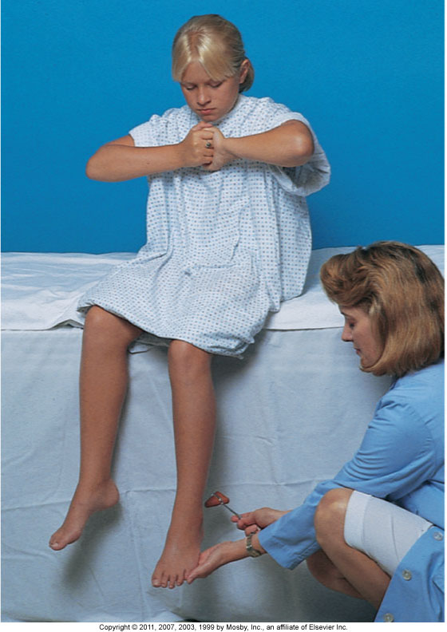
Achilles Reflex

Slide 43
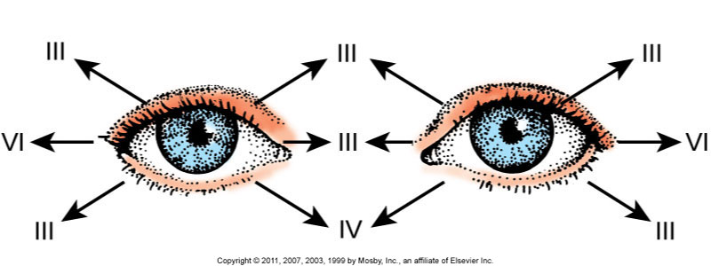
Gaze Position

Slide 44
Neurologic Assessment
Motor
Sensory
Cerebellar function and cranial nerves
Behavior

Slide 45
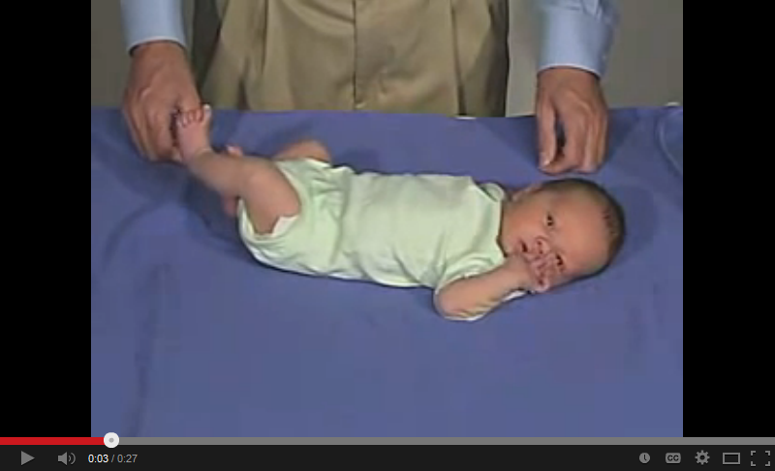
Infant Physical Assessment
Physical Exam- Newborn Normal: Tone-Upper Extremity Tone
Video Link
in Your Module

Slide 46
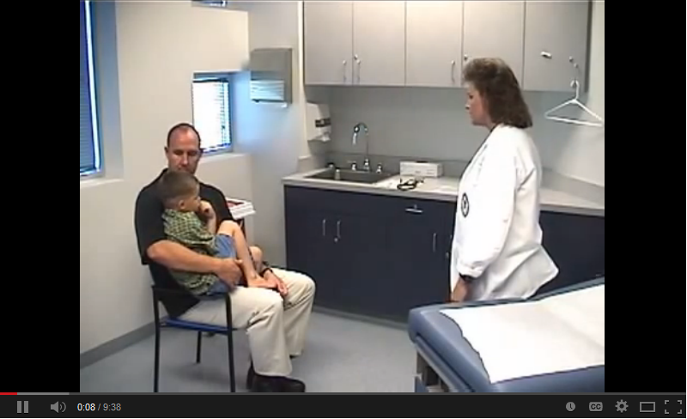
Pre-School Physical Exam
Pediatrics- Toddler
Video Link
in Your Module

Slide 47
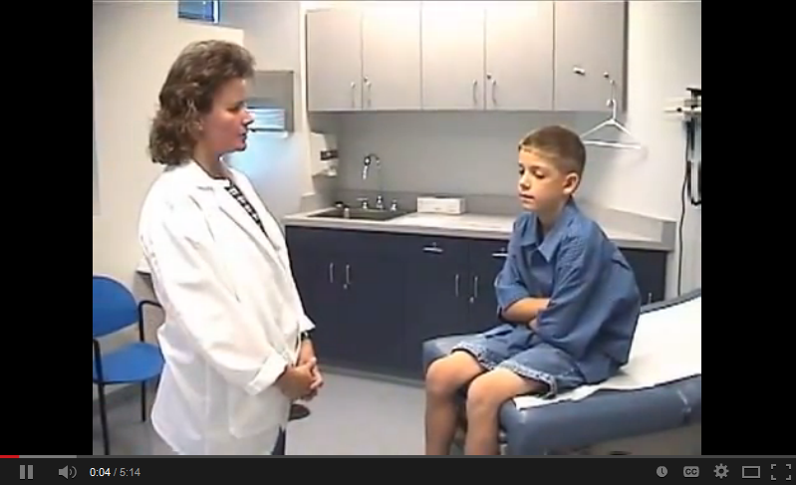
School Age Child Physical Exam
Pediatrics- School Age
Video Link
in Your Module

